Slide 1
Presbytery Events

Slide 2
USING THE CHAT FACILITY | TO ASK QUESTIONS
Chat with meeting participants
During the meeting, if you want to ask questions, click on the Show Conversation in your meeting controls.
Here, you can type a new message, question or respond to other messages like you normally would in a chat.
Pop your questions into the chat facility and click on the right-hand arrow below to send.

Slide 3
Session 1:
Approaching the journey
out of lockdown

Slide 4
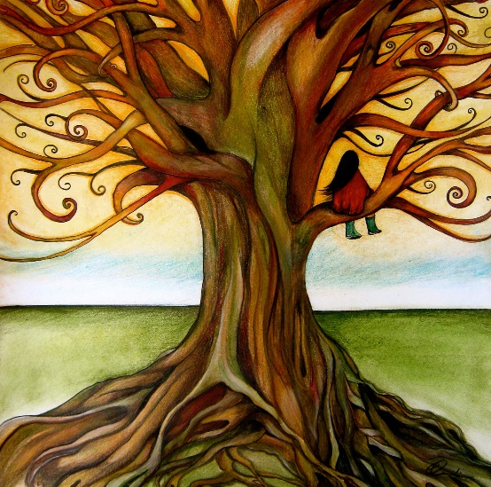
“Hope deferred makes the heart sick, but a dream fulfilled is a tree of life.”
Proverbs 13:12
Notes:
If full screen does not work, please use black background

Slide 5
APPROACHING THE JOURNEY OUT OF LOCKDOWN
Not
unravelling
Unfolding

Slide 6
APPROACHING THE JOURNEY OUT OF LOCKDOWN
Be ready to make the most of the gradual easing of restrictions to grasp the opportunities of what each new freedom allows you to do.

Slide 7
APPROACHING THE JOURNEY OUT OF LOCKDOWN
Treat the gradual easing of restrictions as your friend in setting a sensible pace for a return to what feels like a more natural rhythm of church life.

Slide 8
APPROACHING THE JOURNEY OUT OF LOCKDOWN
Focus on getting core things back first, beginning with the restoration of worship, followed by gatherings which promote reconnection with those groups with whom ties have been most weakened.

Slide 9
APPROACHING THE JOURNEY OUT OF LOCKDOWN
Give yourself permission to acknowledge that not everything you did before should recommence and that there may be new and different ways of reshaping core activities of church life.

Slide 10
APPROACHING THE JOURNEY OUT OF LOCKDOWN
Think about the possibilities of extending church activities and facilities to others beyond our own membership as a way of sharing God's grace.

Slide 11
APPROACHING THE JOURNEY OUT OF LOCKDOWN
Anticipate that progress may be haphazard, with unexpected gains to be gratefully celebrated, but also likely changes of pace, maybe even pauses, on the journey.

Slide 12
APPROACHING THE JOURNEY OUT OF LOCKDOWN

Slide 13
BREAKOUT ROOMS
What simple messages do your congregation particularly need to hear to approach the journey out of lockdown well?

Slide 14
Children’s and
youth ministry focus
Notes:
Title slides backgrounds can be set in solid colour
With Calibri Bold text – minimum 72pt

Slide 15
Leaders
Notes:
If full screen does not work, please use black background

Slide 16
LEADERS
Ask and listen
Assess capacity
Identify new leaders
Come together
Identify possibilities

Slide 17
Relationships
Notes:
If full screen does not work, please use black background

Slide 18
RELATIONSHIPS
Re-establish relationships
Create safe places
Have fun
Connect with parents

Slide 19
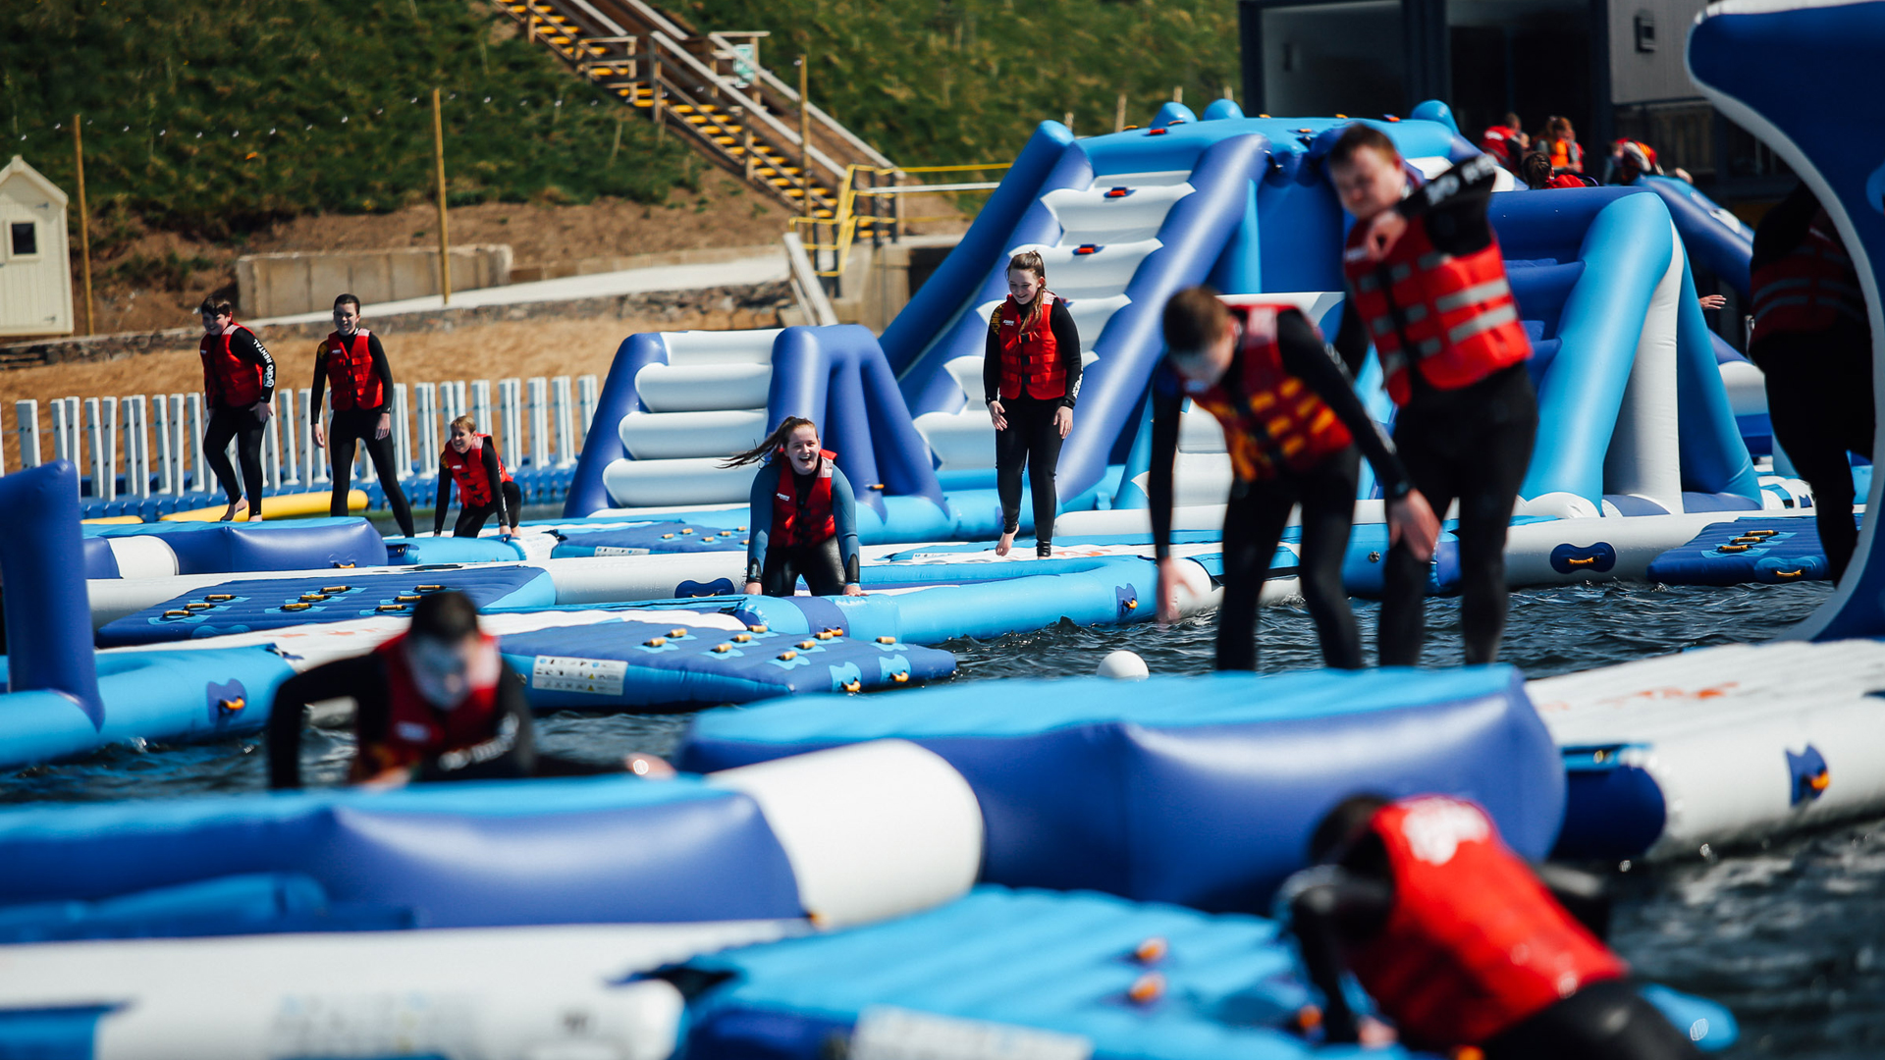
Building
Notes:
If full screen does not work, please use black background

Slide 20
BUILDING
Feel no pressure
Embrace difference
Expect drop-off
Identify clear priorities
Innovate

Slide 21
Session 2:
Anticipating the next stages
of the journey out of lockdown
Notes:
Title slides backgrounds can be set in solid colour
With Calibri Bold text – minimum 72pt

Slide 22
ANTICIPATING THE NEXT STAGES OF THE JOURNEY

Slide 23
ANTICIPATING THE NEXT STAGES OF THE JOURNEY
Plan and prepare now to get ready to make the most of the gradual easing of restrictions, rather than waiting until they do.

Slide 24
ANTICIPATING THE NEXT STAGES OF THE JOURNEY
1. How do we continue to re-establish our worship service and strengthen connection with members of all ages in our congregation?
2. What limited range of activities should we prioritise when restrictions on gathering begin to ease?
3. What lessons have we learned so far during the Covid-19 pandemic that can help us in this phase?

Slide 25
ANTICIPATING THE NEXT STAGES OF THE JOURNEY
Kirk session and others in formal leadership positions

Slide 26
ANTICIPATING THE NEXT STAGES OF THE JOURNEY
As restrictions ease further and we begin to gather a little more momentum in our church life, there will come a moment of greater opportunity to physically get together to renew our relationships.

Slide 27
ANTICIPATING THE NEXT STAGES OF THE JOURNEY
1. How can we bring different groups of people together within current guidelines with an emphasis on building community, rather than all the normal ministry content of gatherings?
2. How might we maximise the lighter nights and better weather to be together with a ‘holiday feel’?
3. How can we gather organisational leadership teams socially to quickly gauge who is coming back again and who might not be and, where necessary, to begin to recruit new and emerging leaders?

Slide 28
ANTICIPATING THE NEXT STAGES OF THE JOURNEY
Kirk session and leaders of organisations and activities and ‘pied pipers’

Slide 29
ANTICIPATING THE NEXT STAGES OF THE JOURNEY
Having worked on getting ready and getting the fabric of relationships in your congregation back together again, there will be a moment to restore more coordinated activity on a more regular basis.

Slide 30
ANTICIPATING THE NEXT STAGES OF THE JOURNEY
1. What activities, in addition to worship, will we recommence, when, and how often?
2. What will congregational and organisational programmes consist of given likely ongoing restrictions on social distancing and wearing of masks indoors? How might we harness digital gatherings, alongside in-person meetings, if we can?
3. How will we effectively publicise the recommencement of activities within our membership, among those who previously attended and the wider community?

Slide 31
ANTICIPATING THE NEXT STAGES OF THE JOURNEY
Leaders of organisations and activities brought together to understand the bigger picture

Slide 32
ANTICIPATING THE NEXT STAGES OF THE JOURNEY

Slide 33
BREAKOUT ROOMS
What simple things can you do to get ready and to get key groups together over the summer period?

Slide 34
WHAT’S COMING UP
Thursday 3 June
Together again for children’s ministry
Thursday 10 June
Together again for youth ministry
Thursday 17 June
Fanning the flame as kirk sessions
Wednesday 23 June
Growing our presence in the community

Slide 35
WHAT’S COMING UP
Latest release:
Wednesday 19 May
The Church Recovery Guide
Wednesday 9 June
Reconnecting in the summer season
Wednesday 23 June
In conversation with PCI global mission workers

Slide 36
STAYING CONNECTED
Keep up-to-date by following the PCI social media channels…
FACEBOOK
TWITTER
INSTAGRAM
/pciassembly
/PCIChildrensMinistry
/PCIYouthMinistry
/PCIYoungAdults
/PresbyterianWomen
@pciassembly
@pcimoderator
@pciassembly

Slide 37
CONTACT US
www.presbyterianireland.org
E. clw@presbyterianireland.org
T. +44(0) 28 9032 2284
Sign up to PCI E-quip to be kept up-to-date with future resources and events for your congregation.
www.presbyterianireland.org/e-quip

