Slide 1

Notes:
Through United Appeal the Presbyterian Church in Ireland is serving and reaching out to people with the love of Christ locally, nationally and internationally.
It is at the heart of our mission, helping to fund people, events and projects, channelling the money you so generously give to make mission happen.
It’s all part of being the people that Jesus calls us to be…

Slide 2
Notes:
As Jesus instructs us in the story of the sheep and the goats from Matthew 25 – ‘Truly, I say to you, as you did it to one of the least of these my brothers, you did it to me’.
Here are two stories of how your giving through United Appeal supports projects fulfills that mission of being the people that Jesus calls us to be.

Slide 3
Notes:
Gary and Mary Reid and their family have been working with the Maasai people in southwest Kenya since 2005. Partnering with the Presbyterian Church of East Africa (PCEA), they are involved in church planting and development work with the PCEA Acacia Grove Mission Station.
Acacia Grove helps vulnerable children who have suffered from abuse, female genital mutilation (FGM), child labour or neglect. It also assists women who have been abused, and provides refuge when this is required.

Slide 4
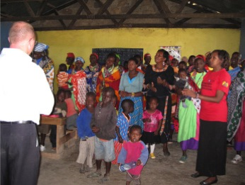
God continues to work through the Reids to build
His Kingdom among the Maasai in this area.
Notes:
The mission station has a holistic approach to offering care in the community. As well as helping with education and distributing Bibles, they deliver food, when it is needed, to malnourished children and poor families.
They also transport seriously ill or injured people to one of the local dispensaries, or larger hospitals – the closest being over 75kms away.
With the help of United Appeal, God continues to work through the Reids to build His Kingdom among the Maasai in this area.

Slide 5
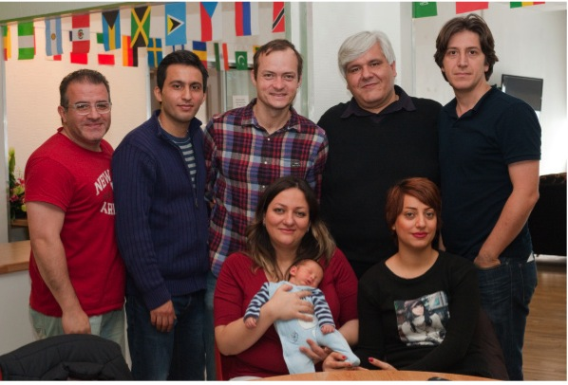
Notes:
The International Meeting Point (IMP), located on Belfast’s Lisburn Road, reaches out to migrants and asylum seekers in the city.
Funded by United Appeal and the South and East Belfast Presbyteries, the centre welcomes people from over 30 different countries and is dedicated to meeting their practical and spiritual needs.

Slide 6
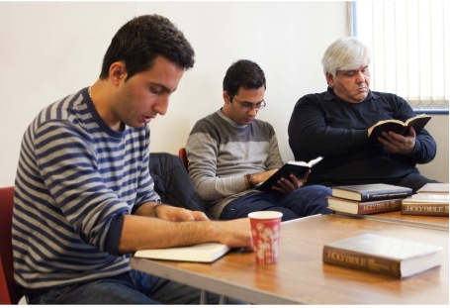
With the help of United Appeal, the Meeting Point is reaching
out to the ‘stranger’ in Belfast and sharing God’s love.
Notes:
The International meeting Point offers a wide variety of help and services to those who come through its doors: serving food and drinks in the café, offering legal advice, running English classes, taking people shopping, helping the unemployed find jobs and leading Bible studies.
With the help of United Appeal, the Meeting Point is reaching out to the ‘stranger’ in Belfast and sharing God’s love.

Slide 7
Through praying and giving.
Please play your part in the wider mission of our whole Church and give cheerfully and sacrificially – and please keep praying.
Notes:
Every aspect of our Church’s mission depends to some extent on United Appeal. Hundreds of projects and programmes at home and overseas are helping to advance God’s kingdom, showing God’s love in action to hundreds of thousands of people.
Thanks to the generous support that Presbyterians like you continue to offer, this work can flourish.
In 2014 United Appeal will contribute £3,250,000/ €3,941,632 to help fund the mission of our Church. Each congregation has a ‘target of honour’ to help raise this amount. Please play your part in the wider mission of our whole Church and give cheerfully and sacrificially as our generous God has called us to do.
Your prayer support is also vital.
Keep up to date with prayer needs through the Prayer Handbook and sign up for daily prayer points straight to your inbox at
www.presbyterianireland.org/prayer.

Slide 8
Together
getting things done

