Slide 1
GROWING IN FRUITFULNESS
John 15v.1-17

Slide 2
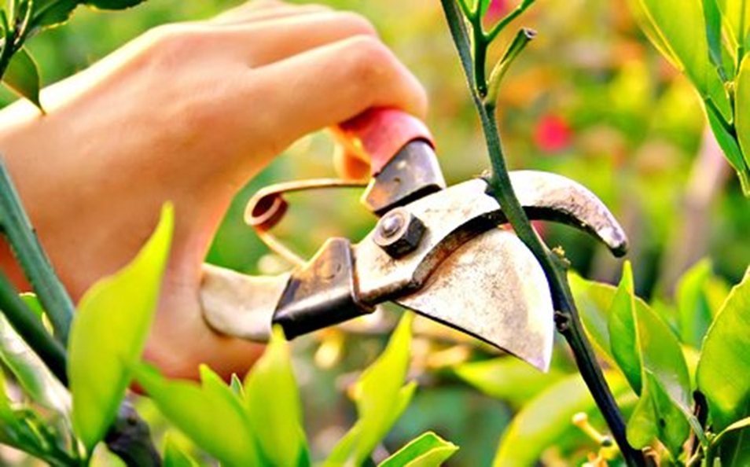
PRUNE v.1&2 Fruitful congregations are led to lean forward into the future

Slide 3
ALWAYS ROOTED v.1
Jesus the True Vine v.1
The Church draws it’s life from Him and reaches out through Him

Slide 4
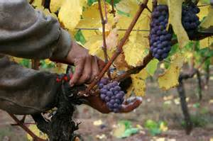
ALWAYS CHANGING v.1
The Father as Gardener v.1
Tending the life of His Church – watching, developing, nurturing, tweaking, bring on

Slide 5
ALWAYS LEANING FORWARD v.2
The Church as fruit bearing branch v.1
Led forward to the next harvest: Acknowledging the pain of pruning and uncertainty of the future v.2

