Slide 1
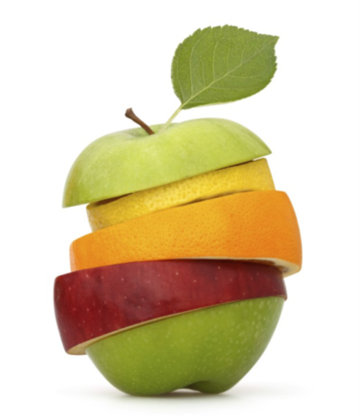
GROWING IN FRUITFULNESS
John 15v.1-17

Slide 2
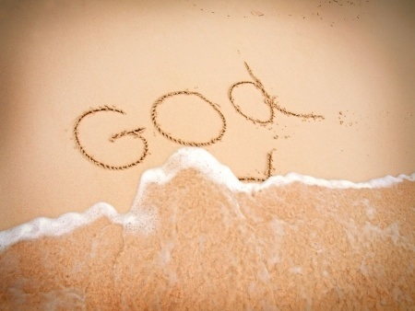
GO v.16&17 Fruitful congregations make an impression for God locally & globally through outreach & involvement in His wider activity in the world

Slide 3
OUTWARD MISSION v.16
You did not choose me, but I chose you and appointed you to go and bear fruit.

Slide 4
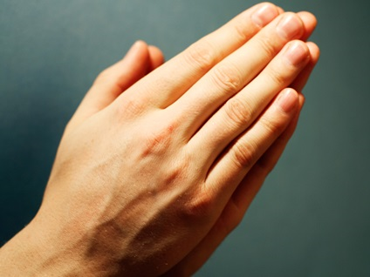
UPWARD PRAYER v.16
Then the Father will give you whatever you ask in my name.

Slide 5
INWARD HEART v.17
Loving ‘each other’ spilling over into loving ‘every other’

