Slide 1
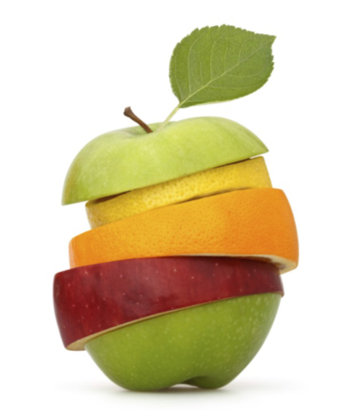
GROWING IN FRUITFULNESS
John 15v.1-17

Slide 2
LOVE v.12-14 Fruitful congregations develop their life as a community of God’s People

Slide 3
LOVE
Love each other as I have loved you v.12

Slide 4
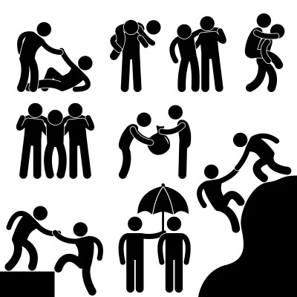
SERVICE
Laying down our lives v.13 – serve others rather than expect to be served ourselves

Slide 5
FRIENDSHIP
Coming out of ourselves and letting others come into our lives

Slide 6
DEVELOPING SPACE AND PLACE TO BUILD COMMUNITY IN CONGREGATIONAL LIFE
How do we develop our life as a community of God’s people?

