Slide 1
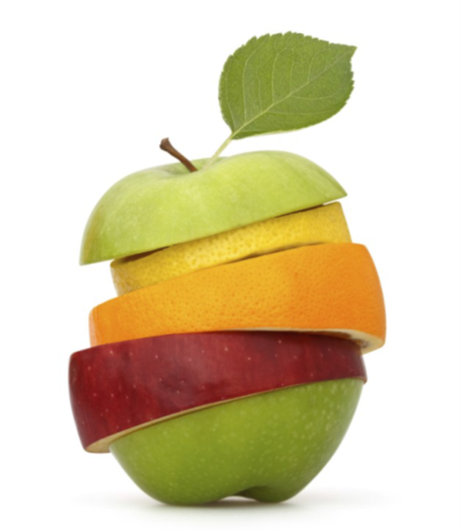
GROWING IN FRUITFULNESS
Together for Fruitfulness
I. Corinthians 3v.1-9

Slide 2
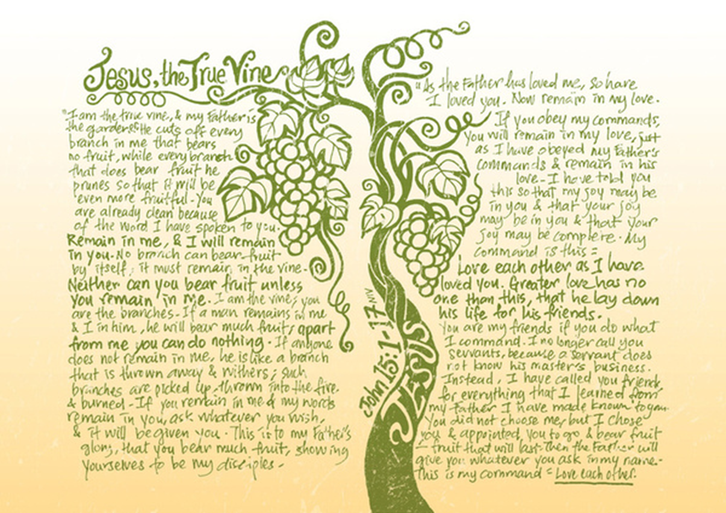
GROWING IN FRUITFULNESS

Slide 3
GROWING IN GOD’S WAYS FOR US: LESSONS FROM THE CONGREGATION OF CORINTH

Slide 4
GROWING TOGETHER IN CONGREGATIONAL LIFE & WITNESS
1. Growing as members of the congregation v.1-4

Slide 5
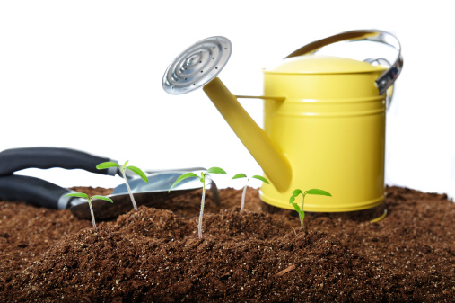
GROWING TOGETHER IN CONGREGATIONAL LIFE & WITNESS
2. Growing as a congregation in living out God’s purposes for our life & witness v.4-8

Slide 6
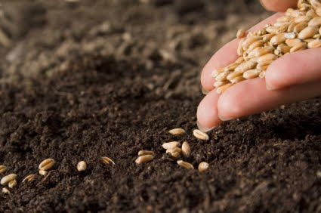
GROWING TOGETHER IN CONGREGATIONAL LIFE & WITNESS
3. Growing in our appreciation of what fruitfulness looks like v.9

Slide 7
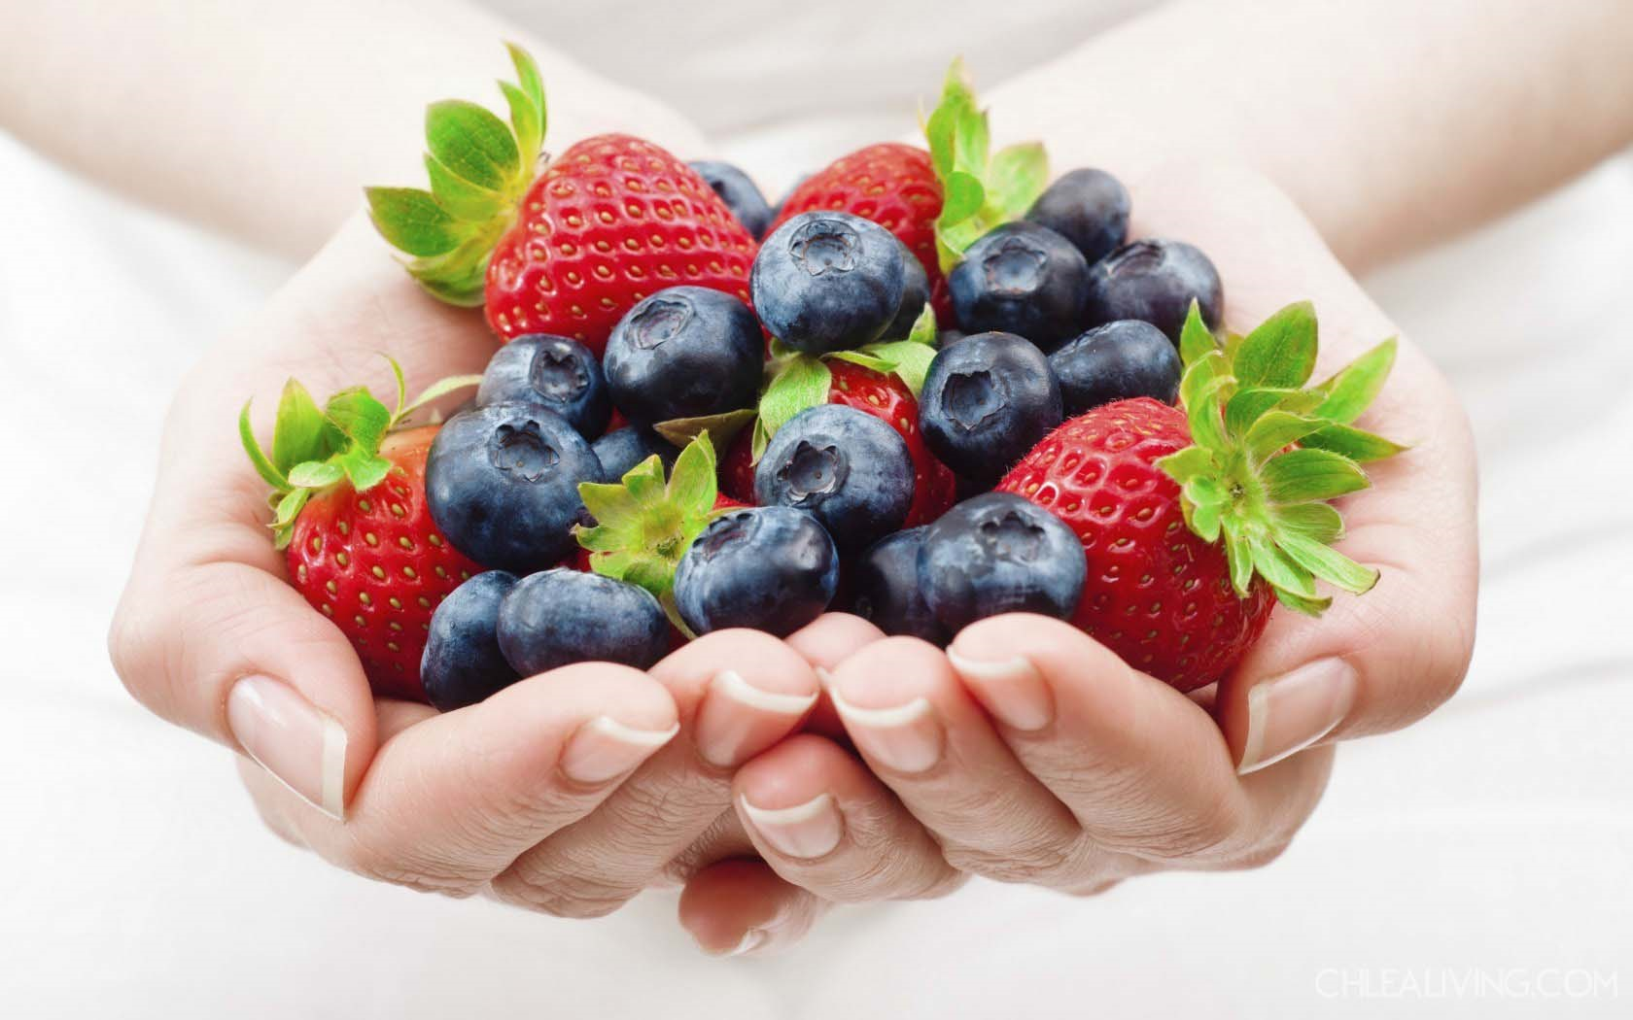
EYES TO SEE WHAT GOD IS GROWING AMONG US
Read & listen to God’s Word as part of your congregation

Slide 8
EYES TO SEE WHAT GOD IS GROWING AMONG US
Ask each other the question, ‘What is God doing among us’?

Slide 9
EYES TO SEE WHAT GOD IS GROWING AMONG US
Find out more about what is happening in things you aren’t part of in congregational life & witness

Slide 10
EYES TO SEE WHAT GOD IS GROWING AMONG US
Be generous and gentle in looking for fruitfulness, it often ripens slowly

Slide 11
EYES TO SEE WHAT GOD IS GROWING AMONG US
Recognise that fruitfulness comes & goes in seasons – expect to have to re-shape and prune

Slide 12
EYES TO SEE WHAT GOD IS GROWING AMONG US
Pray expectantly the God will help us identify our ‘one purpose’ (v.8) for the next season of our congregation’s life & witness

Slide 13
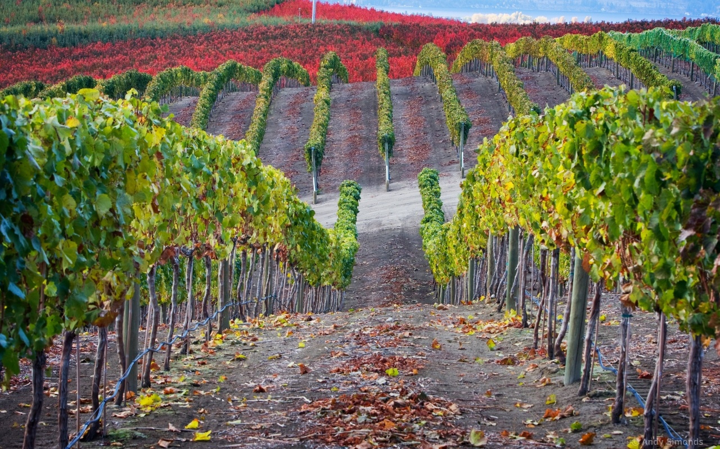
Fruitful Congregation Prayer Based on John 15v.1-17 & I. Corinthians 3v.1-9

Slide 14
Fruitful Congregation Prayer
Lord of the Church, in every time and place,
we thank you that You are the God who makes things grow.
We thank you for signs of your fruitfulness among us as a congregation.
The power of Jesus, the true vine, flowing in us and through us,
is what causes our life and witness as Your people to flourish.

Slide 15
Fruitful Congregation Prayer
All knowing God, who sees our hearts,
We confess that often we have been unfruitful,
not because You have not wanted to grow your Kingdom among us,
but because we have:-
Not listened carefully to Your word and followed it;
Lost our expectation of Your Spirit’s work among us;
Demanded our own preferences, rather than surrendered to Your will for us;
Not pulled together in Your one purpose for us, but pulled apart in jealousy, quarrelling, cliques and factions.

Slide 16
Fruitful Congregation Prayer
Forgiving Father, who tends our congregation’s life and witness,
we thank You that we are already clean because of the word of Your pardoning grace.
Prune us, cutting off what bears no fruit;
Shape us, so that we can be even more fruitful in living out Your purposes for us;
Teach us, showing us through Jesus, Your living Word, what we need to learn;
Enable us to better remain in Him and to know His life flowing in us.

Slide 17
Fruitful Congregation Prayer
Sovereign Lord, who chooses and appoints us to go and bear fruit,
in this season of our congregation’s life and witness,
help us to hear your voice and follow where You call.
We ask for grace not only to look to our own personal agendas, preferences and advantage.
We ask for that spirit of love that lays down all of that in the service of the glory of God and for the good of others.
We ask for clarity to know Your will for our congregation – nothing more, nothing less, nothing else.

Slide 18
Fruitful Congregation Prayer
Only Wise God, generous in giving wisdom without finding fault to those who ask,
as fellow workers in the field that is Your church,
in these often bewildering times of challenge and change,
we seek Your face.
Remaining in You and desiring to be shaped by Your word,
we ask, believing, that You will guide us,
as we now listen to discern Your ways for us.
Make known to us the next steps towards Your growing in us greater fruitfulness for our Father’s glory. Amen

