Slide 1
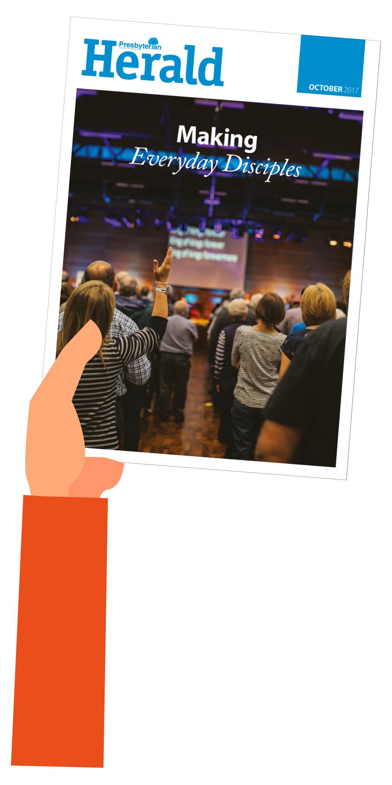
A voice for Presbyterians
NEWS | FEATURES | OPINIONS | MISSION | REVIEWS | RESOURCES
To order today, please ask our Herald agent,
Insert your agent’s name here
for more details.
An annual subscription remains at just £10 for 2018

