Slide 1
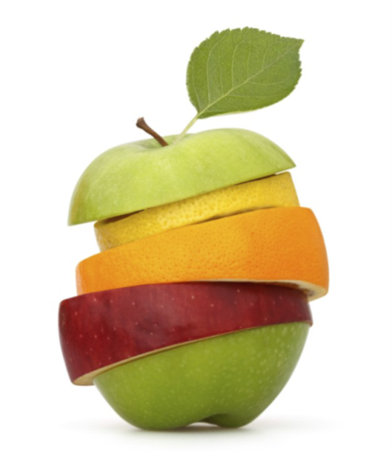
GROWING IN FRUITFULNESS
John 15v.1-17

Slide 2
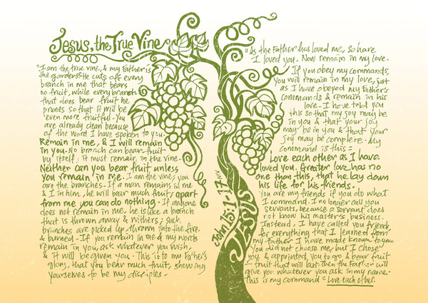
The vision

Slide 3
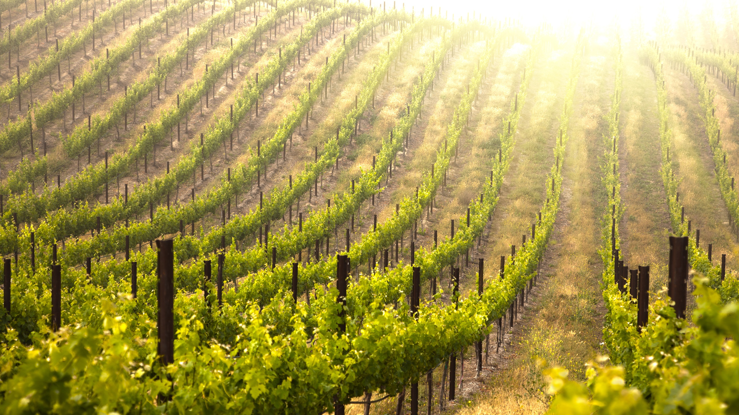

Slide 4
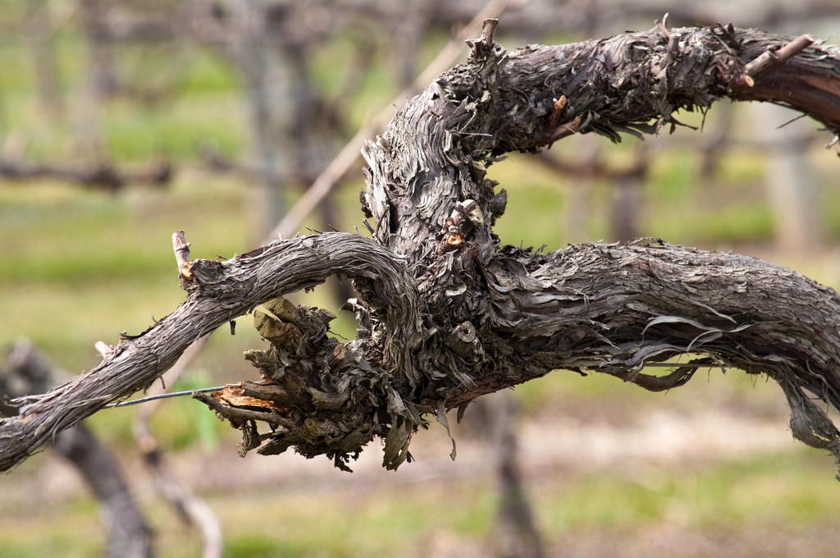

Slide 5
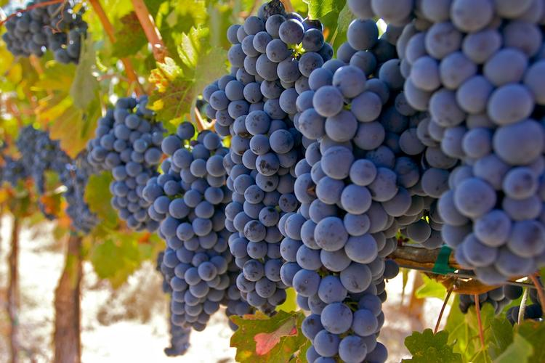

Slide 6
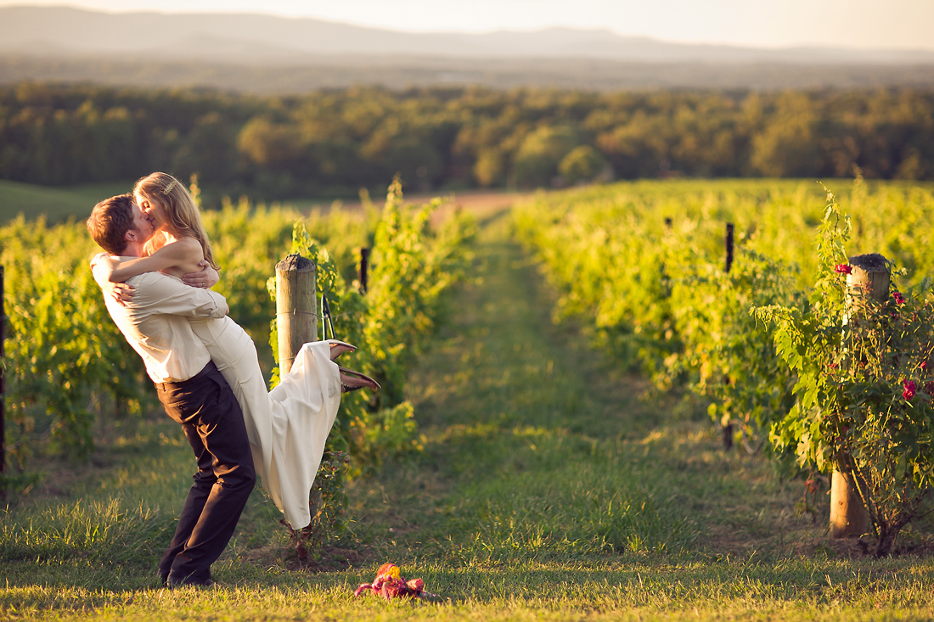

Slide 7
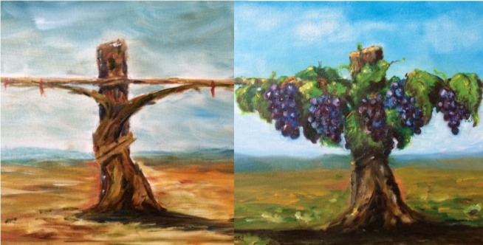

Slide 8
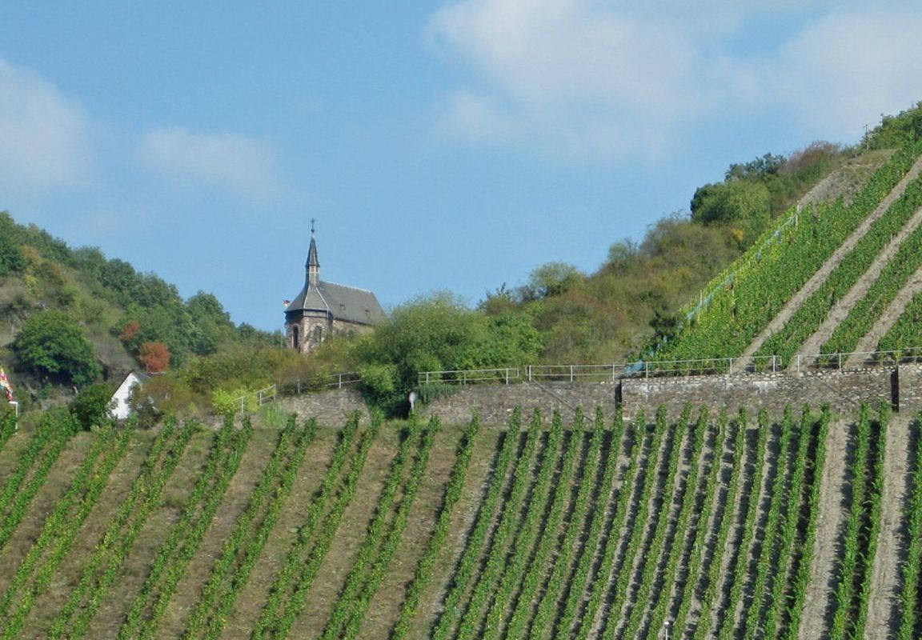

Slide 9
Which picture illustrating John 15 did you find most striking? Why?

Slide 10
A VISION OF FRUITFULNESS IN CHALLENGING TIMES FOR THE CHURCH
More than merely faithfulness to the way we have always done things in a changing world;
Often less than success in the eyes of a superficial world;
But always the growth of His Kingdom that is not of this world.

Slide 11
GROWING IN FRUITFULNESS
Picture – Church: It’s a field, not a factory v.1

Slide 12
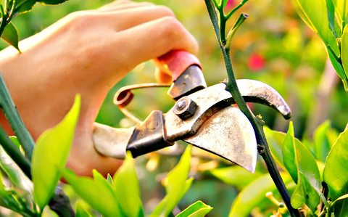
GROWING IN FRUITFULNESS
Pain – Growth: It involves pruning v.2

Slide 13
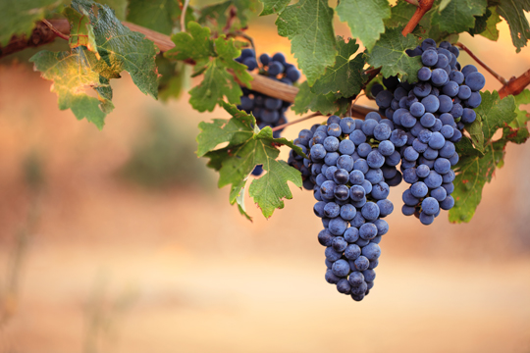
GROWING IN FRUITFULNESS
Promise – Expectation: Look for the fruit v.5

Slide 14
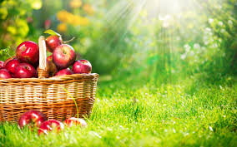
GROWING IN FRUITFULNESS
Prayer – Ask: Fruit is given from above v.7

Slide 15
GROWING IN FRUITFULNESS
Purpose – Him: It’s not about us v.8

Slide 16
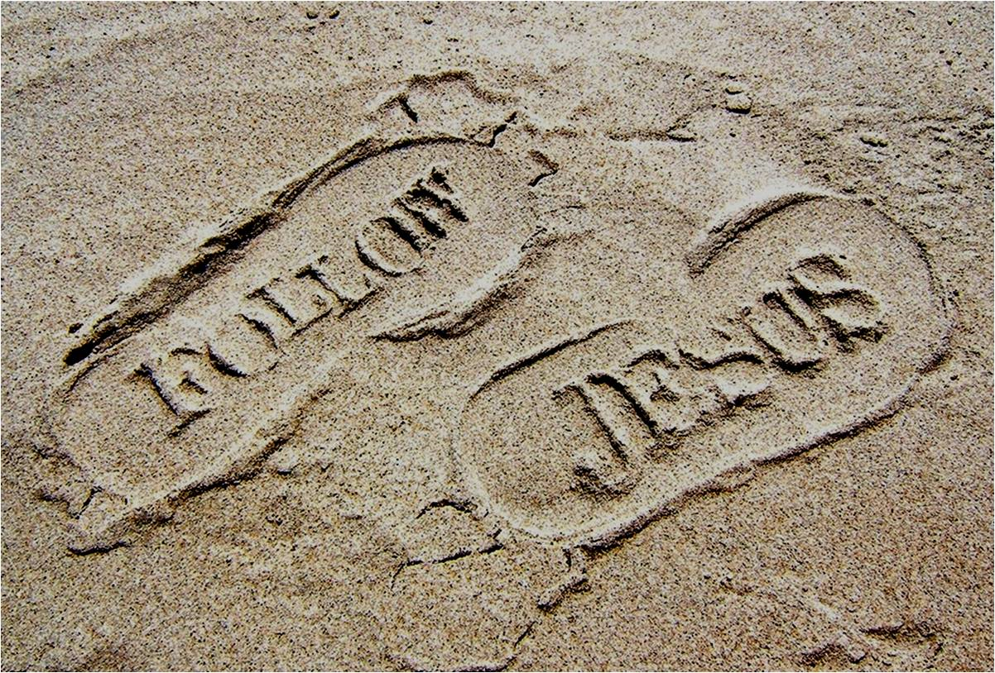
GROWING IN FRUITFULNESS
Pathway – Follow: It’s modelled by Jesus v.9-15

Slide 17
GROWING IN FRUITFULNESS
Privilege – Appointed: Right here, right now v.16

Slide 18
‘Going to church’
is just a
weekly routine
Leaders are expected to do all they can to maintain everything they can the way it is now
Following Jesus in everyday living is seen as an optional upgrade on church membership
Unfruitful
Congregations
Expectation of involvement locally and globally is that we pay and pray for others to ‘go’ & rely on a ‘they’ll come to us’ mind set
‘Church’ is a place where events & programmes happen, but real relationships are shallow
The understanding of the congregation’s purpose is that it is there to meet the preferences of existing members

Slide 19
Recognise your area of greatest unfruitfulness

Slide 20
Place encounter with the Living God at the centre of their life
Are led to lean forward into the future
Move the vision of membership from ‘belonging to church’ to ‘longing to be’ followers of Christ in every aspect of life
Fruitful
Congregations
Make an impression for God locally and globally through outreach and involvement in His wider activity in the world
Develop their life as a community of God’s People
Are shaped by understanding their life and witness as part of God’s unfolding story of redemption

Slide 21
Recognise your area of greatest fruitfulness

Slide 22
Growing the fruitfulness conversation in your congregation
Season 1 SEEDING: Introduce God’s vision of fruitfulness to your members
Season 2 RIPENING: Identify two areas in which you want to prioritise growth
Season 3 HARVESTING: Implement the development of habits and ways of doing things which, under God, work the ground and sow the seed for a local expression of fruitfulness

Slide 23
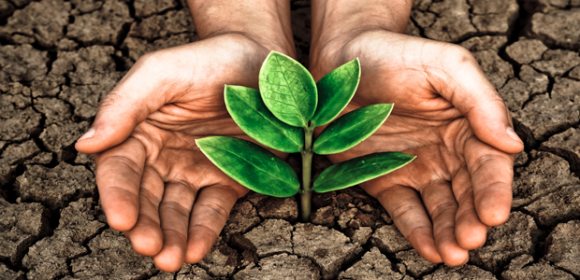
A conversation that is yours to grow
Know, plan, pace your own particular journey toward greater fruitfulness

Slide 24
Resources for growing the fruitfulness conversation in your congregation
www.presbyterianireland.org/fruitfulcongregations
Season 1 SEEDING: Introduce God’s vision of fruitfulness to your members
– Web-based, flexible launch resource & material for 6 follow up sessions

Slide 25
Resources for growing the fruitfulness conversation in your congregation
Season 2 RIPENING: Identify two areas in which you want to prioritise growth
- A second evening gathering to take stock
- A discussion tool to choose two areas in which to work for use in Kirk Session, working groups or whole congregation setting

Slide 26
Resources for growing the fruitfulness conversation in your congregation
Season 3 HARVESTING: Implement the development of habits and ways of doing things which, under God, work the ground and sow the seed for a local expression of fruitfulness
– Signposting resources, stories and ideas

Slide 27
Resources for growing the fruitfulness conversation in your congregation
In every season WATERING: Interceding in prayer
– Fruitful Congregations Prayer Journey www.presbyterianireland.org/Prayer/Prayer-Journey

Slide 28
Season 1 SEEDING: Introduce God’s vision of fruitfulness to your members
Working out of John 15 - Flexible launch material
Picture – Church: It’s a field, not a factory v.1
Pain – Growth: It involves pruning v.2
Promise – Expectation: Look for the fruit v.5
Prayer – Ask: Fruit is given from above v.7
Purpose – Him: It’s not about us v.8
Pathway – Follow: It’s modelled by Jesus v.9-15
Privilege – Appointed: Right here, right now v.16

Slide 29
Season 1 SEEDING: Introduce God’s vision of fruitfulness to your members
Working out of John 15
Six flexible sessions, one on each area of congregational fruitfulness
‘Prune’ v.2 Led to lean forward into the future
‘Remain’ v.3&4 Place encounter with the Living God at the centre of their life
‘Show’ v.7-11 Move the vision of membership from belonging to church to longing to be followers of Christ in every aspect of life
‘Love’ v.12-14 Develop their life as a community of God’s people
‘Learn’ v.15 Are shaped by understanding their life & witness as part of God’s unfolding story of redemption
‘Go’ v.16 Make an impression for God locally & globally through outreach & involvement in His wider activity in the world

Slide 30
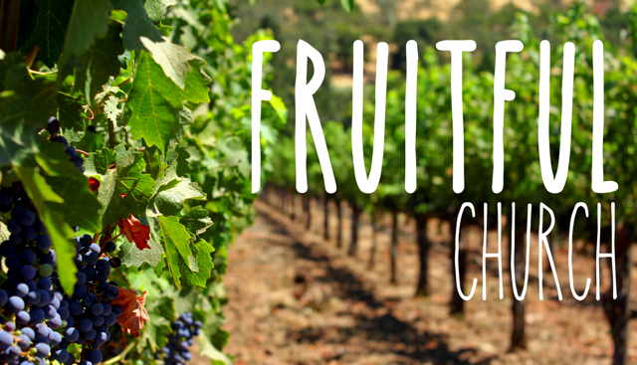
How will you seed the vision of fruitfulness in your congregation?

Slide 31
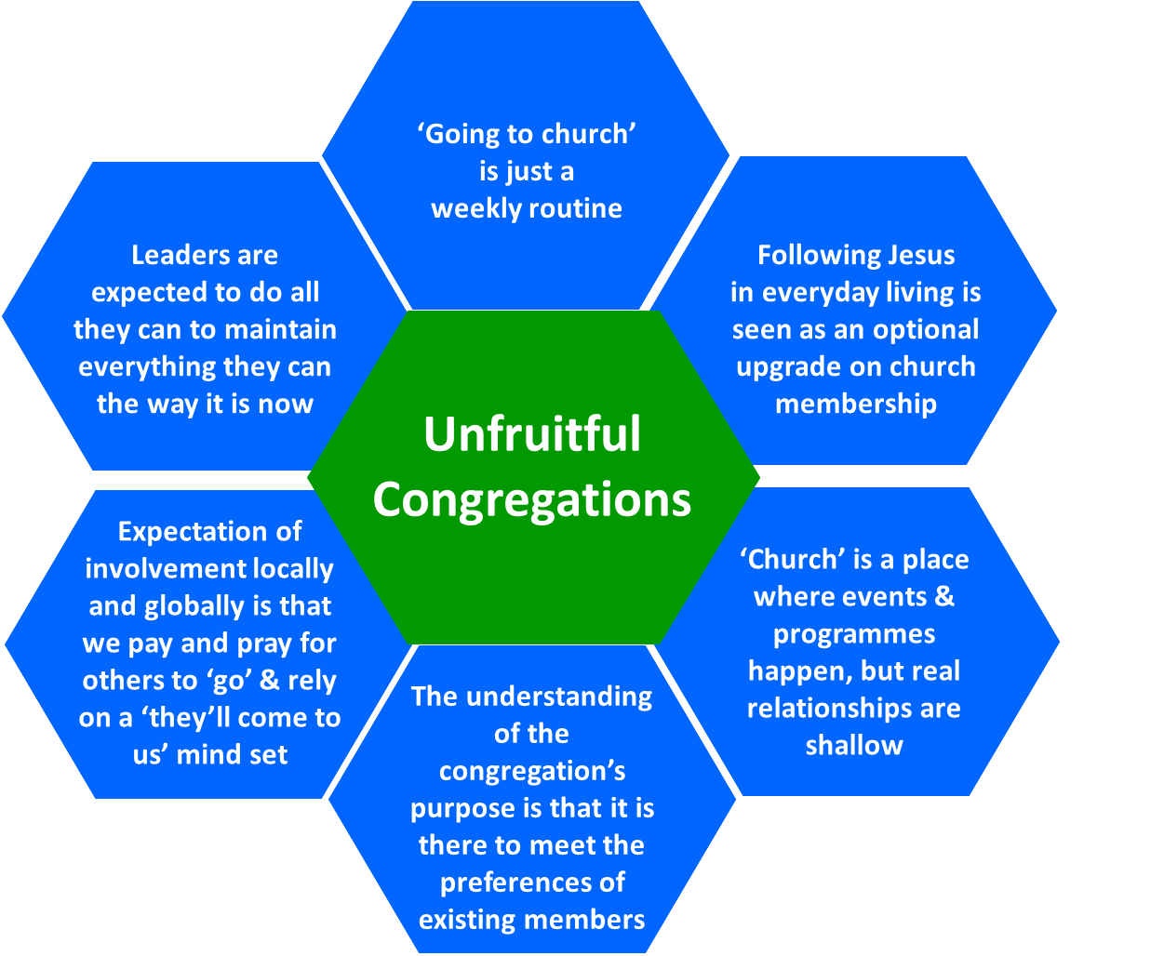
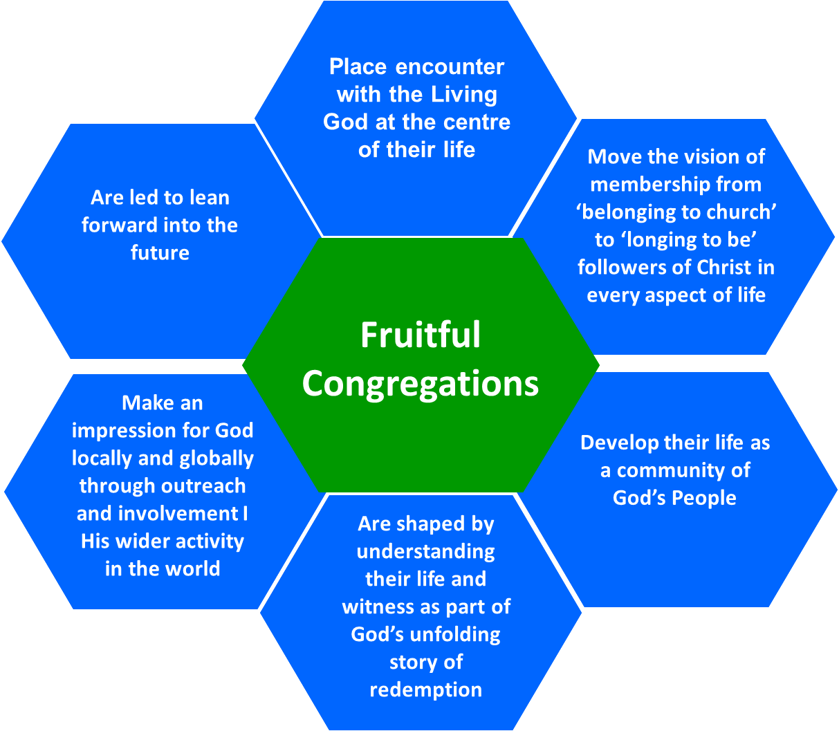
Season 2 RIPENING: Identify two areas in which you want to prioritise growth
Strength to build on
Weakness to address

Slide 32
Season 3 HARVESTING: Implement the development of habits and ways of doing things which, under God, work the ground and sow the seed for a local expression of fruitfulness
Make an impression for God locally and globally through outreach and involvement in His wider activity in the world
Develop their life as a community of God’s People
Fruitful Congregation
Overseas
Involvement
Pastoral Care
Evangelism
Close to Home
Community
Engagement
Intergenerational
worship

Slide 33
Council support for the journey
Flexible materials
Council Staff as listening ear as you undertake your journey
Another gathering in February/March 2017 to equip you for the conversation about identifying two areas in which you want to prioritise growth
Specialist suggestions in third season

Slide 34
Questions and Prayer

