Slide 1


Together
getting things done

Slide 2
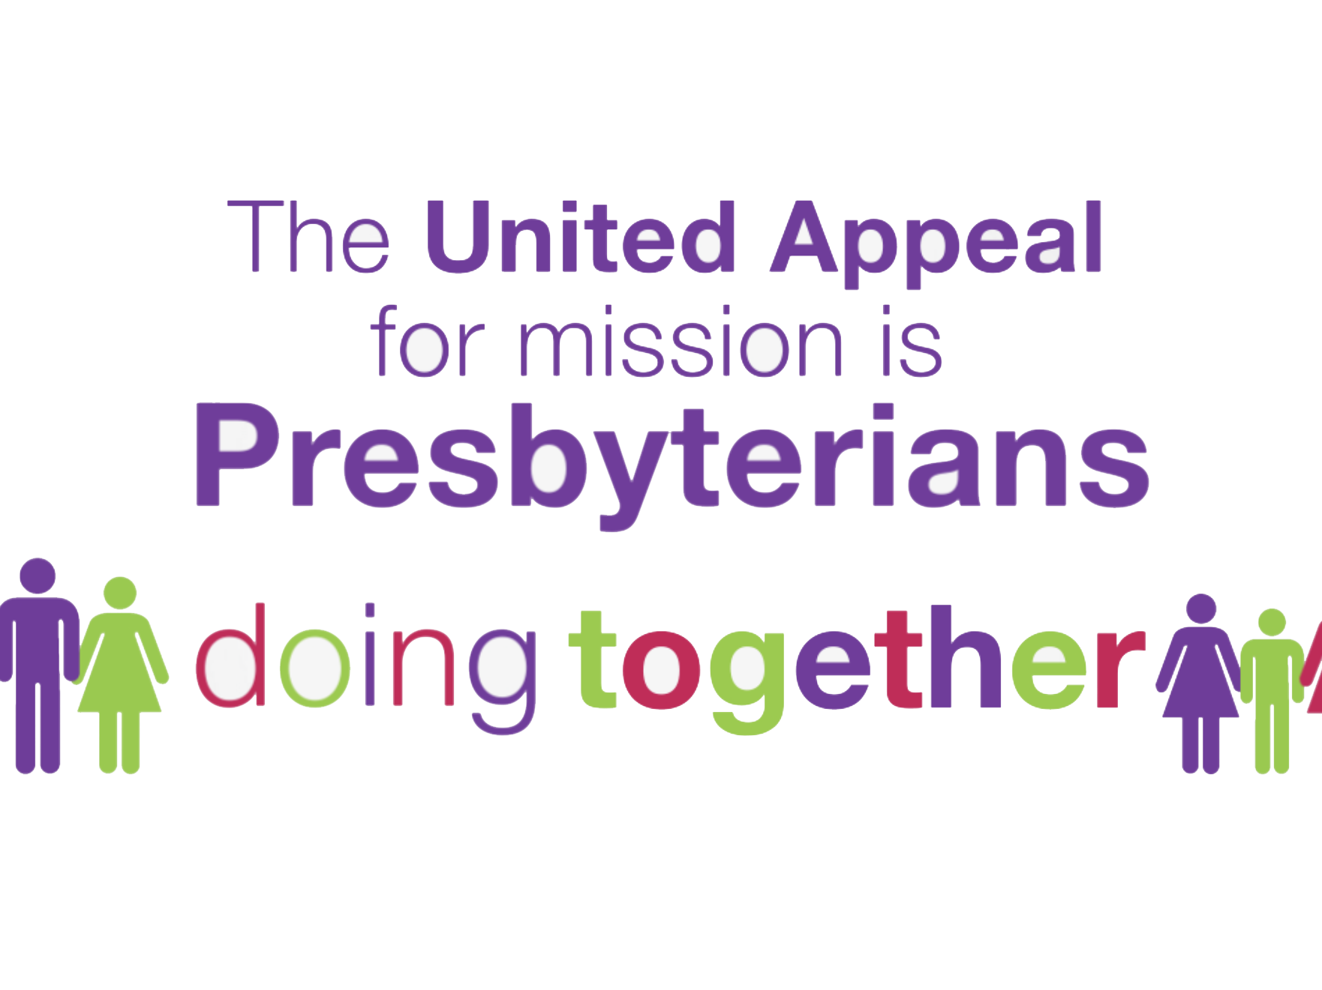
Notes:
The United Appeal for Mission is Presbyterians doing together… Your money through United Appeal is used to fund …

Slide 3

Notes:
…what none of us can do on our own

Slide 4

Notes:
As a Church we are making big differences here in Ireland and all over the world. Together we support…

Slide 5
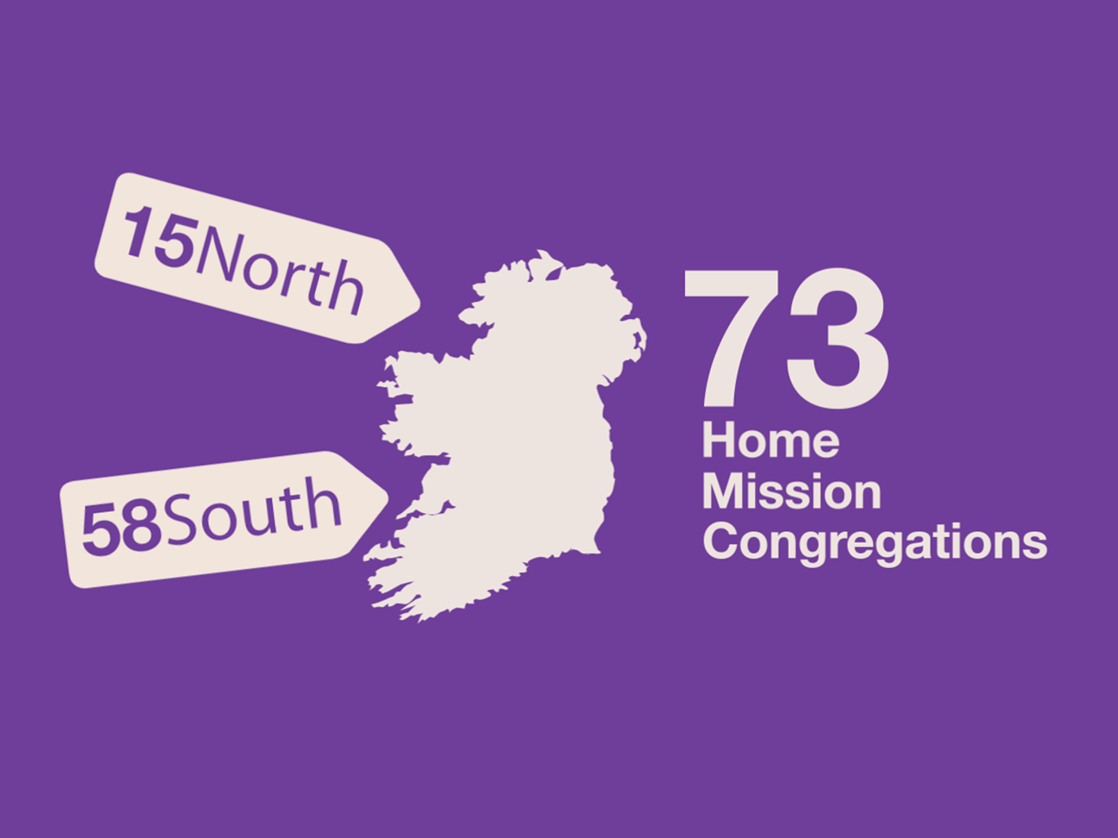
Notes:
73 Home Mission Congregations, 15 in the North and 58 in the South;

Slide 6
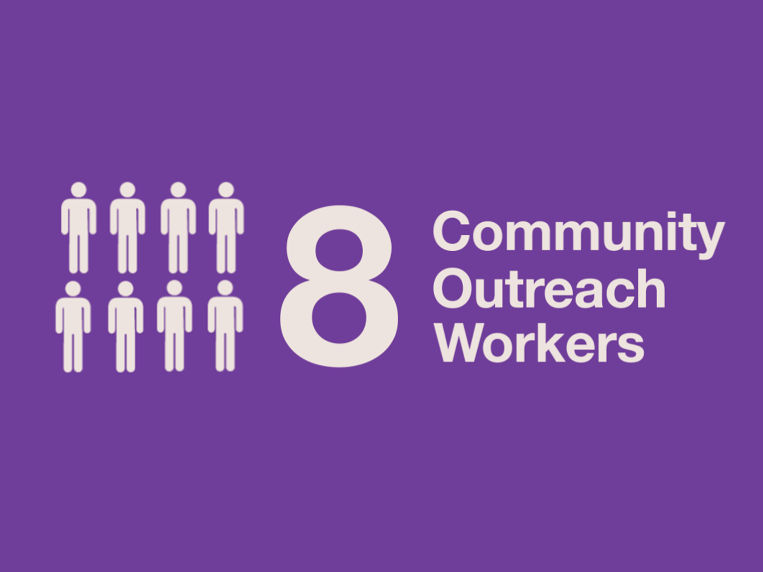
Notes:
8 Community Outreach Workers; and 6 Irish Mission Workers.

Slide 7

Notes:
and 6 Irish Mission Workers.

Slide 8
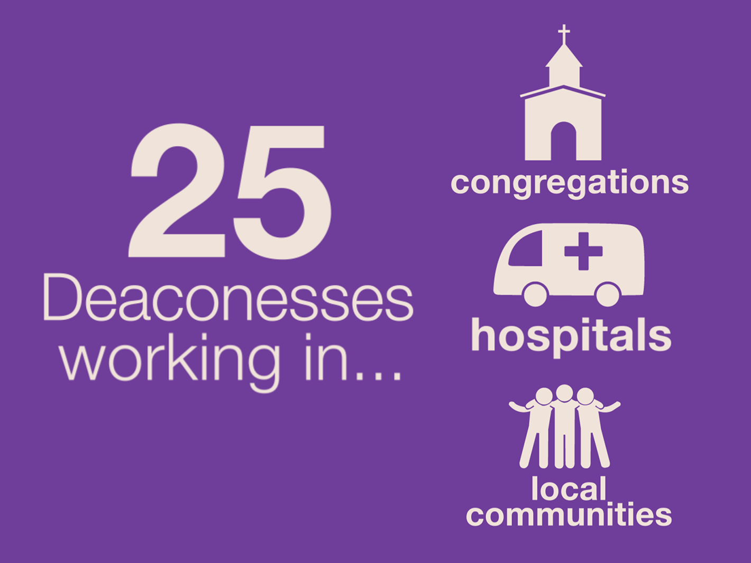
Notes:
Your money also contributes to the support of 25 Deaconesses serving in congregations, hospitals and local communities

Slide 9
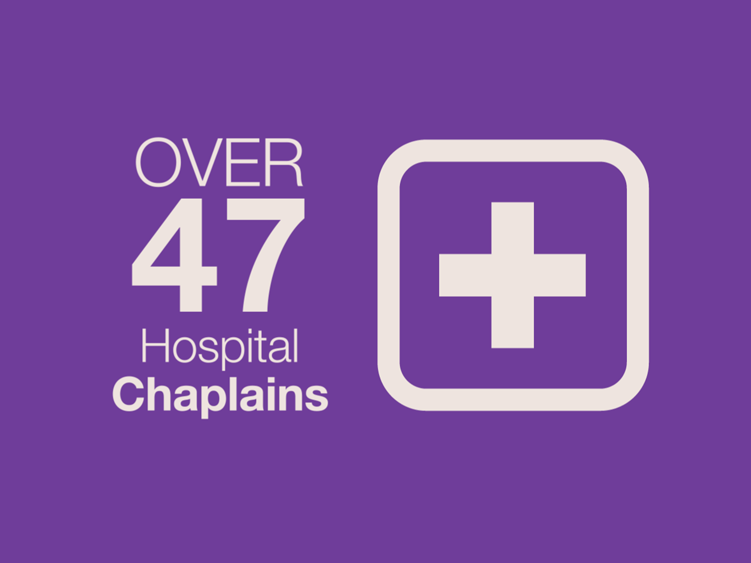
Notes:
As well as 70 Chaplains. - 47 serving in hospitals,

Slide 10

Notes:
15 in the Armed Forces.

Slide 11
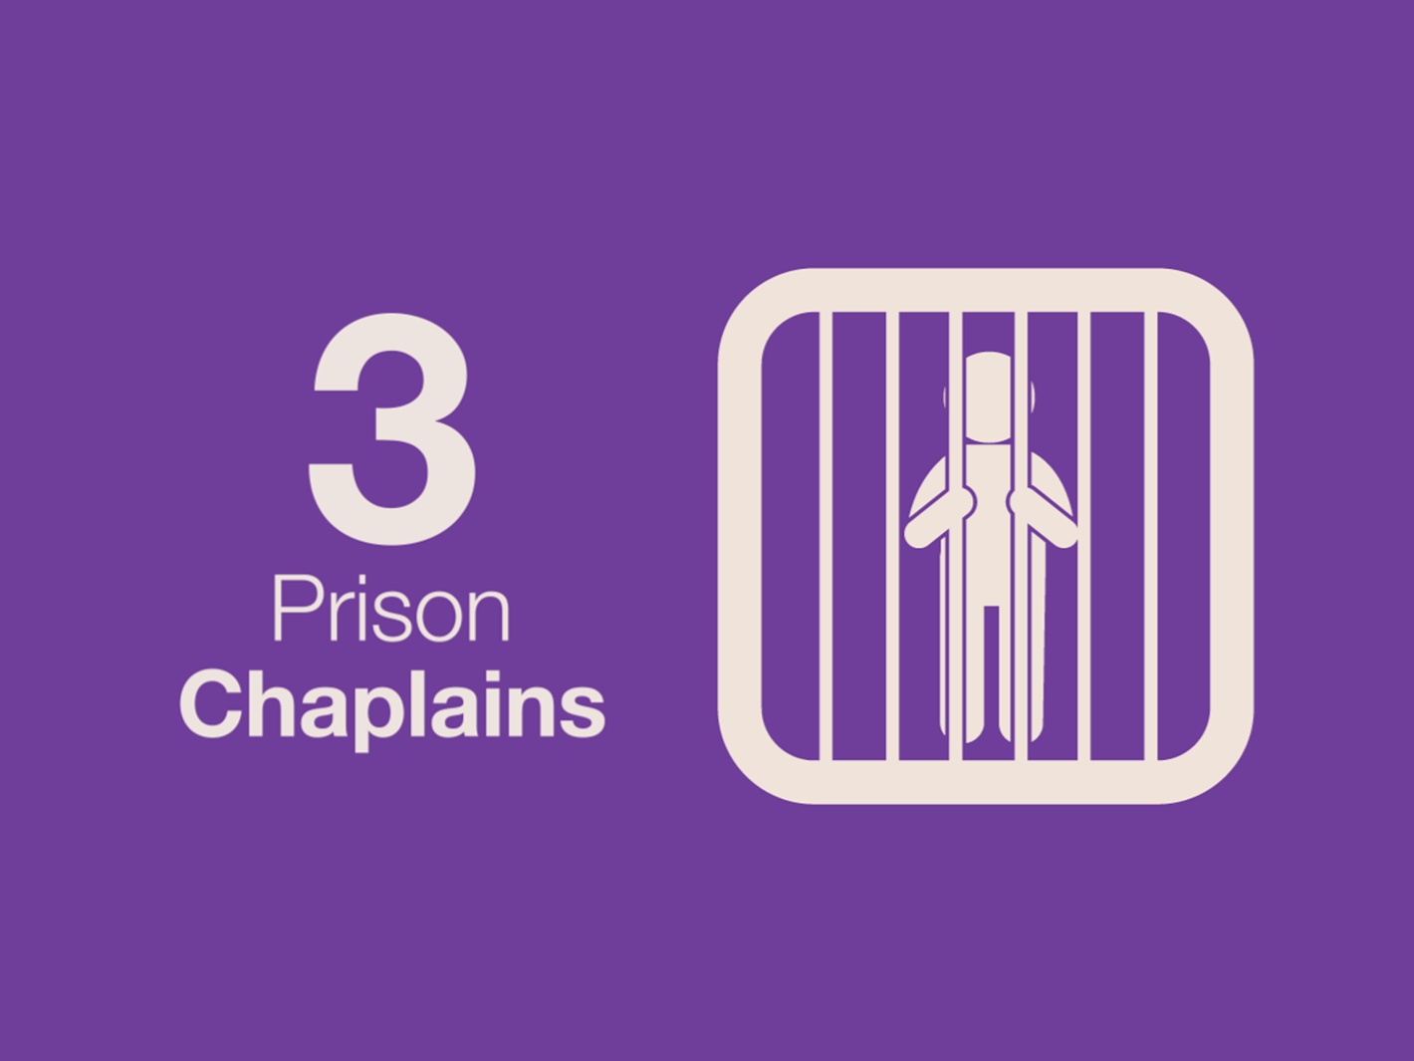
Notes:
3 in Prisons.

Slide 12

Notes:
And 5 in Universities

Slide 13
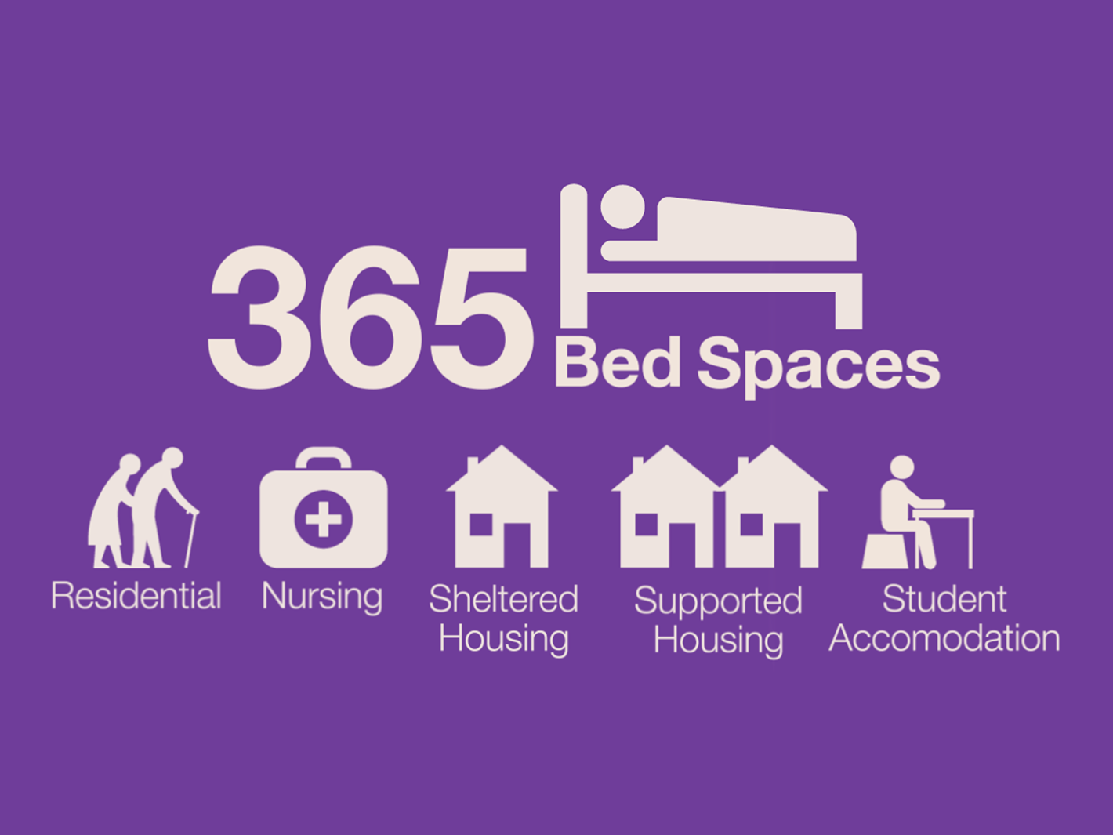
Notes:
The United Appeal also allows for the provision of 445 beds to people in residential and nursing care and those with learning disabilities, as well as student accomodation.

Slide 14

Notes:
Together we provide a wide range of training and events….

Slide 15

Notes:
Including Taking Care.
Taking Care is the name of the child protection policy and programme of PCI. The aim is to create and promote a safe environment for children, young people and leaders. Through the United Appeal we were able to fund and conduct 163 Taking Care Training Sessions in 2014.

Slide 16

Notes:
Last year over 3,500 attended events for children and young people including MAD, the Mix, the Word, the SPUD Youth Assembly and the Kids’ Big and Little Days Out.

Slide 17
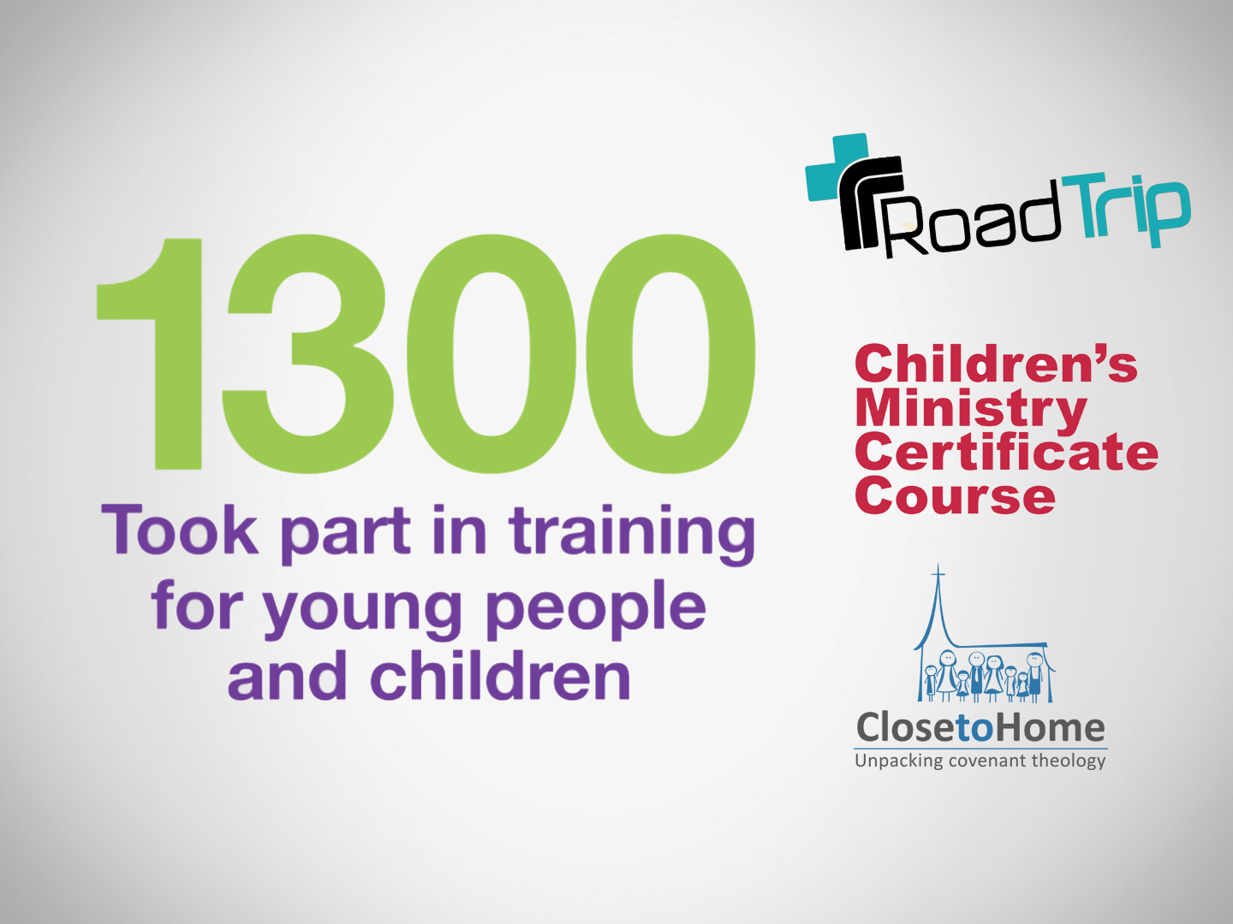
Notes:
1,300 people took part in training events for young people and children including the Close to Home Conference, the YAC Road Trip, Little Resources and the Children’s Ministry Certificate Course.
There are currently around 119,000 children and young people attending PCI organisations throughout Ireland, cared for by a team of around 33,000 volunteers and staff.

Slide 18
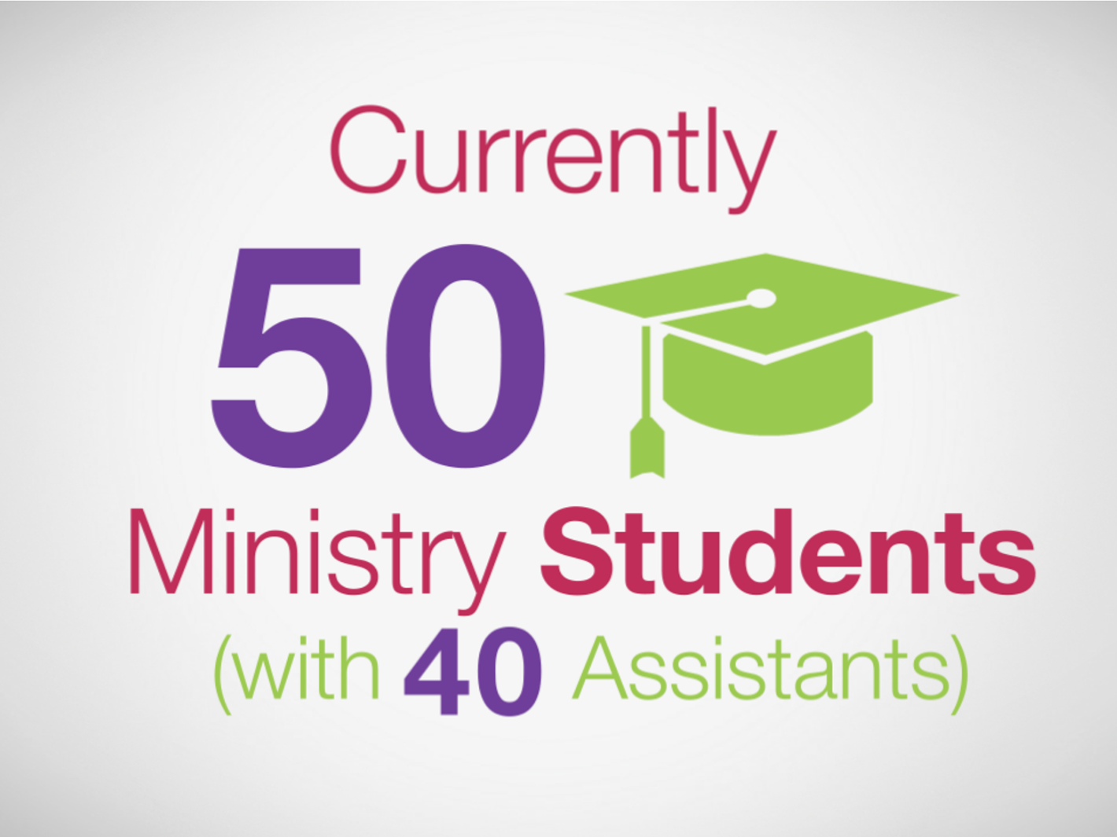
Notes:
Thanks to United Appeal funding we have currently 50 Ministry students with 40 assistants

Slide 19
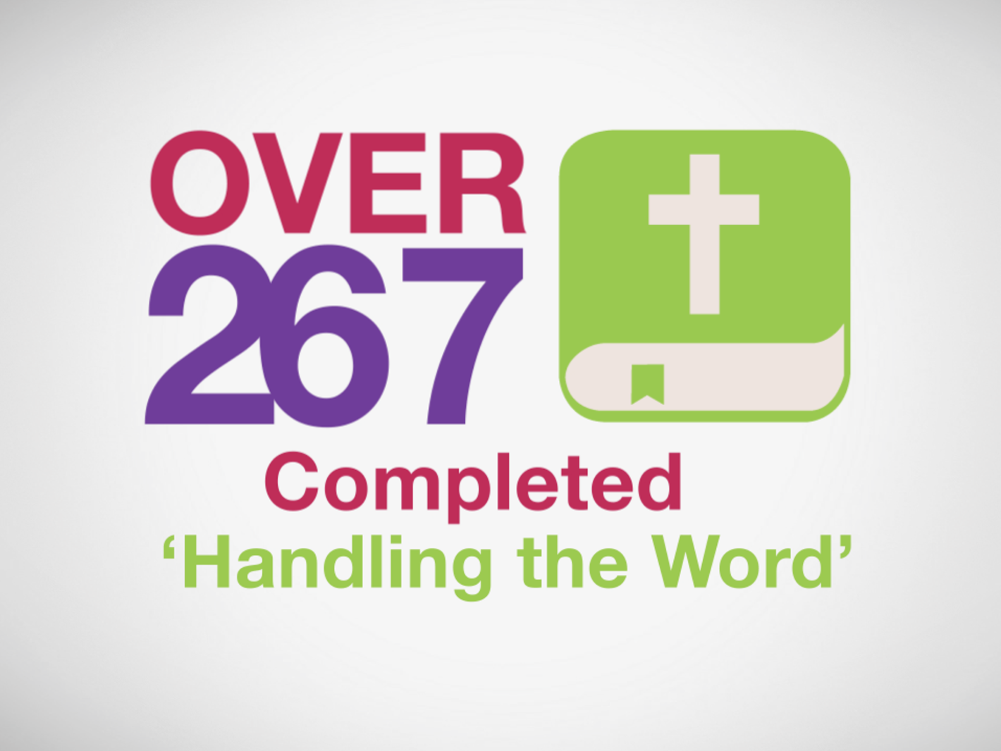
Notes:
Over 260 have completed the ‘Handling the word’ course

Slide 20
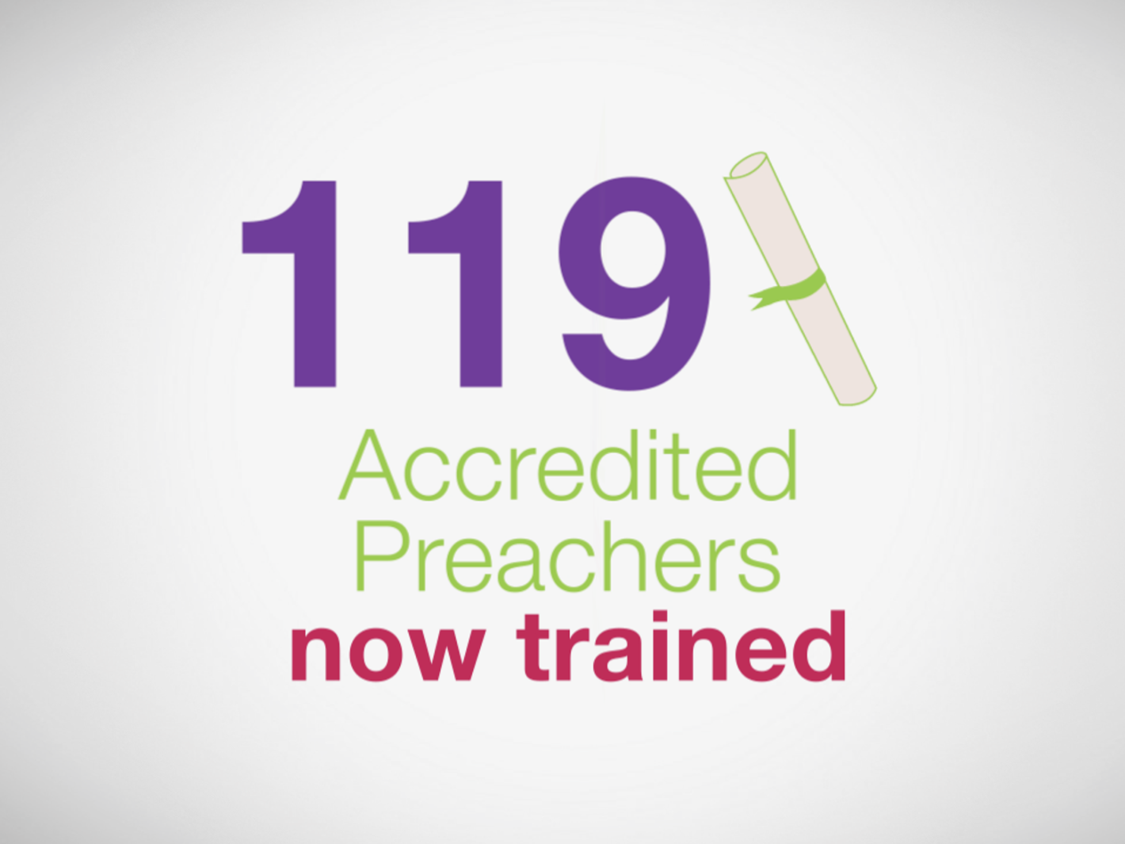
Notes:
And there are now over 100 Accredited Preachers

Slide 21
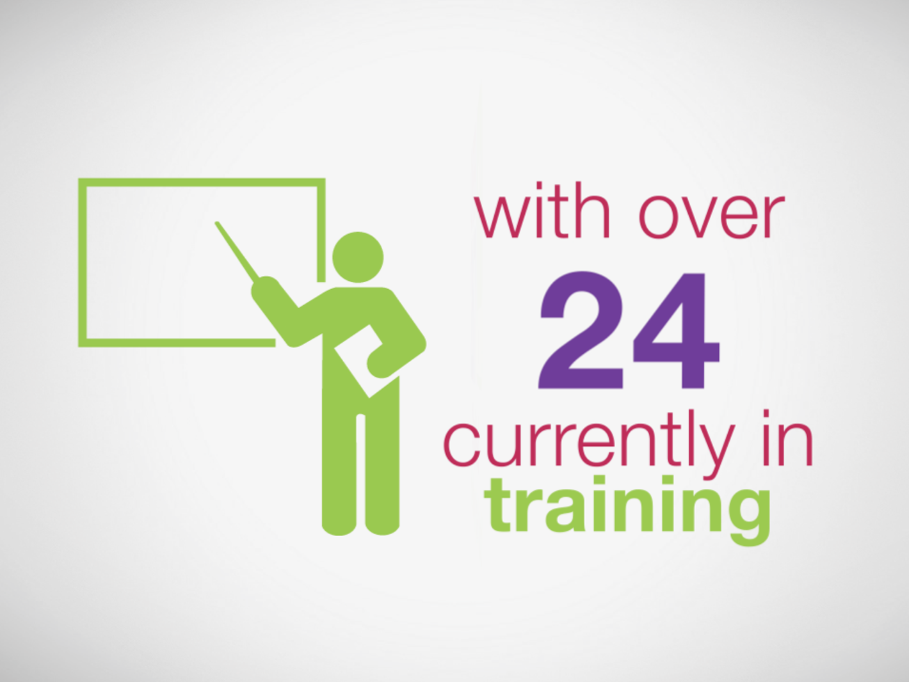
Notes:
With over 24 in training.

Slide 22

Notes:
Involvement overseas has been an integral part of PCI’s activities since the first missionary was sent to Gujarat, Northwest India in 1841. At present PCI has links with indigenous churches, Christian institutions or international mission agencies in more than 25 countries around the world, working in partnership in areas of development; outreach; ministry; peace building; education; medical mission; women’s empowerment and Child, Youth and Student Ministries.

Slide 23
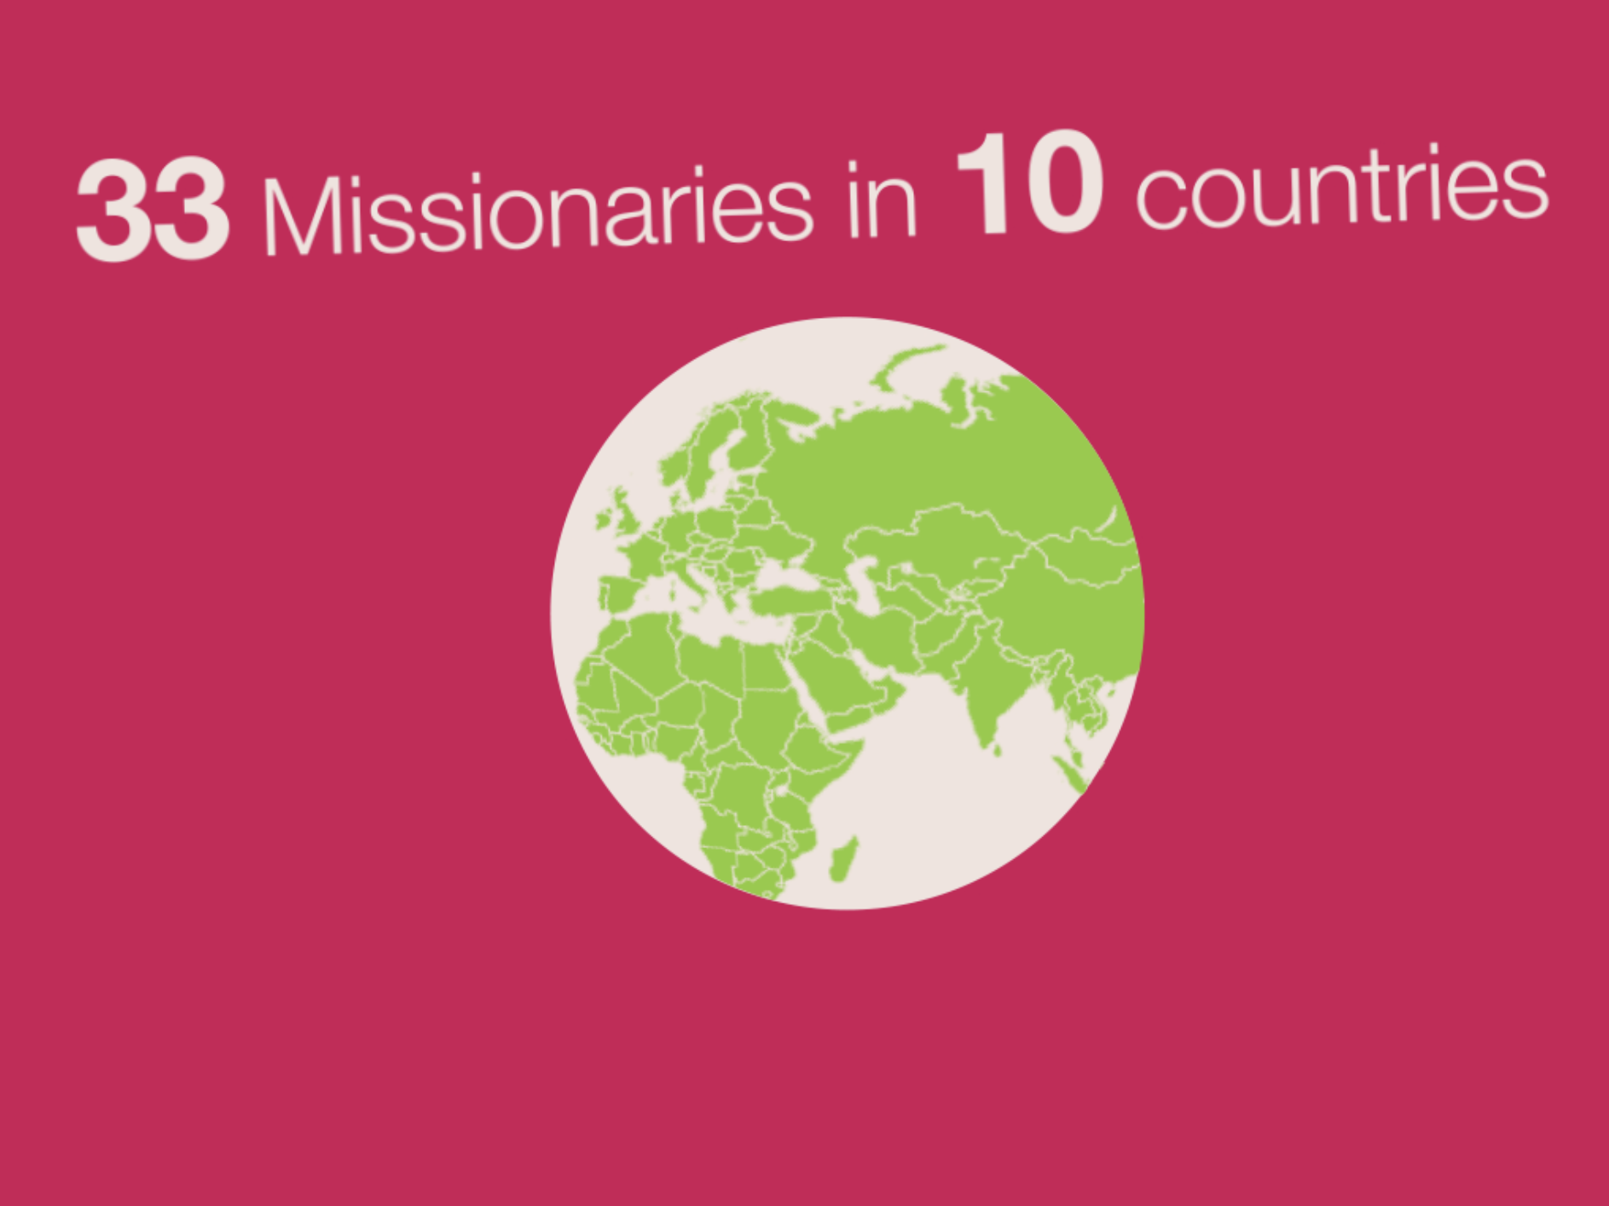
Notes:
United Appeal funds have also enabled to support and maintain over 30 PCI missionaries serving in 10 countries.

Slide 24

Notes:
And have also enabled us to train 66 individuals for short-term mission work

Slide 25
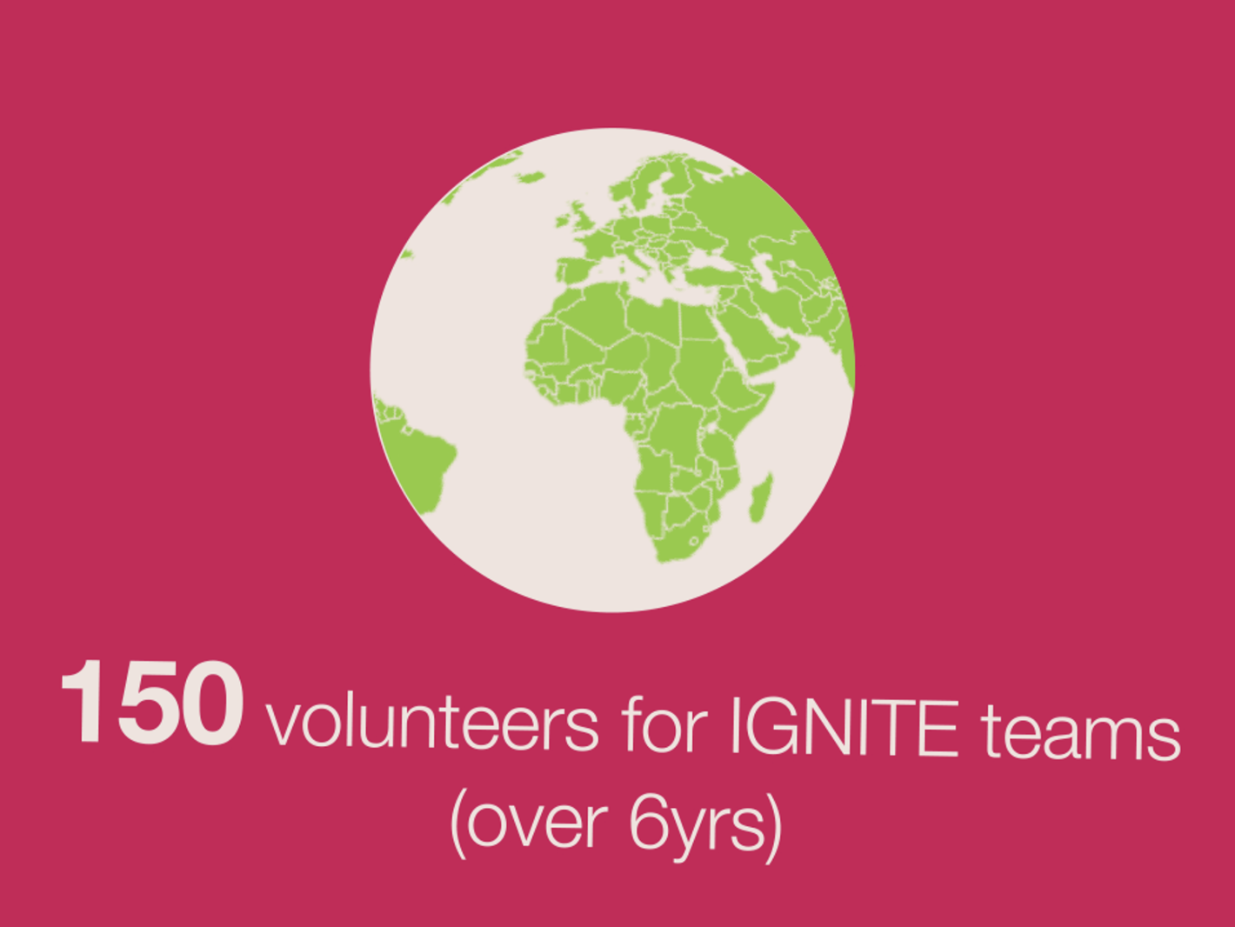
Notes:
The United Appeal has helped enable us to send 150 volunteers on IGNITE teams to Africa and various countries in Europe over the last 6 years.

Slide 26

Notes:
We can do all of this because you give through your congregation. Every aspect of our Church’s mission depends to some extent on United Appeal. Hundreds of projects and programmes at home and overseas are helping to advance God’s kingdom, showing God’s love in action to hundreds of thousands of people. Thanks to your generous support this work can flourish.

Slide 27
Together
getting things done

