Slide 2
Side by Side Intergenerationally
Biblical relationships across the generations

Slide 4
Side by Side Intergenerationally
Inspirations 2020-22
GROUP DISCUSSION

Slide 5
1.What is the age-profile of your group?
a. How many fall into each of these age ranges:
20-39; 40-59; 60-79; 80+
b. Are all age-groups represented?

Slide 6
2. What are the benefits of being part of this group?
3. What do you do individually, and as a group, to
encourage other women to join with you?
Do you have any new thoughts or ideas about how
to open up the group to them?

Slide 7
Imagine:
4. Imagine you have never
been to this group before. What would you like people to do in order to make you feel welcome and to help you understand what is going to happen in the group?

Slide 8
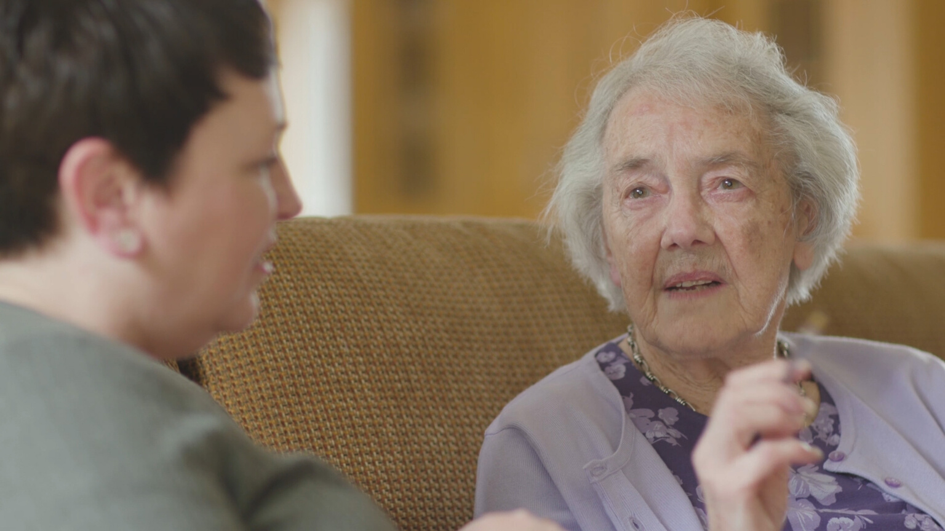
5. Why do you think it is
important for people of different ages to mix?
6. If people tend to
associate with women from their own generation, what could you do to encourage them to mix with others?

Slide 9
7. Can you think of any passages in the Bible that suggest the importance of intergenerational relationships?
Side by Side Intergenerationally

Slide 10
Side by Side Intergenerationally
Inspirations 2020-22
BIBLE STUDY

Slide 11
You, however, must teach what is appropriate to sound doctrine. Teach the older men to be temperate, worthy of respect, self-controlled, and sound in faith, in love and in endurance. Likewise, teach the older women to be reverent in the way they live, not to be slanderers or addicted to much wine, but to teach what is good. Then they can urge the younger women to love their husbands and children, to be self-controlled and pure, to be busy at home, to be kind, and to be subject to their husbands, so that no one will malign the word of God.
Read
Titus 2:1-5

Slide 12
1.How were the older women to learn and what was Titus instructed to teach them?
2. How much value do we
put on learning from the people God has gifted as teachers in the church?
Titus 2:1-5

Slide 13
3. Think of a time when you put
into practice something you had learned from God’s Word.
Take time to share this experience with others in your group.
4. How can we create opportunities for
relationships to develop between different generations which will provide opportunities for the kind of teaching
and training Paul suggested?

