Slide 1
Maintaining Healthy Congregations
Bible Study - Ephesians 4:1-6
Living with Difference

Slide 2
I, therefore, the prisoner of the Lord, beg you to lead a life worthy of the calling to which you have been called, with all humility and gentleness, with patience, bearing with one another in love, making every effort to maintain the unity of the Spirit in the bond of peace. There is one body and one Spirit, just as you were called to the one hope of your calling, one faith, one baptism, one God and Father of all, who is above all and through all and in all.
Ephesians 4:1-6 (NRSV)

Slide 3
Biblical Virtues for Living Together
Humility

Slide 4
You have made human beings a little lower than God, and crowned them with glory and honour. Psalm 8:5

Slide 5
Sometimes we….
Make sweeping generalizations
Assert opinions as fact
Project our views onto others
Assert as truth what we can’t possibly know for certain

Slide 6
Dogs make better pets than cats.
Everyone knows the Leinster rugby team is better than Ulster
God prefers hymns to modern praise songs

Slide 7
Making statements more humble:
Use words like “some” instead of generalisations
Use “I” statements rather than universal claims
Use phrases such as “from my perspective,” “in my understanding” “as I see it”
Begin statements with “ I believe” or “I feel” when they are an opinion, perception or belief

Slide 8
I believe Jesus would not approve of that.

Slide 9
I could be wrong, however I believe Jesus would not approve of that.
Humility urges each of us to remember and acknowledge that we could be wrong in matters both small and significant.

Slide 10
Humility
demands that we
watch our language

Slide 11
Biblical Virtues for Living Together
Humility
Patience

Slide 12
"We appeal to you, brothers and sisters…
Be at peace among yourselves. And we urge you, beloved, to admonish the idlers,
encourage the faint hearted, help the weak,
be patient with all of them"
(1 Thessalonians 5:13-14, NSRV).

Slide 13
“For now we see in a mirror, dimly, but then we will see face to face. Now, I know only in part, then I will know fully, even as I have been fully known.”
I Corinthians 13:12

Slide 14
There is a house next door to the church which belongs to your church.
It has become available to rent at a low rate. You, as a group of members, have been given the task of allocating the house to an individual of your choice.
There are five applicants.

Slide 15
Helen (40)
Has a previous conviction as a Drug Dealer

Slide 16
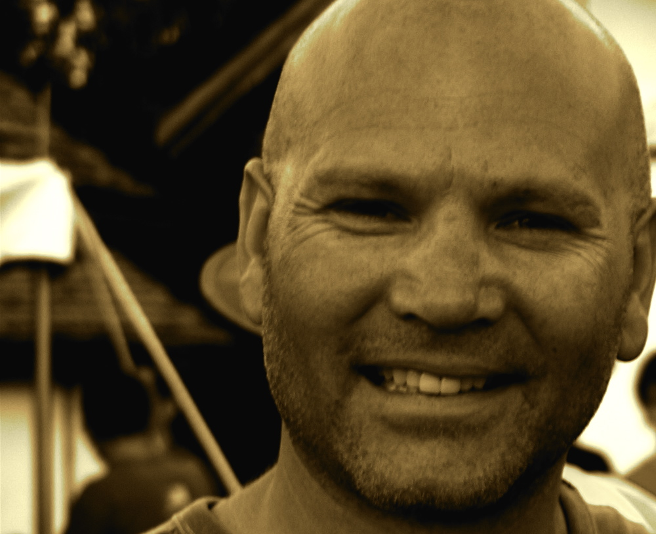
Stephen (52)
Retired Bank Manager and church member

Slide 17
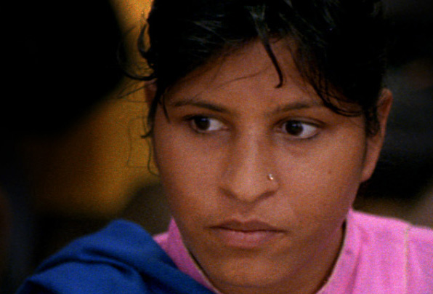
Mary (32)
Primary School Teacher

Slide 18
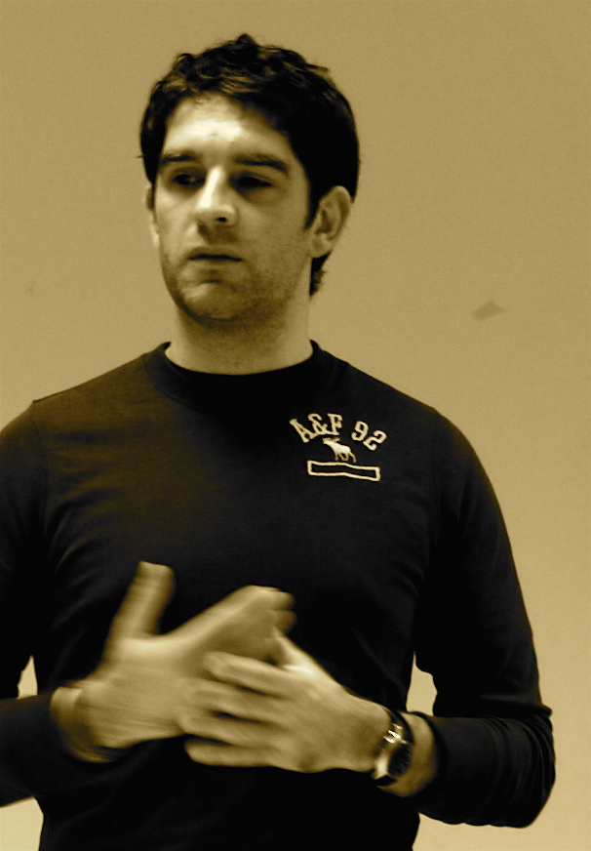
Terry (36)
Sports enthusiast and local politician

Slide 19
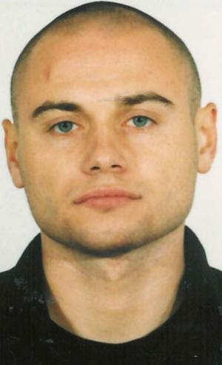
Rudi (24)
Migrant
worker

Slide 20
You have 1 minute to write down their names in your order of preference now for having them as your new tenant.

Slide 21
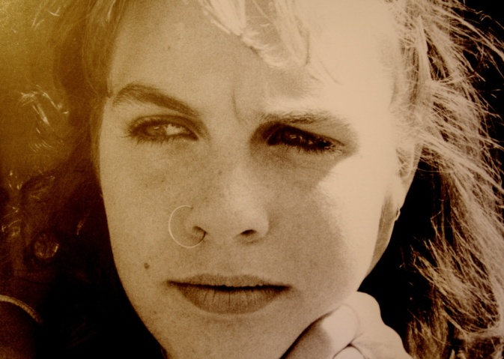
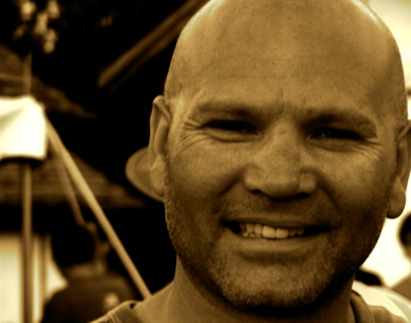
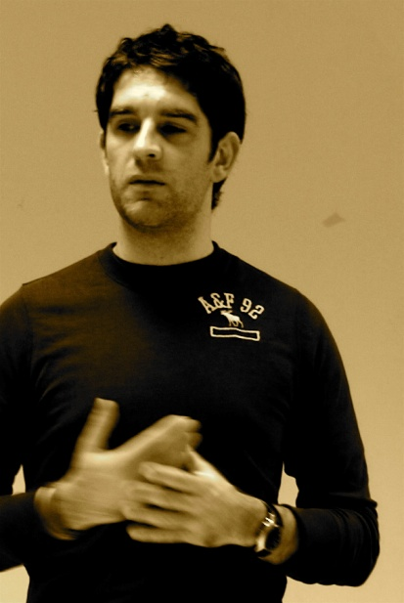
A Helen (40)
Convicted drug dealer
B Mary (32)
Teacher
C Stephen (52)
Retired Bank Manger
E Terry (36)
Politician
E Rudi (24)
Migrant worker

Slide 22
You now have 2 minutes as a group to try to agree on a common list.

Slide 23
A Helen (40)
Convicted drug dealer
B Mary (32)
Teacher
C Stephen (52)
Retired Bank Manger
E Terry (36)
Politician
E Rudi (24)
Migrant worker

Slide 24
Helen (40)
Is enthusiastic about making connections with the youth as a volunteer counselor

Slide 25
Stephen (52)
Believes he could be helpful to the church in fundraising

Slide 26
Mary (32)
Trained as an Primary School Teacher and would volunteer in the church’s after-school programme

Slide 27
Terry (36)
Would coach sports in the youth club

Slide 28
Rudi (24)
Is currently being investigated by law enforcement officers

Slide 29
You have 1 minute to write down their names in your order of preference for having them as your new tenant.

Slide 30
A Helen (40)
Convicted drug dealer
B Mary (32)
Teacher
C Stephen (52)
Retired Bank Manger
E Terry (36)
Politician
E Rudi (24)
Migrant worker

Slide 31
You now have 2 minutes as a group to try to agree on a common list.

Slide 32
A Helen (40)
Convicted drug dealer
B Mary (32)
Teacher
C Stephen (52)
Retired Bank Manger
E Terry (36)
Politician
E Rudi (24)
Migrant worker

Slide 33
Reformed Drug Dealer
Helen is 40 and was a heroin addict for 10 years. She has been clean for the past 15 years, and for the past five years has been working as an Education Officer with the Health Promotion Agency.

Slide 34
Retired Bank Manager
Stephen is 52, and was recently asked to take early retirement because he was involved in fraud at his branch. His employers did not want the case splashed all over the newspapers so they agreed to let him retire.

Slide 35
Primary Teacher
Mary (32) has just left her job
and moved towns after allegations that she is a lesbian surfaced in her previous community.

Slide 36
Local Politician
Terry (36) has a young family. He decided to get involved in politics three years ago and felt Sinn Fein best represented low income families. He has always been active within the community and is known for his work with the elderly and youth.

Slide 37
Migrant Worker
Rudi recently arrived in the UK to try and support his younger brother through his last year of university. He misses home but is hard working and currently has a job as a cleaner. His appeal for asylum is being investigated.

Slide 38
You now have 2 minutes as a group to try to agree on a common list.

Slide 39
A Helen (40)
Convicted drug dealer
B Mary (32)
Teacher
C Stephen (52)
Retired Bank Manger
E Terry (36)
Politician
E Rudi (24)
Migrant worker

Slide 40
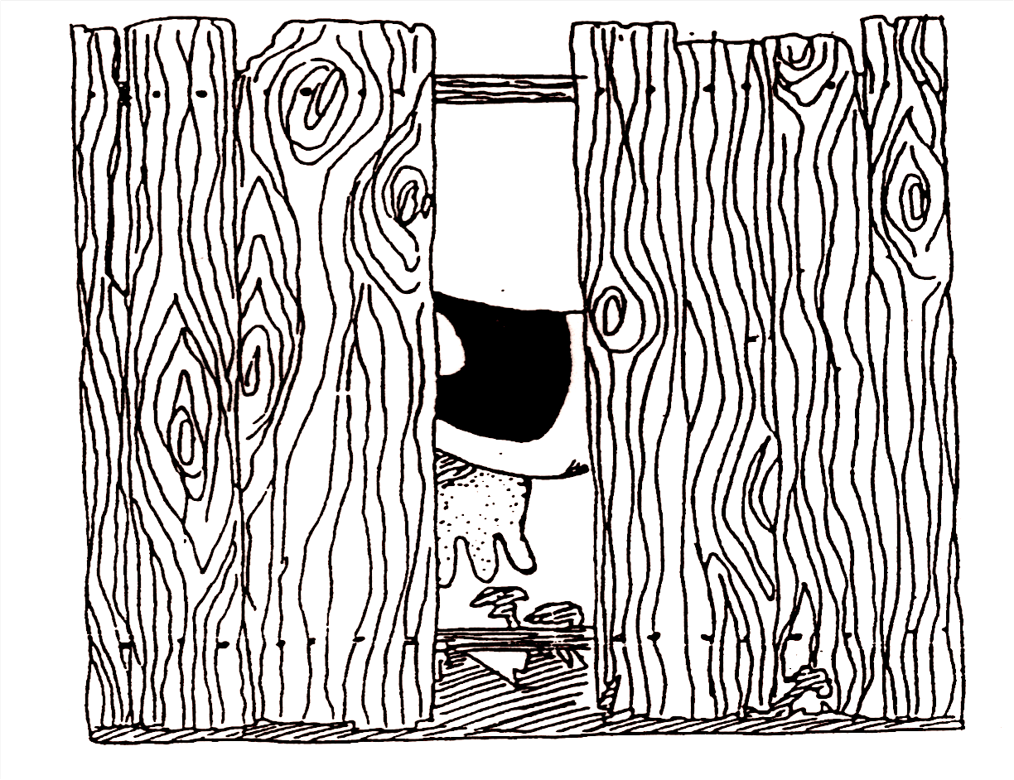
In front of the fence…..

Slide 41
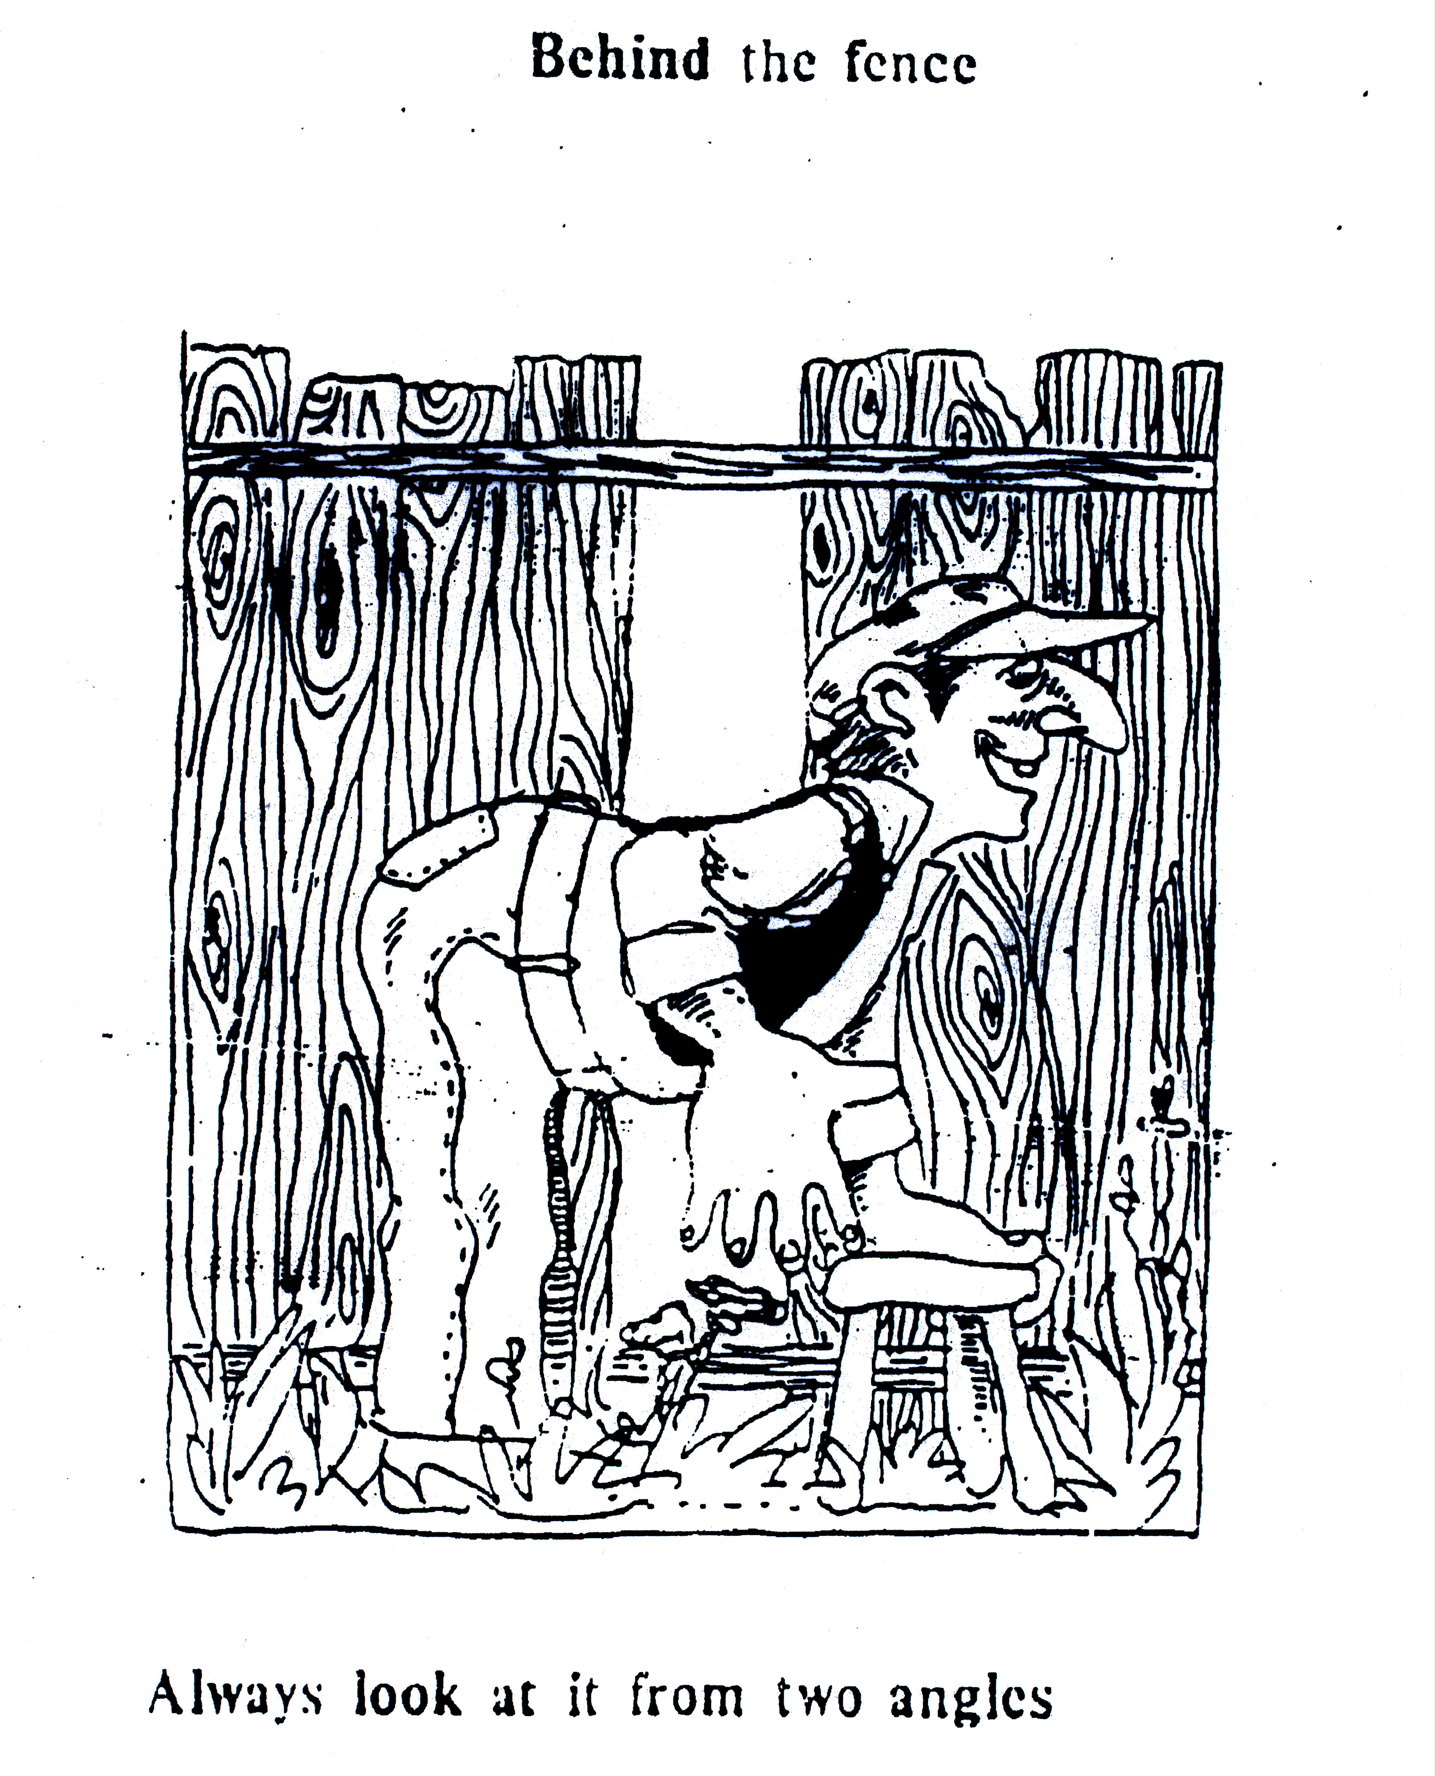
…….behind the fence

Slide 42
“For now we see in a mirror, dimly, but then we will see face to face. Now, I know only in part, then I will know fully, even as I have been fully known.”
I Cor.13:12 (NRSV)

Slide 43
Virtues for Living Together
Humility
Patience
Integrity

Slide 46
Virtues for Living Together
Humility
Patience
Integrity
Mutual respect

Slide 47
"This is my commandment,
that you love one another
as I have loved you"
John 15:12 (NRSV)

Slide 48
Forbearance
To delay a negative reaction to another’s action, inaction or presence; to tolerate or indulge another

Slide 49
I, therefore, the prisoner of the Lord, beg you to lead a life worthy of the calling to which you have been called, with all humility and gentleness, with patience, bearing with one another in love, making every effort to maintain the unity of the Spirit in the bond of peace. There is one body and one Spirit, just as you were called to the one hope of your calling, one faith, one baptism, one God and Father of all, who is above all and through all and in all.
Ephesians 4:1-6 (NRSV)

