Slide 1
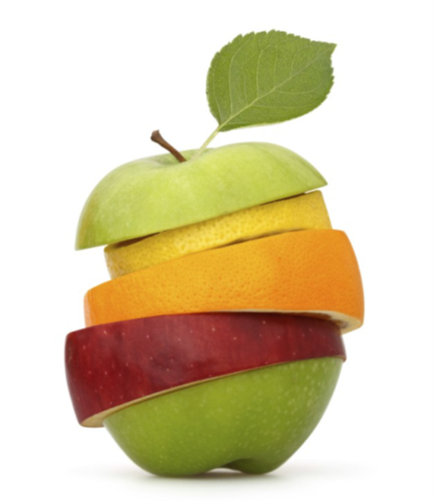
GROWING IN FRUITFULNESS
John 15v.1-17

Slide 2
REMAIN v.3&4 Fruitful congregations place encounter with the Living God at the centre of their life

Slide 3
OFF CENTRE v.3&4
Remaining centred on a living relationship with God v.1

Slide 4
CENTREPIECE
Time spent in the presence of the Living God – praise, prayer, responding to the prompting of His Word

Slide 5
COMMUNITY CENTRE
Together in Sunday Worship – engaging with God; encountering Him afresh; expressing gratitude; exploring His will; experiencing His presence; expecting Him to work

Slide 6
PARTICIPATING IN WORSHIP
Concentrating hearts and minds– expect to meet with God; connect with Him; reflect on what He says

Slide 7
FRUITFULNESS FLOWS FROM THE CENTRE OUTWARDS
‘No branch can bear fruit by itself; it must remain in the vine. Neither can you bear fruit unless you remain in me’ v.4

