Slide 1
GROWING IN FRUITFULNESS
Season Two: Ripening
Toward identifying two areas in which your congregation wants to prioritise growth

Slide 2
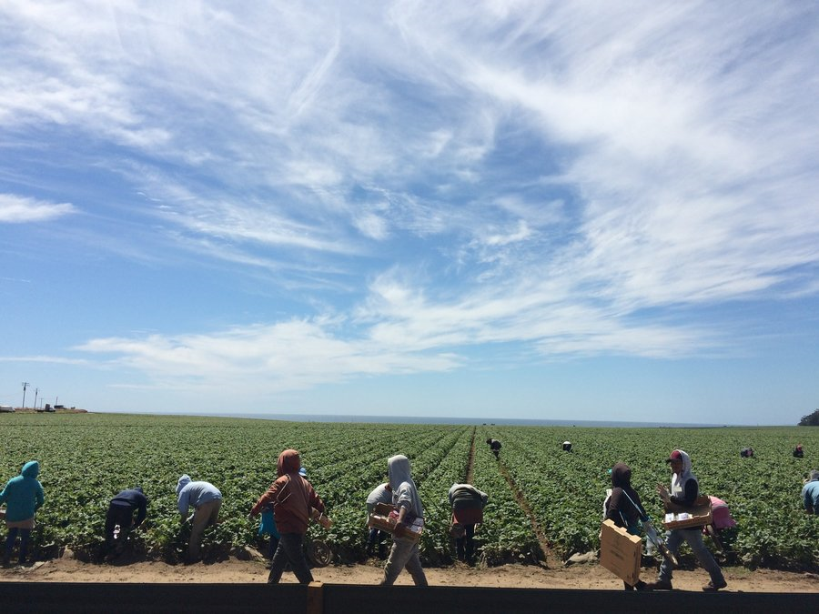
GETTING IT TOGETHER… A SHARED DISCERNING

Slide 3
GROWING IN FRUITFULNESS
Together for Fruitfulness
I. Corinthians 3v.1-9

Slide 4
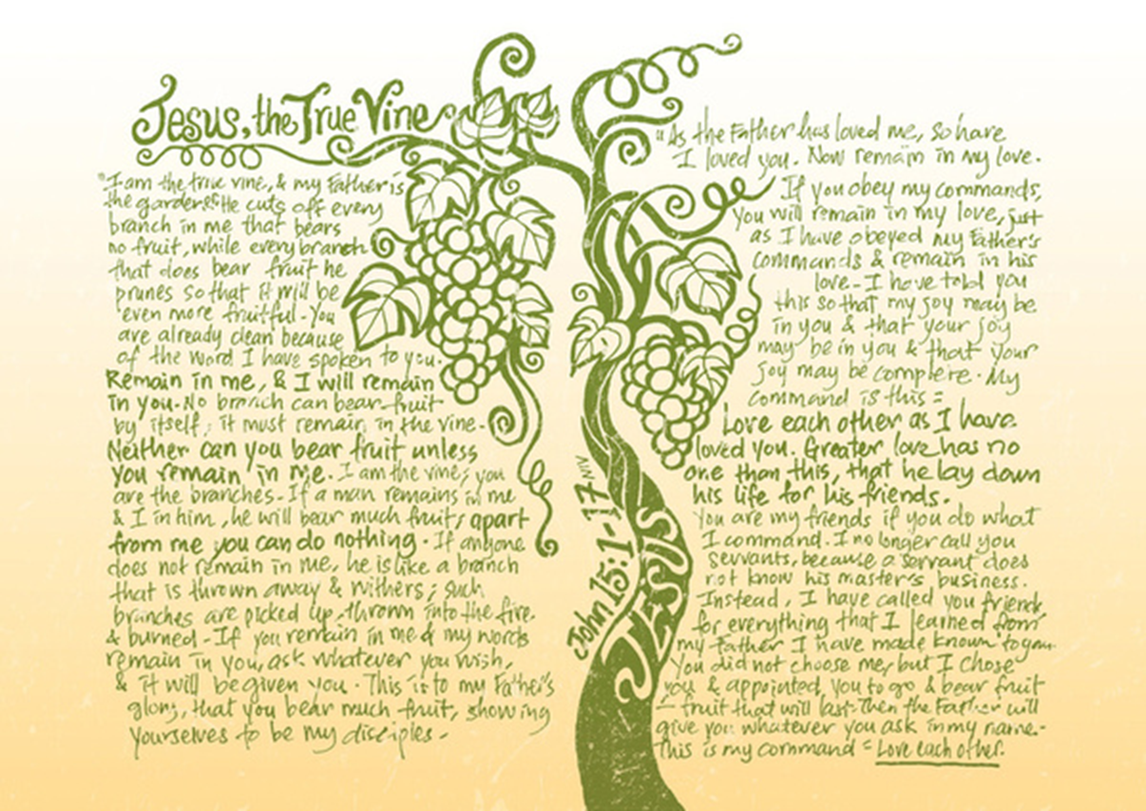
GROWING IN FRUITFULNESS

Slide 5
GROWING IN GOD’S WAYS FOR US: LESSONS FROM THE CONGREGATION OF CORINTH

Slide 6
I. CORINTHIANS 3v.1-9
3 Brothers and sisters, I could not address you as people who live by the Spirit but as people who are still worldly – mere infants in Christ. ² I gave you milk, not solid food, for you were not yet ready for it. Indeed, you are still not ready. ³ You are still worldly. For since there is jealousy and quarrelling among you, are you not worldly? Are you not acting like mere humans? ⁴ For when one says, ‘I follow Paul,’ and another, ‘I follow Apollos,’ are you not mere human beings?

Slide 7
⁵ What, after all, is Apollos? And what is Paul? Only servants, through whom you came to believe – as the Lord has assigned to each his task. ⁶ I planted the seed, Apollos watered it, but God has been making it grow. ⁷ So neither the one who plants nor the one who waters is anything, but only God, who makes things grow. ⁸ The one who plants and the one who waters have one purpose, and they will each be rewarded according to their own labour. ⁹ For we are fellow workers in God’s service; you are God’s field, God’s building.

Slide 8
GROWING TOGETHER IN CONGREGATIONAL LIFE & WITNESS
1. Growing as members of the congregation v.1-4

Slide 9
GROWING TOGETHER IN CONGREGATIONAL LIFE & WITNESS
2. Growing as a congregation in living out God’s purposes for our life & witness v.4-8

Slide 10
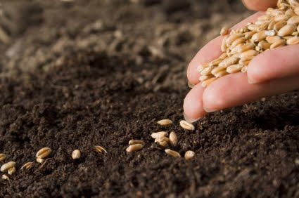
GROWING TOGETHER IN CONGREGATIONAL LIFE & WITNESS
3. Growing in our appreciation of what fruitfulness looks like v.9

Slide 11
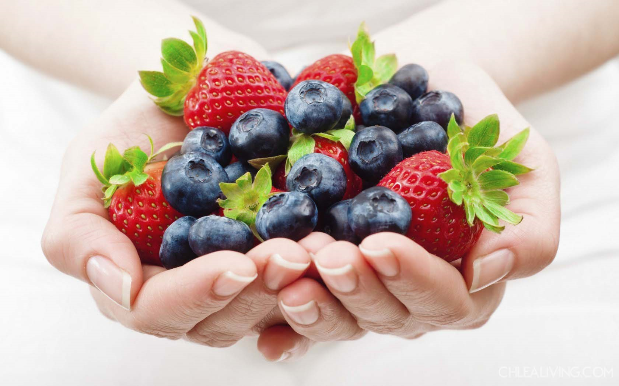
EYES TO SEE WHAT GOD IS GROWING AMONG US
Read & listen to God’s Word as part of your congregation

Slide 12
EYES TO SEE WHAT GOD IS GROWING AMONG US
Ask each other the question, ‘What is God doing among us’?

Slide 13
EYES TO SEE WHAT GOD IS GROWING AMONG US
Find out more about what is happening in things you aren’t part of in congregational life & witness

Slide 14
EYES TO SEE WHAT GOD IS GROWING AMONG US
Be generous and gentle in looking for fruitfulness, it often ripens slowly

Slide 15
EYES TO SEE WHAT GOD IS GROWING AMONG US
Recognise that fruitfulness comes & goes in seasons – expect to have to re-shape and prune

Slide 16
EYES TO SEE WHAT GOD IS GROWING AMONG US
Pray expectantly the God will help us identify our ‘one purpose’ (v.8) for the next season of our congregation’s life & witness

Slide 17
What do you see as the challenge and opportunity of widening the decision making about which two areas of your congregation’s life and witness to prioritise?

Slide 18
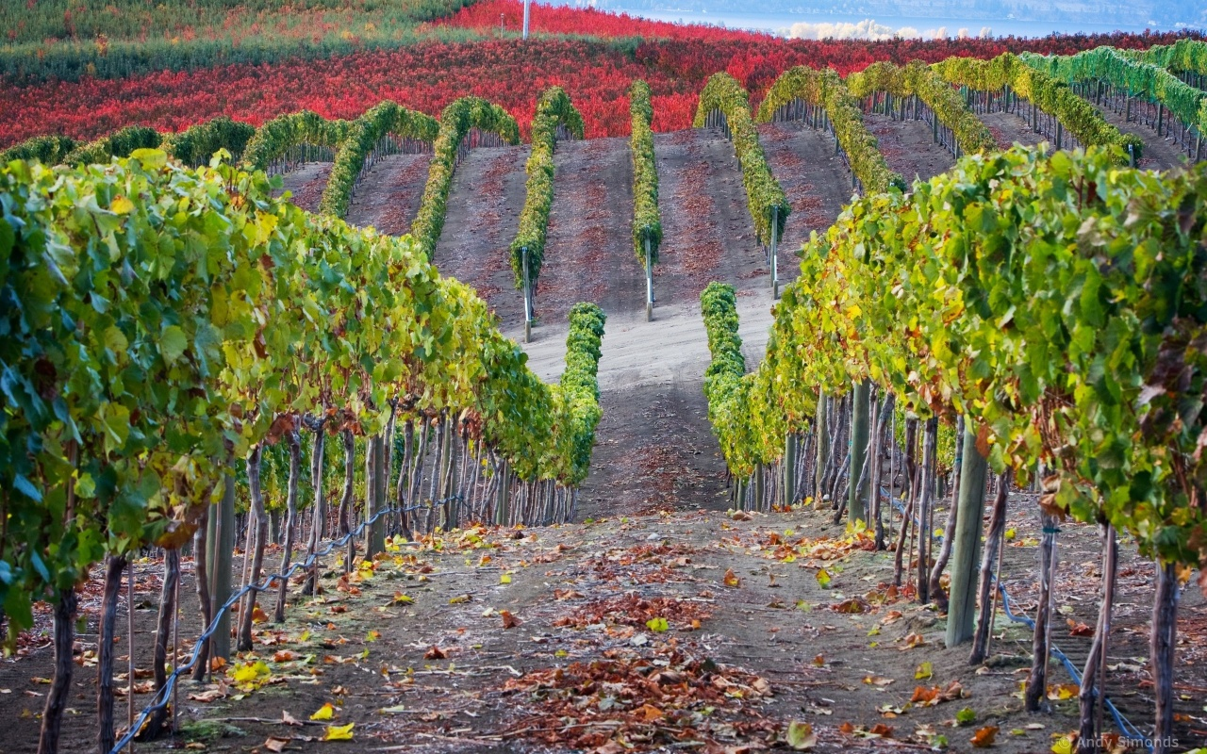
Fruitful Congregation Prayer Based on John 15v.1-17 & I. Corinthians 3v.1-9

Slide 19
Fruitful Congregation Prayer
Lord of the Church, in every time and place,
we thank you that You are the God who makes things grow.
We thank you for signs of your fruitfulness among us as a congregation.
The power of Jesus, the true vine, flowing in us and through us,
is what causes our life and witness as Your people to flourish.

Slide 20
Fruitful Congregation Prayer
All knowing God, who sees our hearts,
We confess that often we have been unfruitful,
not because You have not wanted to grow your Kingdom among us,
but because we have:-
Not listened carefully to Your word and followed it;
Lost our expectation of Your Spirit’s work among us;
Demanded our own preferences, rather than surrendered to Your will for us;
Not pulled together in Your one purpose for us, but pulled apart in jealousy, quarrelling, cliques and factions.

Slide 21
Fruitful Congregation Prayer
Forgiving Father, who tends our congregation’s life and witness,
we thank You that we are already clean because of the word of Your pardoning grace.
Prune us, cutting off what bears no fruit;
Shape us, so that we can be even more fruitful in living out Your purposes for us;
Teach us, showing us through Jesus, Your living Word, what we need to learn;
Enable us to better remain in Him and to know His life flowing in us.

Slide 22
Fruitful Congregation Prayer
Sovereign Lord, who chooses and appoints us to go and bear fruit,
in this season of our congregation’s life and witness,
help us to hear your voice and follow where You call.
We ask for grace not only to look to our own personal agendas, preferences and advantage.
We ask for that spirit of love that lays down all of that in the service of the glory of God and for the good of others.
We ask for clarity to know Your will for our congregation – nothing more, nothing less, nothing else.

Slide 23
Fruitful Congregation Prayer
Only Wise God, generous in giving wisdom without finding fault to those who ask,
as fellow workers in the field that is Your church,
in these often bewildering times of challenge and change,
we seek Your face.
Remaining in You and desiring to be shaped by Your word,
we ask, believing, that You will guide us,
as we now listen to discern Your ways for us.
Make known to us the next steps towards Your growing in us greater fruitfulness for our Father’s glory. Amen

Slide 24
How might you use the Fruitful Congregation Prayer?

Slide 25
Revisiting the journey
Season 1 SEEDING: Introduce God’s vision of fruitfulness to your members
– Web-based, flexible launch resource & material for 6 follow up sessions

Slide 26
Revisiting the journey
Season 2 RIPENING: Identify two areas in which you want to prioritise growth
- Web-based flexible launch resource
- A range of options & tools to choose two areas in which to work for use in Kirk Session, working groups or whole congregation setting

Slide 27
Revisiting the journey
Season 3 HARVESTING: Implement the development of habits and ways of doing things which, under God, work the ground and sow the seed for a local expression of fruitfulness
– Council Signposting to resources, stories and ideas

Slide 28
Revisiting the journey
In every season WATERING: Interceding in prayer
– Fruitful Congregations Prayer Journey (Season 1) www.presbyterianireland.org/Prayer/Prayer-Journey
- Fruitful Congregation Prayer (Season 2)

Slide 29
All resources available at:-
www.presbyterianireland.org/fruitfulcongregations

Slide 30
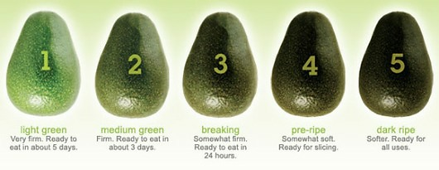
Options for ripening the conversation towards identifying priority areas

Slide 31
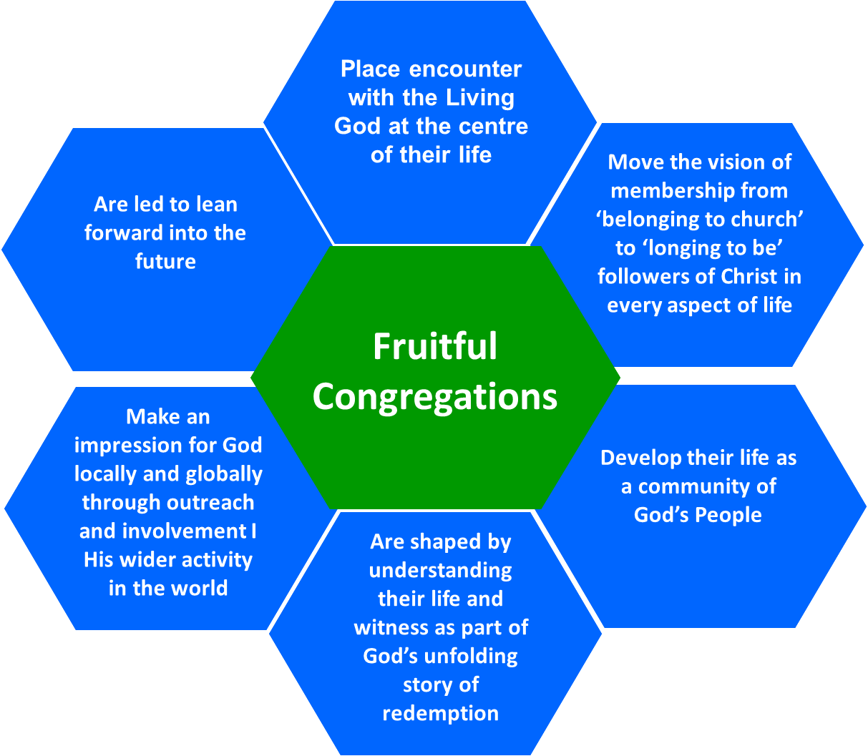
Introducing the fruitful and unfruitful congregation hexagons
Strength to build on
Weakness to address

Slide 32
Towards a vision of a Fruitful Congregation?
What we believe: We plant & water, but only God makes things grow (I. Corinthians 3v.6&7)
Where we are: 21st Century Ireland
Who we are: Irish Presbyterians
What we are learning: Emerging landscape of congregational life & witness across PCI
Ways we approach change: Shared leadership
Workable progress: Focused & gradual efforts

Slide 33
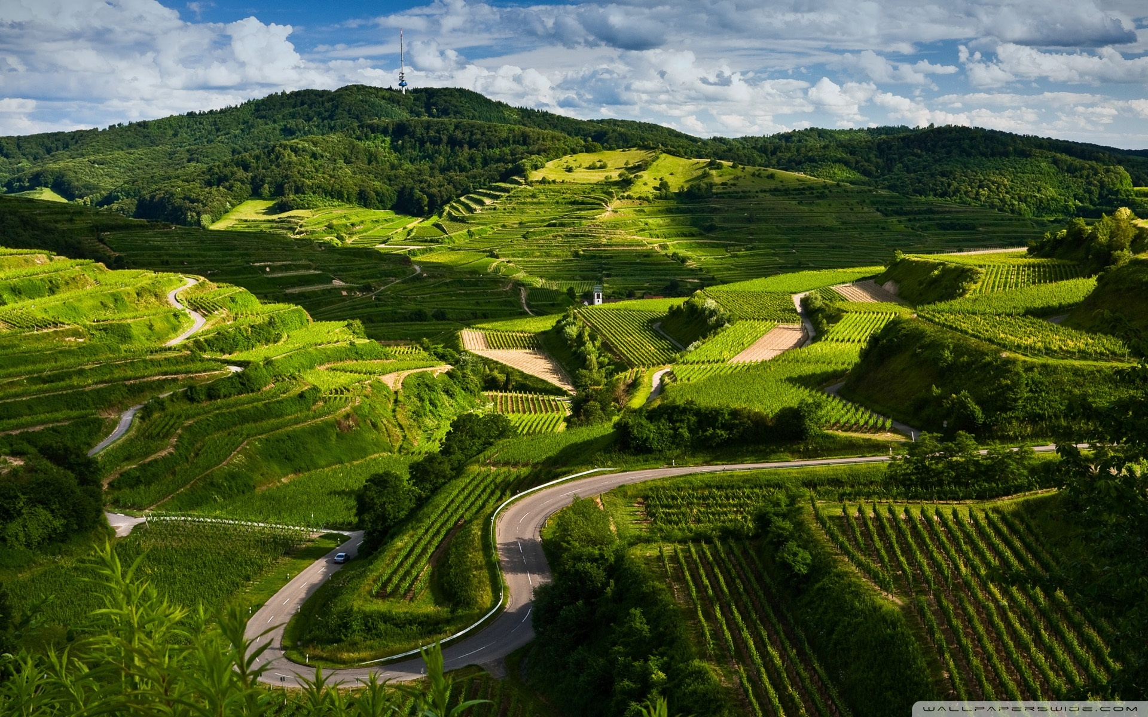
From what we are learning: Emerging landscape of congregational life & witness across PCI

Slide 34
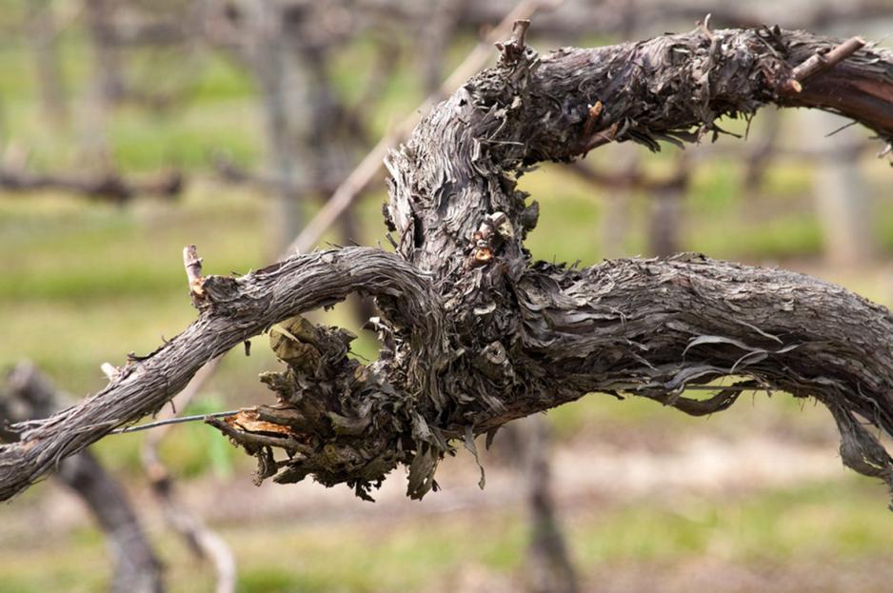
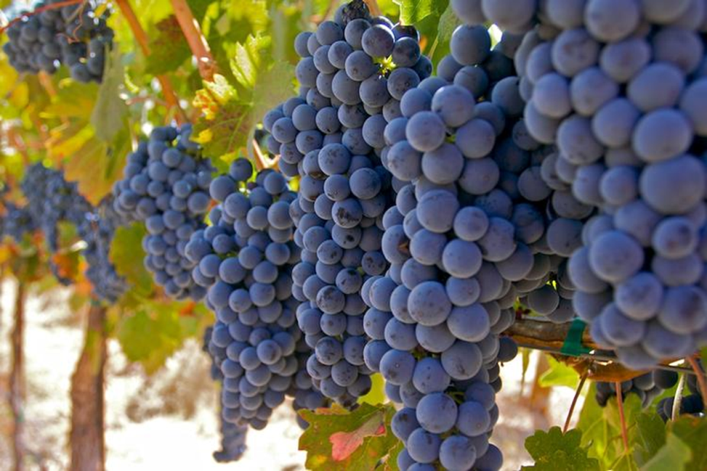
To earthing a vision of fruitfulness locally
Unfruitful
Congregation?
Fruitful Congregation?

Slide 35
‘Going to church’ is just a weekly routine
Leaders are expected to do all they can to maintain everything they can the way it is now
Following Jesus in everyday living is seen as an optional upgrade on church membership
Unfruitful
Congregations
Expectation of involvement locally and globally is that we pay and pray for others to ‘go’ and rely on a ‘they’ll come to us’ mindset
‘Church’ is a place where events and programmes happen, but real relationships are shallow
The understanding of the congregation’s purpose is that it is there to meet the preferences of existing members

Slide 36
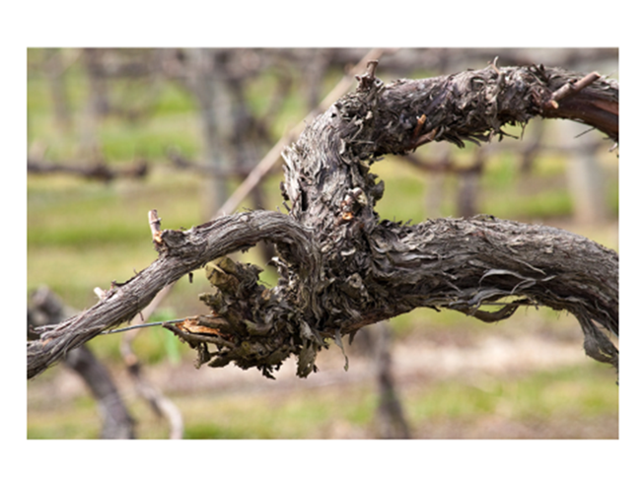
Unfruitful? ‘Might we be a bit like that?’
‘Going to church’ is just a weekly routine – IMAGINE: In worship people come, go, stand, sit, close and open their eyes at the right times, but the general sense is there is not a lot of life
Following Jesus in everyday living is seen as an upgrade on church membership – IMAGINE: For most members there is little connection between their church-going life and their Monday to Saturday worlds

Slide 37
Unfruitful? ‘Might we be a bit like that?’
‘Church’ is a place where events & programmes happen, but real relationships are shallow – IMAGINE: Church life is busy, the doors are always open, but access to the areas behind the doors of our public lives remain tightly shut
The understanding of the congregation’s purpose is that it is there to meet the preferences of existing members – IMAGINE: The big task in church life is to keep every member provided for and content with what is on offer

Slide 38
Unfruitful? ‘Might we be a bit like that?’
Expectation of involvement locally & globally is that we pay and pray for others to ‘go’ & rely on a ‘they’ll come to us’ mind set – IMAGINE: Involvement in overseas mission is arm’s length and formal; Attitude to the local community is, ‘they know where we are if they want us’
Leaders are expected to do all they can, to maintain everything they can, the way it is now – IMAGINE: Leadership meetings revolve around plugging gaps and trying to avoid uncomfortable changes

Slide 39
Recognise our area of greatest unfruitfulness

Slide 40
Place encounter with the Living God at the centre of their life
Are led to lean forward into the future
Move the vision of membership from ‘belonging to church’ to ‘longing to be’ followers of Christ in every aspect of life
Fruitful
Congregations
Make an impression for God locally and globally through outreach and involvement in His wider activity in the world
Develop their life as a community of God’s People
Are shaped by understanding their life and witness as part of God’s unfolding story of redemption

Slide 41
Fruitful? ‘Do we see a bit of that’?
Place encounter with the Living God at the centre of their life – IMAGINE: Members worship and pray with a sense of expectation that God is among them, ready to work in and through their life & witness
Move the vision of membership from ‘belonging to church’ to ‘longing to be’ followers of Christ in every aspect of life – IMAGINE: The way church membership is talked about is that it is expected to equip people of all ages to follow Jesus in all of life’s situations, relationships and circumstances

Slide 42
Fruitful? ‘Do we see a bit of that’?
Develop their life as a community of God’s People – IMAGINE: Time and space is created for members to get to know each other and support one another more deeply
Are shaped by understanding their life & witness as part of God’s unfolding story of redemption – IMAGINE: The congregation has a growing awareness of playing its part right here, right now in what God is doing in Jesus to redeem the world

Slide 43
Fruitful? ‘Do we see a bit of that’?
Make an impression for God locally & globally through outreach & involvement in His wider activity in the world – IMAGINE: What the congregation does makes a difference that can be seen in the mark that it leaves in lives and communities at home and overseas
Are led to lean forward into the future – IMAGINE: Leaders are frequently involved in preparing the congregation for today’s changes and tomorrow’s challenges

Slide 44
Recognise our area of greatest fruitfulness

Slide 45
Season 2 RIPENING: Identifying two areas in which we discern God wants us to prioritise developing growth in the next season of life & witness
Strength to build on
Weakness to address

Slide 46
Fruitful Congregation Prayer Based on John 15v.1-17 & I. Corinthians 3v.1-9

Slide 47
Options for ripening the conversation towards identifying priority areas

Slide 48
What sort of congregation are we?

Slide 49
What are we like?
A congregation:
that likes a structured, scientific, organised, approach
that is confident in verbally expressing itself
that is able to cope with a variety of opinions
that is secure enough to acknowledge weaknesses
that is able to see a big picture emerging
that likes large group discussion, or group discussion, with feedback.

Slide 50
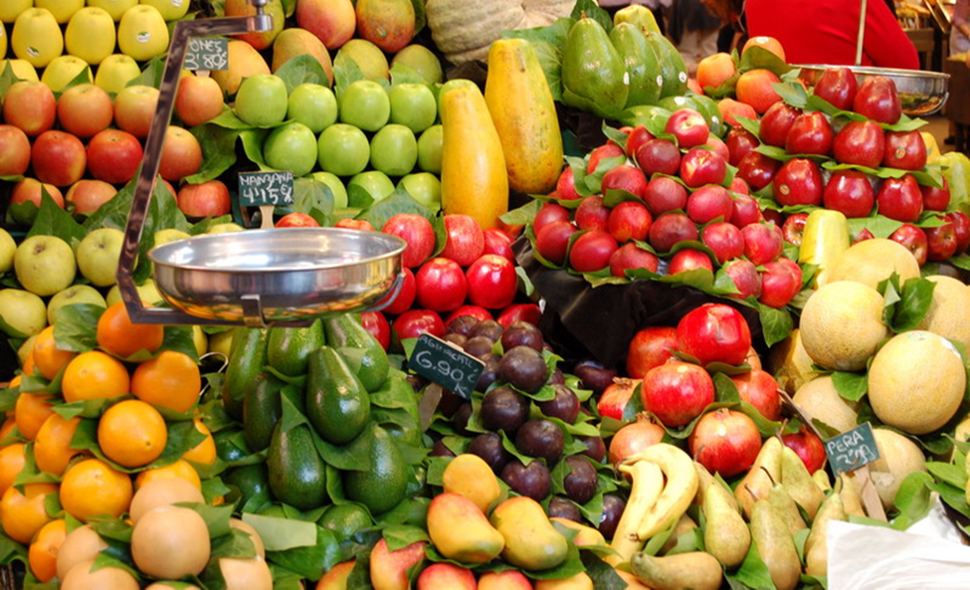
Option 1: Fruit Counter
Give out the six hexagons from the Fruitful Congregations diagram to each person.
Invite them to choose one which represents what they discern is an existing strength of the congregation to build on and display it on a wall.
Arrange the hexagons chosen, like with like.
Repeat with six hexagons from the Unfruitful Congregations
Discuss in one large group or smaller groups

Slide 51
Yes… No… Maybe a bit of this…?

Slide 52
What are we like?
A congregation:
that is less confident about verbally expressing itself
that will find a variety of opinions relationally awkward
that will not easily cope with being confronted with the Unfruitful Congregation analysis
that is not used to pulling together overall strategy
that could work comfortably with visuals and light facilitation.

Slide 53
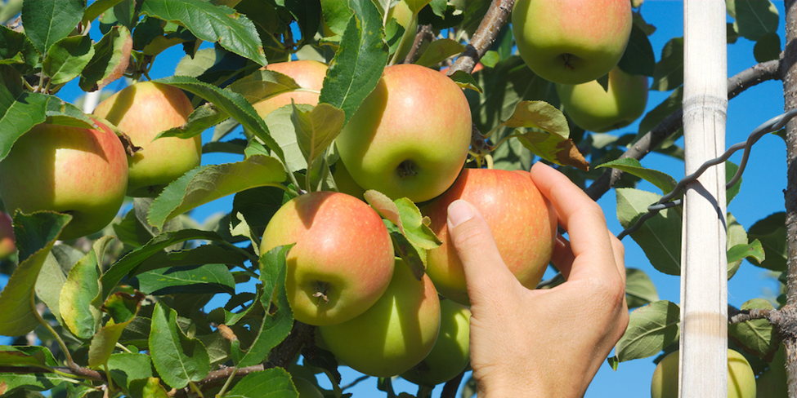
Option 2: Hanging Fruit
Display the six hexagons from the Fruitful Congregations diagram on the wall.
Using post-its, participants write the names of existing organisations or activities which contribute to the congregation’s fruitfulness and stick them under each hexagon.
Note were there are areas of significant activity and growth, gaps in activity and growth and overlaps in the arrangement of activities.
Using post-its, invite participants to identify an area of strength to build on and an area of weakness to address
Using post-its participants write ideas for coordinating existing work and filling gaps that have emerged

Slide 54
Yes… No… Maybe a bit of this…?

Slide 55
What are we like?
A congregation:
that might not be able to gather people together for a larger meeting
that is less confident about expressing itself
that has a lot of disjointed organisations and activities
that will not easily cope with the Unfruitful Congregation analysis
that is not used to pulling together overall strategy
that relies on a smaller group to set direction
that could gather, or visit, organisation leaders and capture the stories they share of what God is doing.

Slide 56
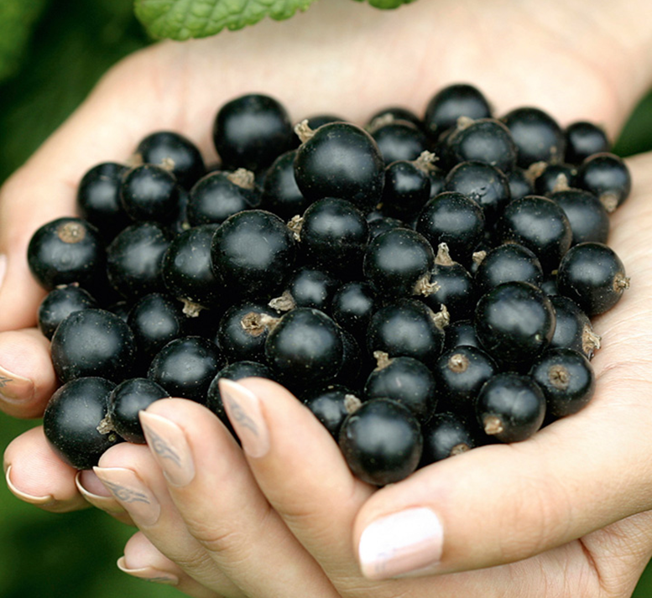
Option 3: Soft Fruit
Depends on a group to guide the journey
Have a ‘Fruitful Congregation Night’ in which organisations and activities of your congregation make a 10 minute presentation covering:-
the particular area(s) of the Fruitful Congregation diagram to which they are aiming to contribute
stories of fruitfulness and unfruitfulness
Have a ‘Fruitful Congregation’ team visit each organisational leadership and conduct the same exercise, feeding back the general picture.
Guiding Group receive feedback, spots patterns, decides next steps.

Slide 57
Yes… No… Maybe a bit of this…?

Slide 58
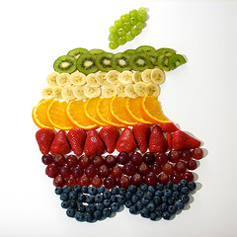
Towards the Tangible Fruit of Outcomes
1. Making sense of the conversation feedback – short summary, small steps
2. Council contact for signposting stories, resources or ideas
3. Communicate widely with the congregation

Slide 59
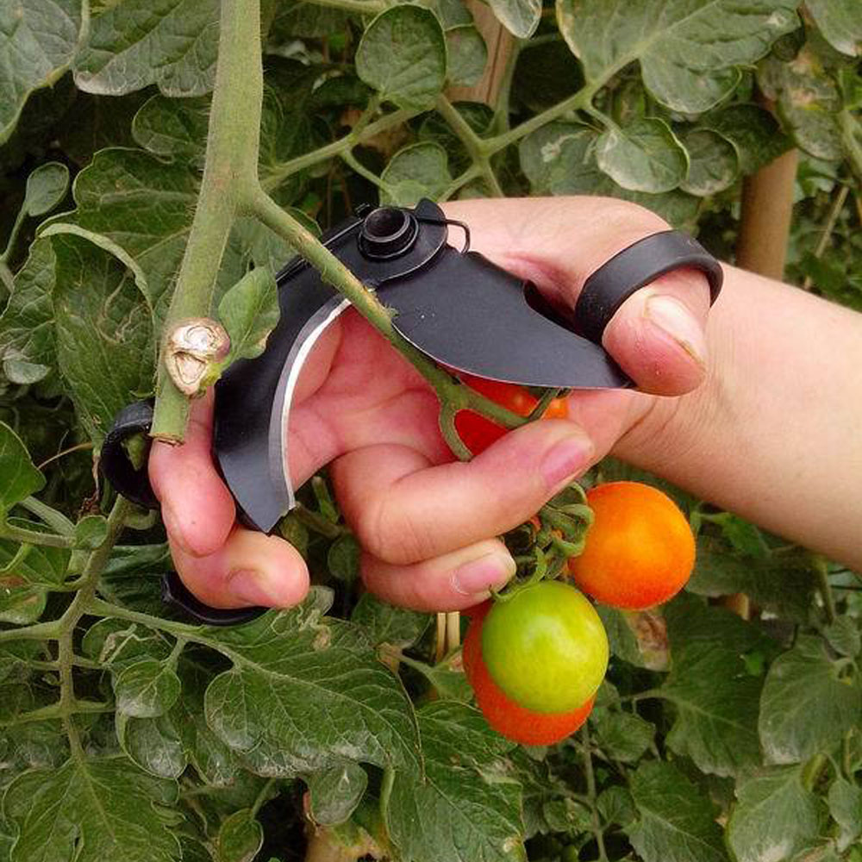
Season 3 HARVESTING: Implement the development of habits and ways of doing things which, under God, work the ground and sow the seed for a local expression of fruitfulness
4. Organise for implementation of new habits & ways of doing things
5. Date and means of evaluation

Slide 60
Questions and Prayer

