Slide 1
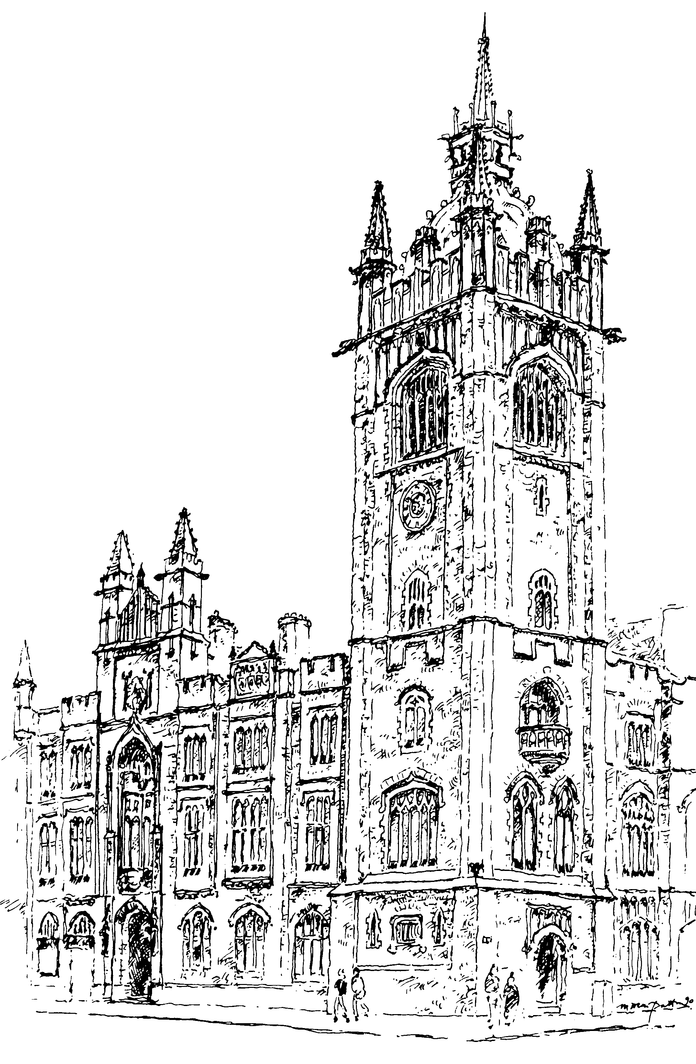

Monday 3 – Friday 7 June 2019
Notes:
This year's General Assembly will run from Monday 3 June to Friday 7 June.
This year again the General Assembly will continue its meeting through to the Friday afternoon, providing additional time for debate and discussion across the week.

Slide 2
Opening of
General Assembly
Monday 3 June 7pm
Installation of the new Moderator
Rev William Henry
Notes:
Opening Night, on Monday 3 June, will begin at 7pm in Assembly Buildings, Belfast, when Presbyterians from across Ireland will hear outgoing Moderator, Dr. Charles McMullen share his thoughts on his year in office. Having been formally elected and installed as the 179th Moderator, Rev William Henry will then give his opening address.
All are welcome – no tickets required

Slide 3
Wednesday Night Celebration
Wednesday 5 June 7.45pm
‘Enjoying God’
Speaker: Rev Glen Scrivener
Notes:
Your attendance is encouraged for the Wednesday Night Celebration at 7.45pm. Entitled ‘Enjoying God’, the keynote speaker will be Rev Glen Scrivener. Glen is
All are welcome – no tickets required

Slide 4


Notes:
Youth Night 2019 will be held Saturday, 8 June at 7.30pm
This is an evening especially designed for the teenagers and young adults of our Church.
This years theme is Called: Hearing God’s Voice – Bearing God’s Name
Tickets are £5 (£7 to include the unplugged event) available online or from the Congregational Life and Witness Office at Assembly Buildings,

Slide 5
Watch live streaming www.presbyterianireland.org
Follow live updates on Twitter
@pciassembly
#pciga19
Notes:
As before live streaming throughout the week will be available on the PCI main website.
And you can keep up-to-date with business on twitter by following @pciassembly

Slide 6
Monday 3 – Friday 7 June 2019
Notes:
Throughout all the weeks business and work your prayers are encouraged.
Please pray for the 2019 General Assembly.
That God will be glorified through all the business proceedings, debates, discussions and fellowship that will take place as our Presbyterian family meets together.
• That the Assembly will be a good witness to those outside our Church. That invited delegates, media personnel and visitors would see a Church that is united, gracious and loving in all its business, discussions and debates.
• Pray that the Moderator’s theme of ‘Enjoying God’ would resonate to His glory: with individuals in their walk with God; in congregations, bringing increasing vibrancy to worship; throughout Ireland, whose people need the fullness of life that only Christ can give.
• That each element of worship – the opening night, the communion service, the Wednesday and Thursday lunchtime services, and the Wednesday night celebration – will honour God and build His people up.
• That as reports are presented and debated, and resolutions passed, all will seek the guidance of the Holy Spirit.
• For the Moderator, Rt Rev Dr William Henry, as he chairs the Assembly.
• For Rev Andrew Thompson and all others involved in the practical preparations for the Assembly such as technology, catering, stewarding and so on.
• For the Clerk, Rev Trevor Gribben, the Deputy Clerk, Rev Jim Stothers, and all other staff members in Assembly Buildings who will be working for the Assembly – with administration, press office or communication duties.

