Slide 1
GROWING IN FRUITFULNESS
John 15v.1-17
I. Corinthians 3v.1-9

Slide 2
Growing the fruitfulness conversation in your congregation
Season 1 SEEDING: Introducing God’s vision of fruitfulness to your members – John 15 focus
Season 2 RIPENING: Identifying two areas in which we want to prioritise growth in fruitfulness in this next season of congregational life & witness – I. Corinthians 3v.1-9

Slide 3
Towards a vision of a Fruitful PCI Congregation?
What we believe: We plant & water, but only God makes things grow (I. Corinthians 3v.6&7)
Where we are: 21st Century Ireland
Who we are: Irish Presbyterians
What we are learning: Emerging landscape of congregational life & witness across PCI
Ways we approach change: Shared leadership
Workable progress: Focused & gradual efforts

Slide 4
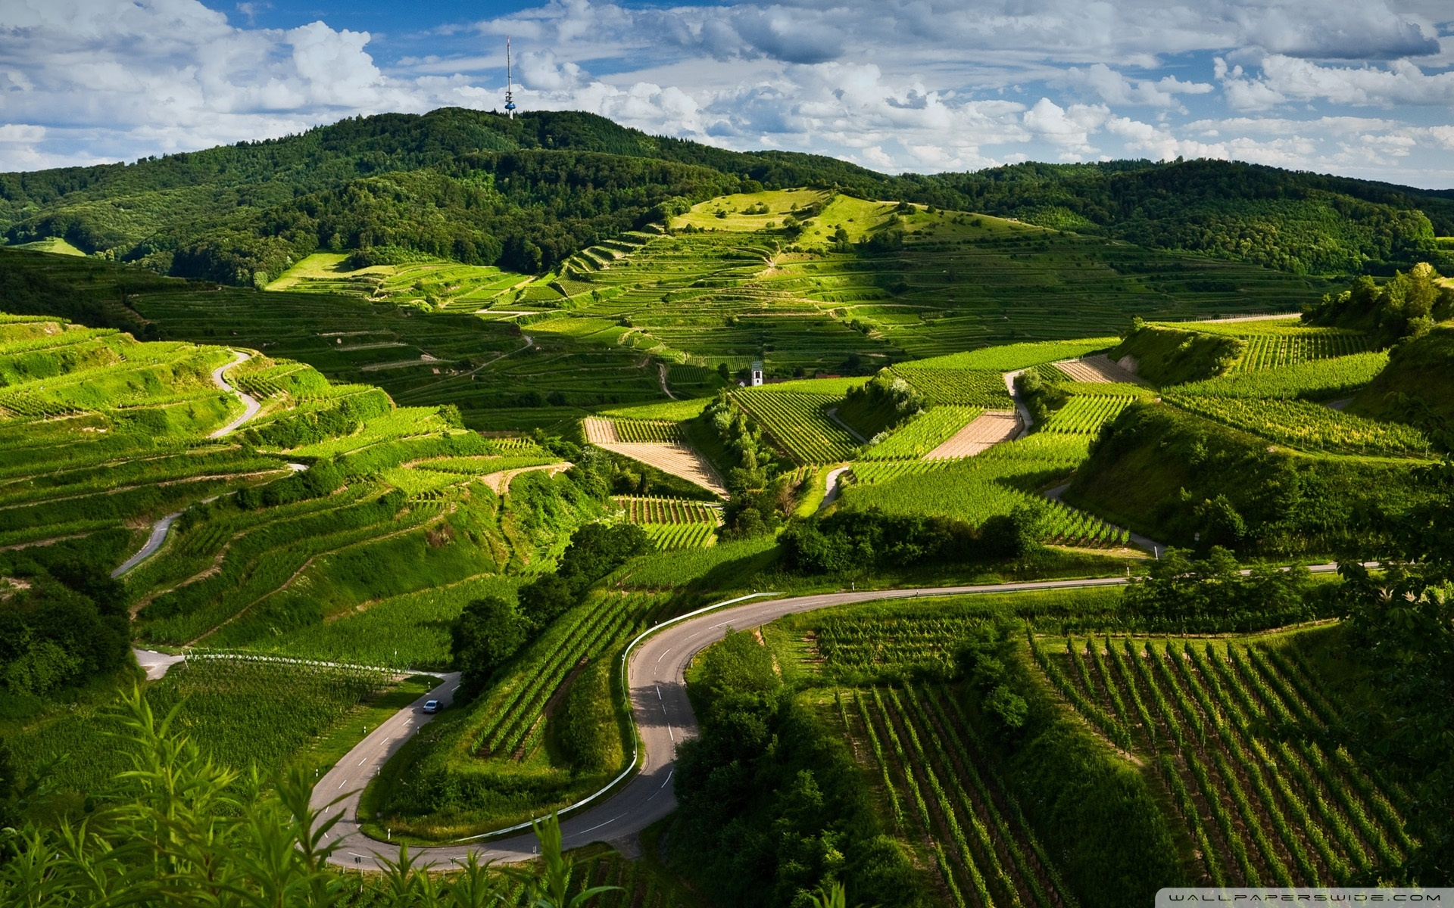
From what we are learning: Emerging landscape of congregational life & witness across PCI

Slide 5
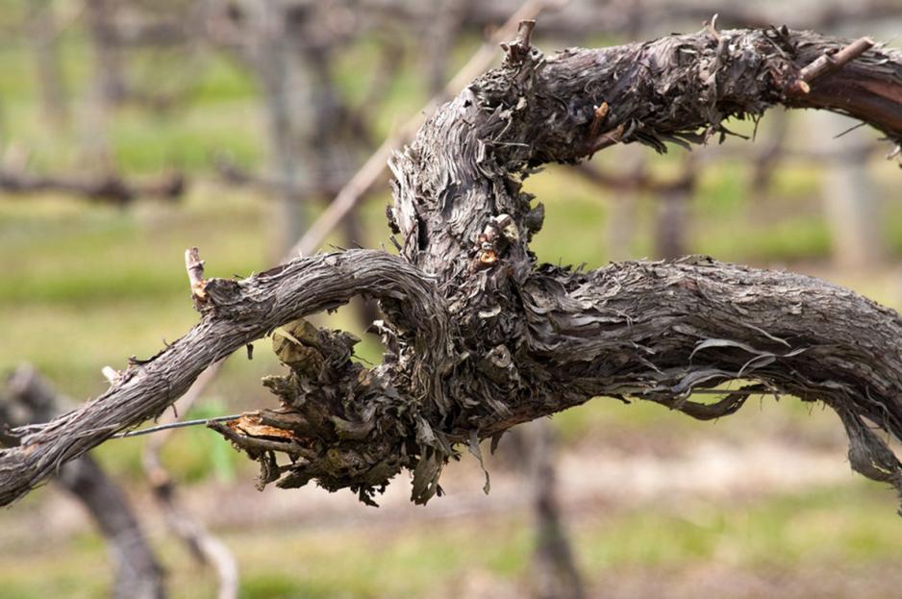
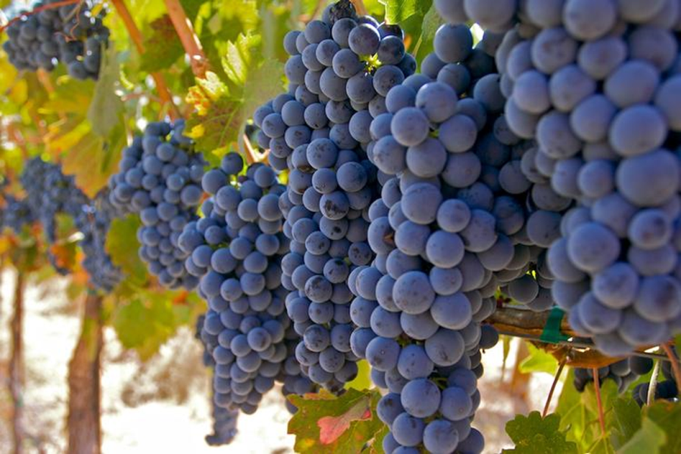
To earthing a vision of fruitfulness locally
Unfruitful
Congregation?
Fruitful Congregation?

Slide 6
‘Going to church’ is just a weekly routine
Leaders are expected to do all they can to maintain everything they can the way it is now
Following Jesus in everyday living is seen as an optional upgrade on church membership
Unfruitful
Congregations
Expectation of involvement locally and globally is that we pay and pray for others to ‘go’ and rely on a ‘they’ll come to us’ mindset
‘Church’ is a place where events and programmes happen, but real relationships are shallow
The understanding of the congregation’s purpose is that it is there to meet the preferences of existing members

Slide 7
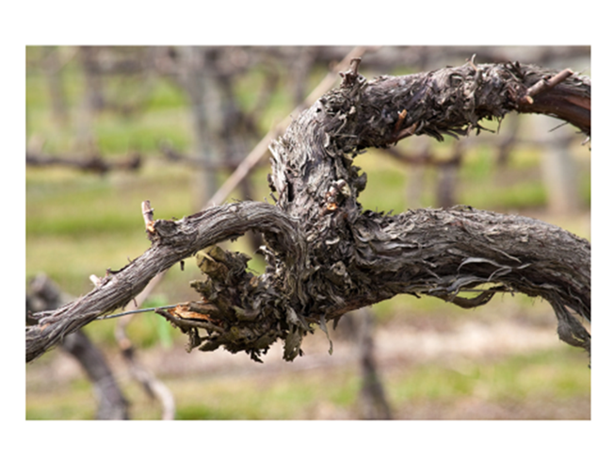
Unfruitful? ‘Might we be a bit like that?’
‘Going to church’ is just a weekly routine – IMAGINE: In worship people come, go, stand, sit, close and open their eyes at the right times, but the general sense is there is not a lot of life
Following Jesus in everyday living is seen as an upgrade on church membership – IMAGINE: For most members there is little connection between their church-going life and their Monday to Saturday worlds

Slide 8
Unfruitful? ‘Might we be a bit like that?’
‘Church’ is a place where events & programmes happen, but real relationships are shallow – IMAGINE: Church life is busy, the doors are always open, but access to the areas behind the doors of our public lives remain tightly shut
The understanding of the congregation’s purpose is that it is there to meet the preferences of existing members – IMAGINE: The big task in church life is to keep every member provided for and content with what is on offer

Slide 9
Unfruitful? ‘Might we be a bit like that?’
Expectation of involvement locally & globally is that we pay and pray for others to ‘go’ & rely on a ‘they’ll come to us’ mind set – IMAGINE: Involvement in overseas mission is arm’s length and formal; Attitude to the local community is, ‘they know where we are if they want us’
Leaders are expected to do all they can, to maintain everything they can, the way it is now – IMAGINE: Leadership meetings revolve around plugging gaps and trying to avoid uncomfortable changes

Slide 10
Recognise our area of greatest unfruitfulness

Slide 11
Place encounter with the Living God at the centre of their life
Are led to lean forward into the future
Move the vision of membership from ‘belonging to church’ to ‘longing to be’ followers of Christ in every aspect of life
Fruitful
Congregations
Make an impression for God locally and globally through outreach and involvement in His wider activity in the world
Develop their life as a community of God’s People
Are shaped by understanding their life and witness as part of God’s unfolding story of redemption

Slide 12
Fruitful? ‘Do we see a bit of that’?
Place encounter with the Living God at the centre of their life – IMAGINE: Members worship and pray with a sense of expectation that God is among them, ready to work in and through their life & witness
Move the vision of membership from ‘belonging to church’ to ‘longing to be’ followers of Christ in every aspect of life – IMAGINE: The way church membership is talked about is that it is expected to equip people of all ages to follow Jesus in all of life’s situations, relationships and circumstances

Slide 13
Fruitful? ‘Do we see a bit of that’?
Develop their life as a community of God’s People – IMAGINE: Time and space is created for members to get to know each other and support one another more deeply
Are shaped by understanding their life & witness as part of God’s unfolding story of redemption – IMAGINE: The congregation has a growing awareness of playing its part right here, right now in what God is doing in Jesus to redeem the world

Slide 14
Fruitful? ‘Do we see a bit of that’?
Make an impression for God locally & globally through outreach & involvement in His wider activity in the world – IMAGINE: What the congregation does makes a difference that can be seen in the mark that it leaves in lives and communities at home and overseas
Are led to lean forward into the future – IMAGINE: Leaders are frequently involved in preparing the congregation for today’s changes and tomorrow’s challenges

Slide 15
Recognise our area of greatest fruitfulness

Slide 16
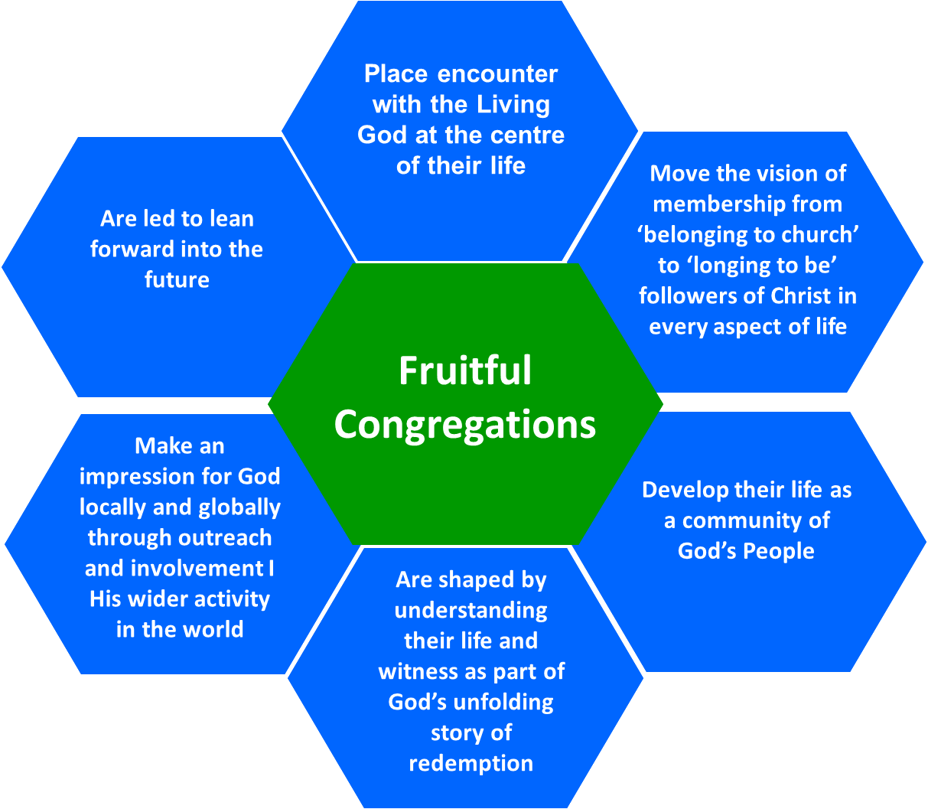
Season 2 RIPENING: Identifying two areas in which we discern God wants us to prioritise developing growth in the next season of life & witness
Strength to build on
Weakness to address

Slide 17
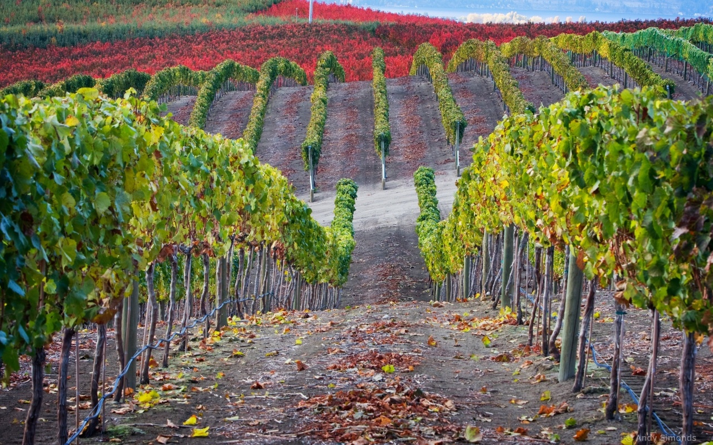
Fruitful Congregation Prayer Based on John 15v.1-17 & I. Corinthians 3v.1-9

Slide 18
Fruitful Congregation Prayer
Lord of the Church, in every time and place,
we thank you that You are the God who makes things grow.
We thank you for signs of your fruitfulness among us as a congregation.
The power of Jesus, the true vine, flowing in us and through us,
is what causes our life and witness as Your people to flourish.

Slide 19
Fruitful Congregation Prayer
All knowing God, who sees our hearts,
We confess that often we have been unfruitful,
not because You have not wanted to grow your Kingdom among us,
but because we have:-
Not listened carefully to Your word and followed it;
Lost our expectation of Your Spirit’s work among us;
Demanded our own preferences, rather than surrendered to Your will for us;
Not pulled together in Your one purpose for us, but pulled apart in jealousy, quarrelling, cliques and factions.

Slide 20
Fruitful Congregation Prayer
Forgiving Father, who tends our congregation’s life and witness,
we thank You that we are already clean because of the word of Your pardoning grace.
Prune us, cutting off what bears no fruit;
Shape us, so that we can be even more fruitful in living out Your purposes for us;
Teach us, showing us through Jesus, Your living Word, what we need to learn;
Enable us to better remain in Him and to know His life flowing in us.

Slide 21
Fruitful Congregation Prayer
Sovereign Lord, who chooses and appoints us to go and bear fruit,
in this season of our congregation’s life and witness,
help us to hear your voice and follow where You call.
We ask for grace not only to look to our own personal agendas, preferences and advantage.
We ask for that spirit of love that lays down all of that in the service of the glory of God and for the good of others.
We ask for clarity to know Your will for our congregation – nothing more, nothing less, nothing else.

Slide 22
Fruitful Congregation Prayer
Only Wise God, generous in giving wisdom without finding fault to those who ask,
as fellow workers in the field that is Your church,
in these often bewildering times of challenge and change,
we seek Your face.
Remaining in You and desiring to be shaped by Your word,
we ask, believing, that You will guide us,
as we now listen to discern Your ways for us.
Make known to us the next steps towards Your growing in us greater fruitfulness for our Father’s glory. Amen

