Slide 1
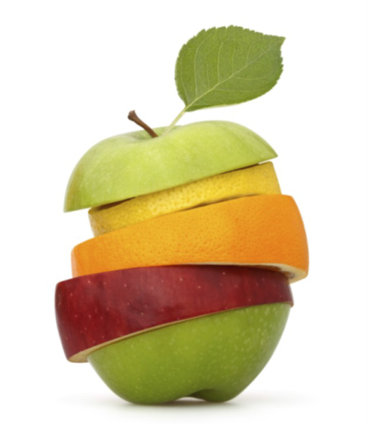
GROWING IN FRUITFULNESS
John 15v.1-17

Slide 2
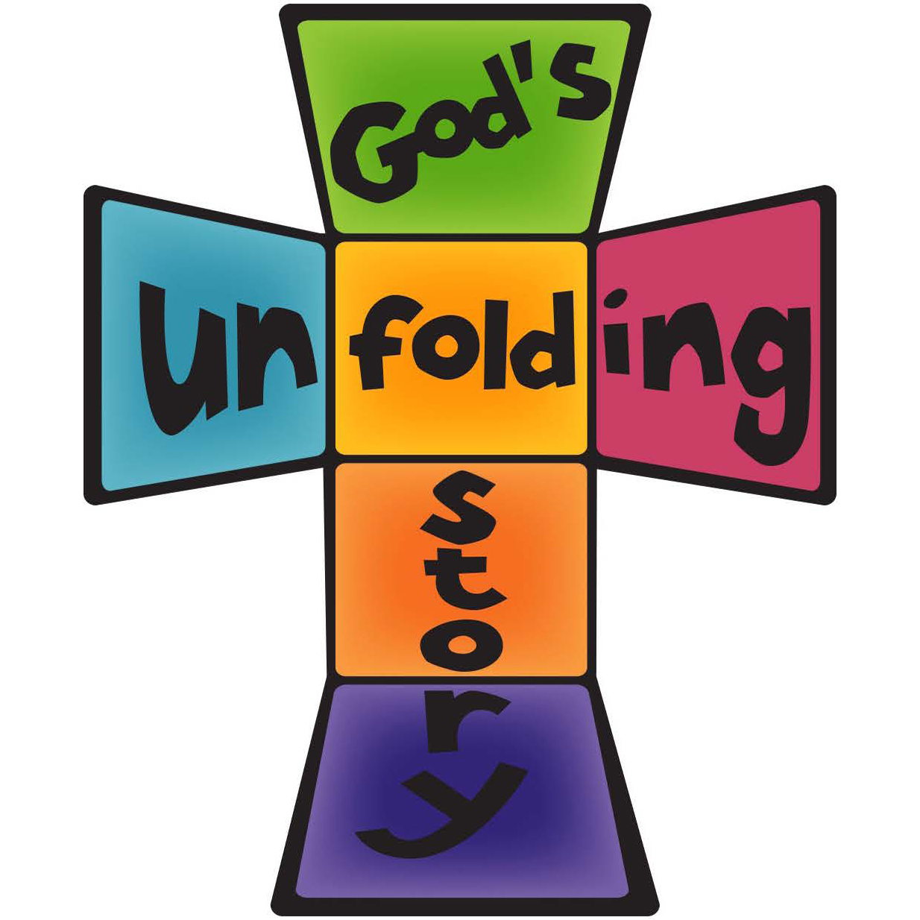
LEARN v.15 Fruitful congregations are shaped by understanding their life & witness as part of God’s unfolding story of redemption

Slide 3
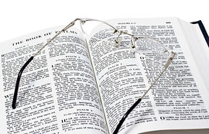
LIFE STORY
The Bible – a story about our lives, interpreted by God & scripted by Him
Life is good – it’s how God made it
Life is broken – by our turning away from God
Life can be different – through Jesus
Life has hope – God is remaking the world

Slide 4
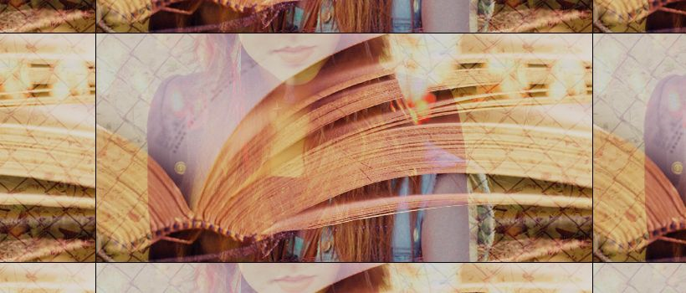
LEARNED STORY v.15
God invites His Church to enter, participate in & contribute to this unfolding story as we learn it from Jesus

Slide 5
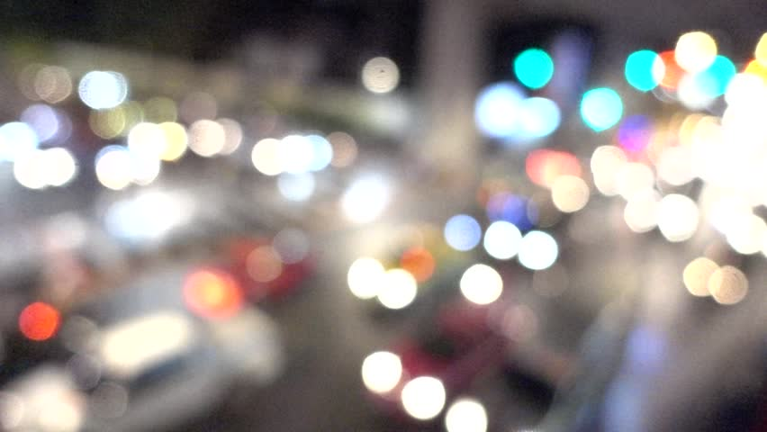
LIVED STORY
When life is good – we thank God
When life is broken – our faith helps make sense of that & we show God’s tenderness
Life can be different – we pursue & promote that possibility
Life has hope – we look forward & point to a brighter tomorrow

Slide 6
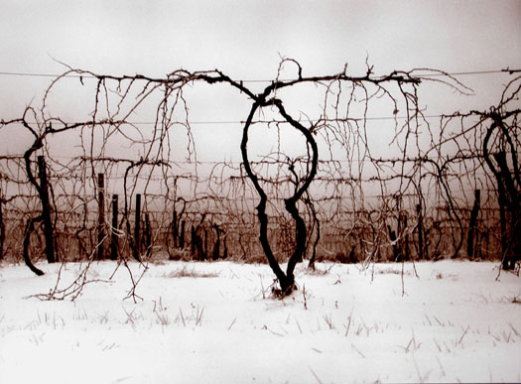
FRUITFULNESS COMES FROM KNOWING & LIVING THE STORY BARRENESS RESULTS FROM LEAVING GOD’S SCRIPT

