Slide 1
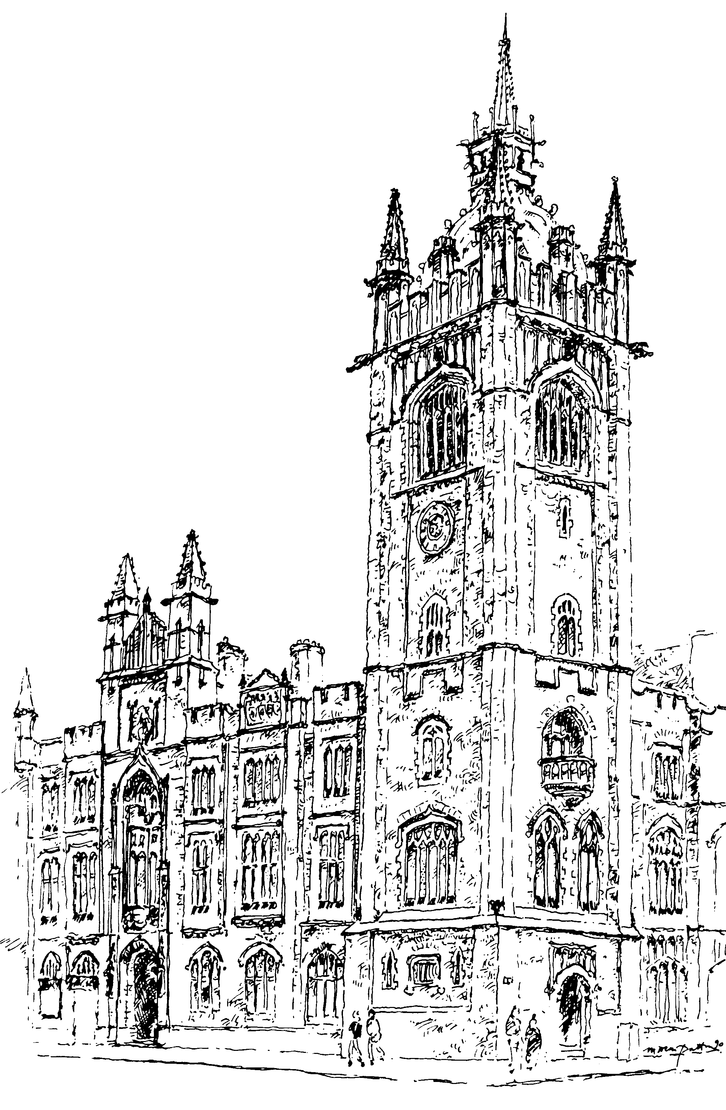

Monday 5 – Friday 9 June 2017
Notes:
This year's General Assembly will run from Monday, 5th June to Friday, 9th June.
This year again the General Assembly will continue its meeting through to the Friday afternoon, providing additional time for debate and discussion across the week.

Slide 2
Opening of
General Assembly
Monday 5 June 7pm
Installation of the new Moderator
Rev Noble McNeely
Notes:
Opening Night, on Monday, 5th June, will begin at 7pm in Assembly Buildings, Belfast, when Presbyterians from across Ireland will hear current Moderator, Dr. Frank Sellar, share his thoughts on his year in office. Having been formally elected and installed as the 177th Moderator, Rev. Noble McNeely will then give his opening address.
All are welcome – no tickets required

Slide 3
Wednesday Night Celebration
Wednesday 7 June 7.45pm
‘Everyday Disciples’
Speaker: Vaughan Roberts
Notes:
Your attendance is encouraged for the Wednesday Night Celebration at 7.45pm. Entitled ‘Everyday Disciples’, the keynote speaker will be Vaughan Roberts, Rector of St. Ebbe's Church, Oxford and Director of the Proclamation Trust
All are welcome – no tickets required

Slide 4

Saturday
10 June 7.30pm
Speaker: Mel Lacey, Oakhill College, London
Music: Rebecca & the Youth Night Band
Notes:
Youth Night 2017 will be held Saturday, 10th June at 7.30pm
This is an evening especially designed for the teenagers and young adults of our Church.
This years theme is (UN) Faithful - A faithful God and His unfaithful people, lessons from Hosea
Come along and hear as this theme is explored, and discover how we can learn from Hosea's experience.
Tickets are £4 available online or from the Congregational Life and Witness Office at Assembly Buildings,

Slide 5
Watch live streaming www.presbyterianireland.org
Follow live updates on Twitter
@pciassembly
#pciga17
Notes:
As before live streaming throughout the week will be available on the PCI main website.
And you can keep up-to-date with business on twitter by following @pciassembly

Slide 6
Monday 5 – Friday 9 June 2017
Notes:
Throughout all the weeks business and work your prayers are encouraged.
Please pray for the 2017 General Assembly.
• That God will be glorified through all the business proceedings, debates, discussions and fellowship that will take place as our Presbyterian family meets together.
• That the Assembly will be a good witness to those outside our Church. That invited delegates, media personnel and visitors would see a Church that is united, gracious and loving in all its business, discussions and debates.
• •That each element of worship – the opening night, the communion service, the Wednesday and Thursday lunchtime services, and the Wednesday night celebration – will honour God and build His people up.
• That as reports are presented and debated, and resolutions passed, all will seek the guidance of the Holy Spirit.
• For the Moderator, Rt. Rev. Dr. Noble McNeely, as he chairs the Assembly.
• For Rev. Andrew Thompson, Mr. Harry Orr and all others involved in the practical preparations for the Assembly such as technology, catering, stewarding and so on.
• For the Clerk, Rev. Trevor Gribben, the Deputy Clerk, Rev. Jim Stothers, and all others staff members in Assembly Buildings who will be working for the Assembly – with administration, press office or communication duties.

