Slide 1
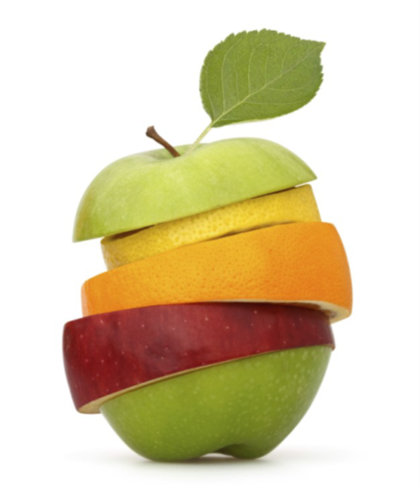
GROWING IN FRUITFULNESS
John 15v.1-17

Slide 2
A VISION OF FRUITFULNESS IN CHALLENGING TIMES FOR THE CHURCH
More than merely faithfulness to the way we have always done things in a changing world;
Often less than success in the eyes of a superficial world;
But always the growth of His Kingdom that is not of this world.

Slide 3
GROWING IN FRUITFULNESS
Picture – Church: It’s a field, not a factory v.1

Slide 4
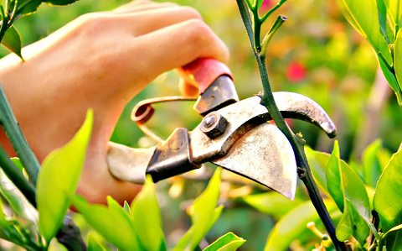
GROWING IN FRUITFULNESS
Pain – Growth: It involves pruning v.2

Slide 5
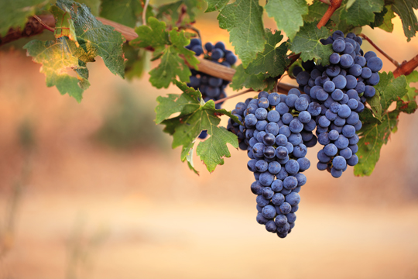
GROWING IN FRUITFULNESS
Promise – Expectation: Look for the fruit v.5

Slide 6
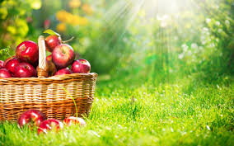
GROWING IN FRUITFULNESS
Prayer – Ask: Fruit is given from above v.7

Slide 7
GROWING IN FRUITFULNESS
Purpose – Him: It’s not about us v.8

Slide 8
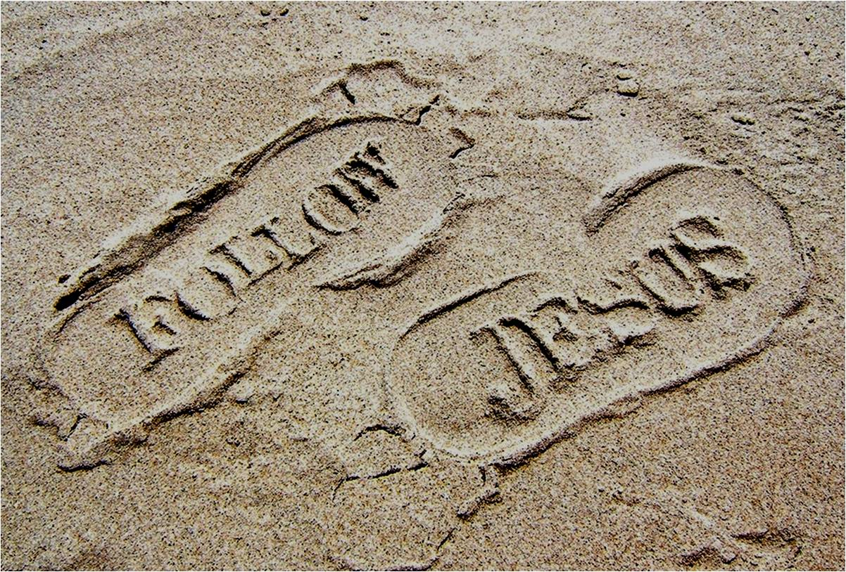
GROWING IN FRUITFULNESS
Pathway – Follow: It’s modelled by Jesus v.9-15

Slide 9
GROWING IN FRUITFULNESS
Privilege – Appointed: Right here, right now v.16

Slide 10
THE FRUITFUL CONGREGATION JOURNEY
Thinking further about fruitfulness
Deciding together on two areas of our congregation’s life & witness in which to prioritise fruitfulness
Beginning to prepare the ground for growing expression of fruitfulness
The Fruitful Congregation Prayer Journey
https://www.presbyterianireland.org/Prayer/Prayer-Journey

