Slide 2
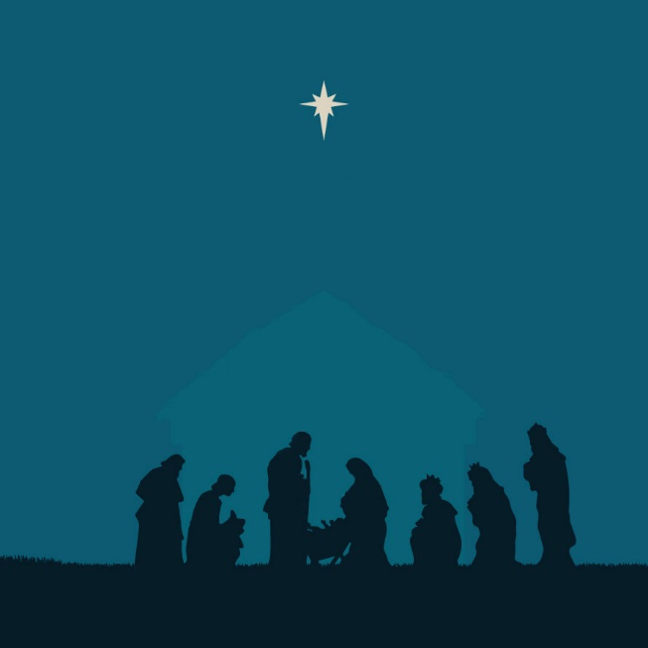
Christmas
The Season of Restoration

Slide 3
The Season of…
Excitement
Exhaustion
Endurance
Expense

Slide 4
RESTORE

Slide 5
RULER
R E S T O R E

Slide 6
Events
R E S T O R E

Slide 7
Saviour
R E S T O R E

Slide 8
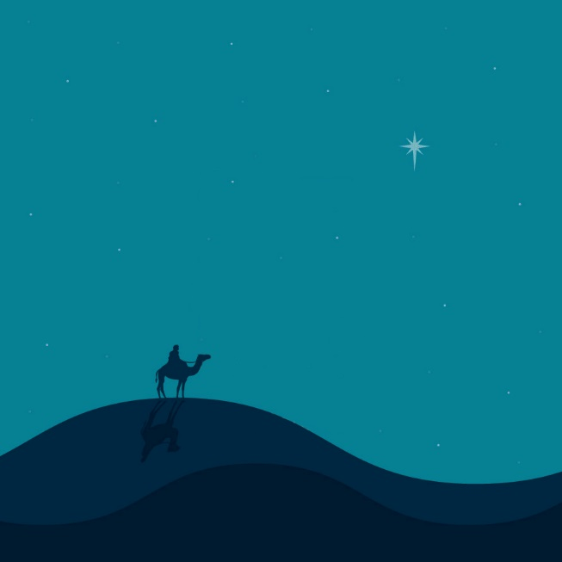
Timing
R E S T O R E

Slide 9
R E S T O R E
Outcome

Slide 10
R E S T O R E
Restoration

Slide 11
R E S T O R E
Everlasting
Life

Slide 12
Christmas
The Season of Restoration

