Slide 1
Session 2:
Anticipating the next stages
of the journey out of lockdown
Notes:
Title slides backgrounds can be set in solid colour
With Calibri Bold text – minimum 72pt

Slide 2
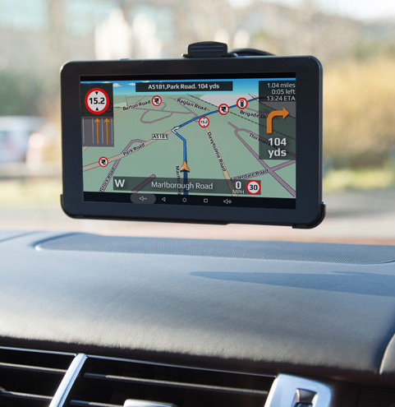
ANTICIPATING THE NEXT STAGES OF THE JOURNEY

Slide 3
ANTICIPATING THE NEXT STAGES OF THE JOURNEY
Plan and prepare now to get ready to make the most of the gradual easing of restrictions, rather than waiting until they do.

Slide 4
ANTICIPATING THE NEXT STAGES OF THE JOURNEY
1. How do we continue to re-establish our worship service and strengthen connection with members of all ages in our congregation?
2. What limited range of activities should we prioritise when restrictions on gathering begin to ease?
3. What lessons have we learned so far during the Covid-19 pandemic that can help us in this phase?

Slide 5
ANTICIPATING THE NEXT STAGES OF THE JOURNEY
Kirk session and others in formal leadership positions

Slide 6
ANTICIPATING THE NEXT STAGES OF THE JOURNEY
As restrictions ease further and we begin to gather a little more momentum in our church life, there will come a moment of greater opportunity to physically get together to renew our relationships.

Slide 7
ANTICIPATING THE NEXT STAGES OF THE JOURNEY
1. How can we bring different groups of people together within current guidelines with an emphasis on building community, rather than all the normal ministry content of gatherings?
2. How might we maximise the lighter nights and better weather to be together with a ‘holiday feel’?
3. How can we gather organisational leadership teams socially to quickly gauge who is coming back again and who might not be and, where necessary, to begin to recruit new and emerging leaders?

Slide 8
ANTICIPATING THE NEXT STAGES OF THE JOURNEY
Kirk session and leaders of organisations and activities and ‘pied pipers’

Slide 9
ANTICIPATING THE NEXT STAGES OF THE JOURNEY
Having worked on getting ready and getting the fabric of relationships in your congregation back together again, there will be a moment to restore more coordinated activity on a more regular basis.

Slide 10
ANTICIPATING THE NEXT STAGES OF THE JOURNEY
1. What activities, in addition to worship, will we recommence, when, and how often?
2. What will congregational and organisational programmes consist of given likely ongoing restrictions on social distancing and wearing of masks indoors? How might we harness digital gatherings, alongside in-person meetings, if we can?
3. How will we effectively publicise the recommencement of activities within our membership, among those who previously attended and the wider community?

Slide 11
ANTICIPATING THE NEXT STAGES OF THE JOURNEY
Leaders of organisations and activities brought together to understand the bigger picture

Slide 12
ANTICIPATING THE NEXT STAGES OF THE JOURNEY

Slide 13
BREAKOUT ROOMS
What simple things can you do to get ready and to get key groups together over the summer period?

Slide 14
WHAT’S COMING UP
Thursday 3 June
Together again for children’s ministry
Thursday 10 June
Together again for youth ministry
Thursday 17 June
Fanning the flame as kirk sessions
Wednesday 23 June
Growing our presence in the community

Slide 15
WHAT’S COMING UP
Latest release:
Wednesday 19 May
The Church Recovery Guide
Wednesday 9 June
Reconnecting in the summer season
Wednesday 23 June
In conversation with PCI global mission workers

Slide 16
STAYING CONNECTED
Keep up-to-date by following the PCI social media channels…
FACEBOOK
TWITTER
INSTAGRAM
/pciassembly
/PCIChildrensMinistry
/PCIYouthMinistry
/PCIYoungAdults
/PresbyterianWomen
@pciassembly
@pcimoderator
@pciassembly

Slide 17
CONTACT US
www.presbyterianireland.org
E. clw@presbyterianireland.org
T. +44(0) 28 9032 2284
Sign up to PCI E-quip to be kept up-to-date with future resources and events for your congregation.
www.presbyterianireland.org/e-quip

