Slide 1
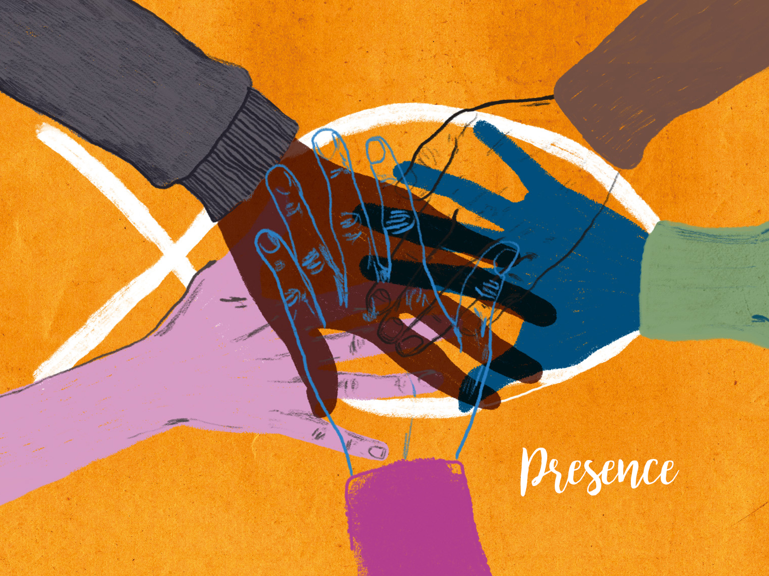

Slide 2
The Word became flesh and made his dwelling among us. We have seen his glory, the glory of the one and only Son, who came from the Father, full of grace and truth.
John 1:14

Slide 3
Pray that our church would find and develop ways of being present in our community –
Ask God that we would be increasingly willing to stretch ourselves to become one with our local community.

Slide 4
Pray that our church would be a good neighbour to our community – Ask God to help us find and develop ways of expressing his love for our local community.

Slide 5
Pray that God’s glory might be seen in us – Ask God that as the attractiveness of his glory was seen in Jesus, it would also be recognised in our life together.

Slide 6
Pray that our church would learn how to express God’s perfect balance of grace and truth – Ask God to help our congregation relate to local people with generosity of life and clarity of witness.

