Slide 1


Assisted dying: the Palliative Care viewpoint
Ilora Finlay
House of Lords
“How people die remains in the memory
of those who live on.” Cicely Saunders

Slide 2
Dignity
Stopping interventions
Control in consultations
Assisted suicide/ euthanasia discussions
Doctors views

Slide 3

‘Assisted Dying?’
Euthanasia
Physician assisted suicide
Assisted suicide

Slide 4


Intentionally Hastening Death
Physician-assisted suicide (PAS)
or
Physician-administered euthanasia (PAE)

Slide 5
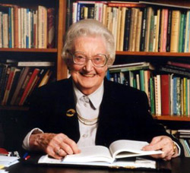
“You matter because you are you, and you matter to the last moment of your life.
We will do all we can, not only to help you die peacefully, but also live until you die.”
Dame Cicely Saunders (1918-2005)

Slide 6
‘The quality of life gap’
Hopes and aspirations
Gap
Reality
Time
K Calman

Slide 7
Dignity is having a sense of personal worth
Dame Cicely Saunders 1992

Slide 8
Dignity
“Care that confers honour, recognised the deservedness of respect and esteem of every individual - despite their dependency, infirmity and fragility - could lie at the heart of care that conserves dignity”
  Chochinov H et al Lancet 2002

Slide 9
Doing no harm: withdrawing intervention
time
Stop intervention

Slide 10
Death
time
Stop intervention

Slide 11
or
Death
time
Stop intervention

Slide 12
or
Death
time
Stop intervention

Slide 13

Euthanasia / physician assisted suicide
? ‘normal’
death?
Death
time
Give drug – express intention to kill
Notes:
Ingestion pentobarbital or secobarbital
Time to unconscious 1-38 min
Time to death 1 min to 104 hours
1 awoke 65 hours after ingestion then died 14 days later

Slide 14
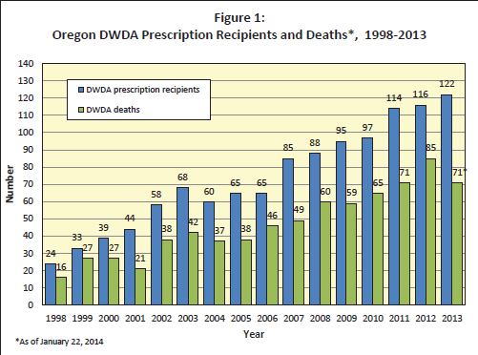
Oregon data
ALS = 7.2%

Slide 15
I just want to die
Young woman
On NIV
Fully dependent
Wants lethal drugs
Husband angry that we were not giving them

Slide 16

Fears
The future worse than today
Pain
Loss of dignity (mind / body)
Loss of control
Loss of autonomy
Being a burden

Slide 17
Decisions need
Information
Capacity to make decision
Voluntariness

Slide 18
1. Information
Diagnosis
Diagnostic errors – 5% at post-mortem
Prognosis
<6 months is notoriously inaccurate
“medicine is a probabilistic art”
even in ‘last 48 hours of life’, 3% improve

Slide 19
2. Capacity to make decisions
Mental capacity
"mental capacity, written down in law, looks simple. It sounds like something objective".
Hotopf M 25 May 2011
  MND 30% cognitively impaired (HoL)
  1 in 6 who passed all tests for PAS in Oregon had undiagnosed depression
    “the current practice of the Death with Dignity Act may not adequately protect all mentally ill patients” Ganzini 2008

Slide 20
3. Voluntariness
Pressures - internal or external
  Fear of being a burden
  Financial costs of care
Fluctuating desire for death
“Compassion”
Not all families are loving families
Influence of doctor – clear beds, save costs, exhausted
Normalisation in society becomes expectation

Slide 21
Our lady with MND?
“I feel like a woman again”

Slide 22


Who steers the consultation?
I just want to die!

Slide 23
So you really want to die?
Listen
Process request
Message = you are right to think that you’d be better off dead
What is making today so terrible?
What can we do to improve today?
Message = you are worth me working hard to improve things

Slide 24
What drives a desire for death?
Feeling a burden – low correlation with physical symptoms (r = 0.02-0.24) and higher correlations with psychological problems (r = 0.35-0.39) and existential issues (r = 0.45-0.49)
Wilson KG et al A burden to others: a common source of distress for the terminally ill. 2005;34(2):115-23.
Depression and hopelessness are mutually reinforcing, independent predictors
Rodin G et al Pathways to distress: the multiple determinants of depression, hopelessness, and the desire for hastened death in metastatic cancer patients 2014 e-pub
Major depression(p<.001)
Wilson KG et al. Desire for euthanasia or physician-assisted suicide in palliative cancer care. 2007;26(3):314-23

Slide 25
Motivations of physicians and nurses to practice voluntary euthanasia: a systematic review
The category most consistently associated with euthanasia is psychological variables.
Most frequently associated:
  past behaviour,
  medical specialty,
  whether the patient is depressed,
  patient's life expectancy
Vézina-Im LA, Lavoie M, Krol P, Olivier-D Avignon M. BMC Palliat Care 2014;13(1):20

Slide 26
UK doctors oppose PAS
GPs Sept 2014
    77% oppose changing the law
Hospital physicians Nov 2014
    57.5% oppose any change in the law
    67.7% oppose physician involvement
    Only 18.9% personally prepared to participate actively in assisting suicide
Association of British Neurologists 2011 review
    86 % were fully supportive that "interventions should not be given with the primary intention of causing death”
Palliative medicine physicians 2015
    82% oppose change in law
    Only 4% prepared to be actively involved

Slide 27
‘Safeguards’
Terminally ill
Clear and settled wish
Mental capacity
Informed of options
2 doctors
Final act initiated by person – self-administer?
“Cannot be watertight”
Prognosis / diagnosis
Coercion / fluctuating wishes
Impaired / depression
Offered palliative care / ?risks
Experience/attitude
Set up a device
No monitoring

Slide 28
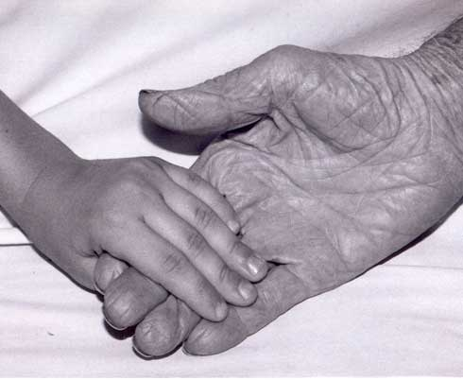
Autonomy is relational
Our living and our dying have an effect on those around us

Slide 29
What is the effect on children?
Don’t know!
“I cant love well enough – it was not enough support to help Mum keep going”

Slide 30
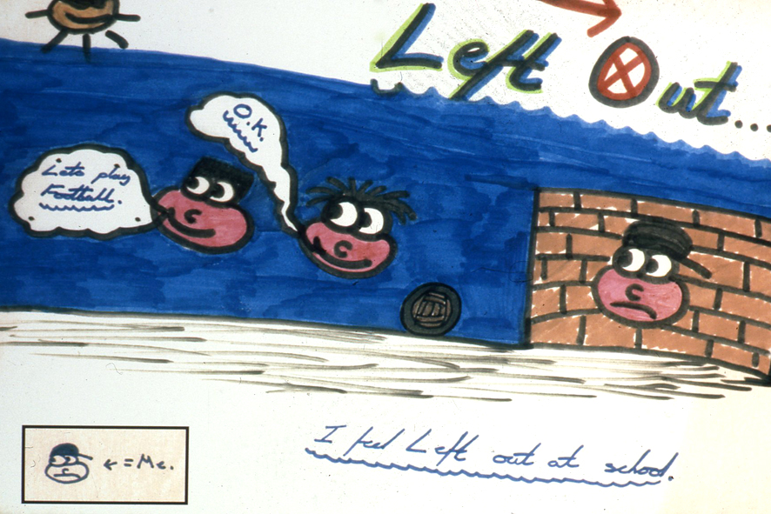

Slide 31
4 years after wanting death
I am … at the end of my life, in bed & unable to do, but able to receive and find an unexpected serenity in receiving.
A week ago I wanted to die, exhausted by an existence that seemed to become hollow and futile, fearful of disrupting lives of those I love so dearly. My wish to die resurfaced; yet my ability to live resurfaced too.

Slide 32


The memory lives on

