Slide 2
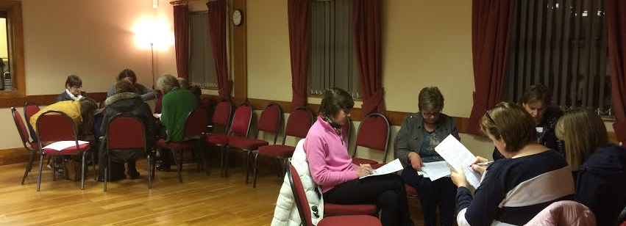
THE POWER OF WOMEN in prayer IN OUR CONGREGATIONS
Your partnership in prayer is invaluable

Slide 3
‘For our struggle is not against flesh and blood, but against the rulers, against the authorities, against the powers of this dark world and against the spiritual forces of evil in the heavenly realms’.
EPHESIANS 6:12
Because of your partnership in prayer, Strongholds fall

Slide 4
Paul said ;
‘I thank my God every time I remember you. ⁴ In all my prayers for all of you, I always pray with joy ⁵ because of your partnership in the gospel from the first day until now, ⁶ being confident of this, that he who began a good work in you will carry it on to completion until the day of Christ Jesus.’ Philippians 1:3-5
Together we serve His church

Slide 5
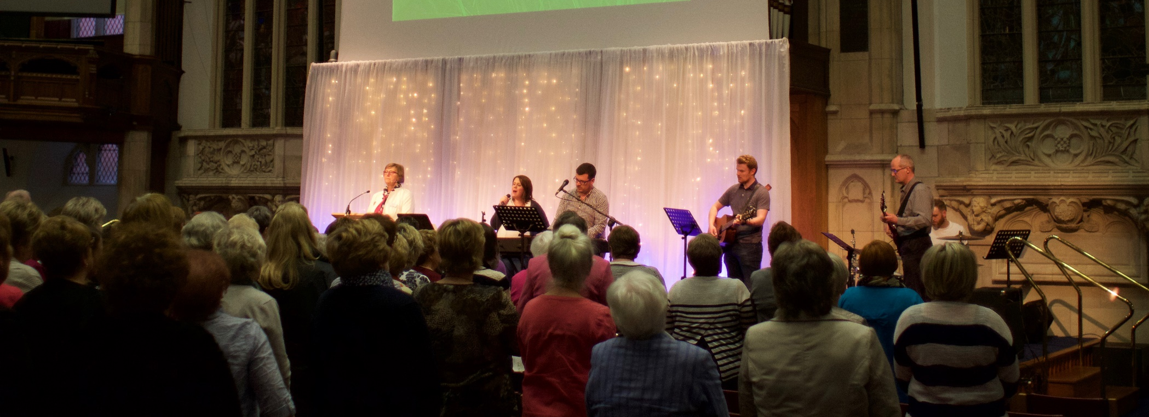
Paul thanked the Philippians for their partnership and we want to thank you for all that you do

Slide 6

Do you know that because of your partnership in the gospel, in 2016 you raised £551,900
This means we can be involved in…

Slide 7
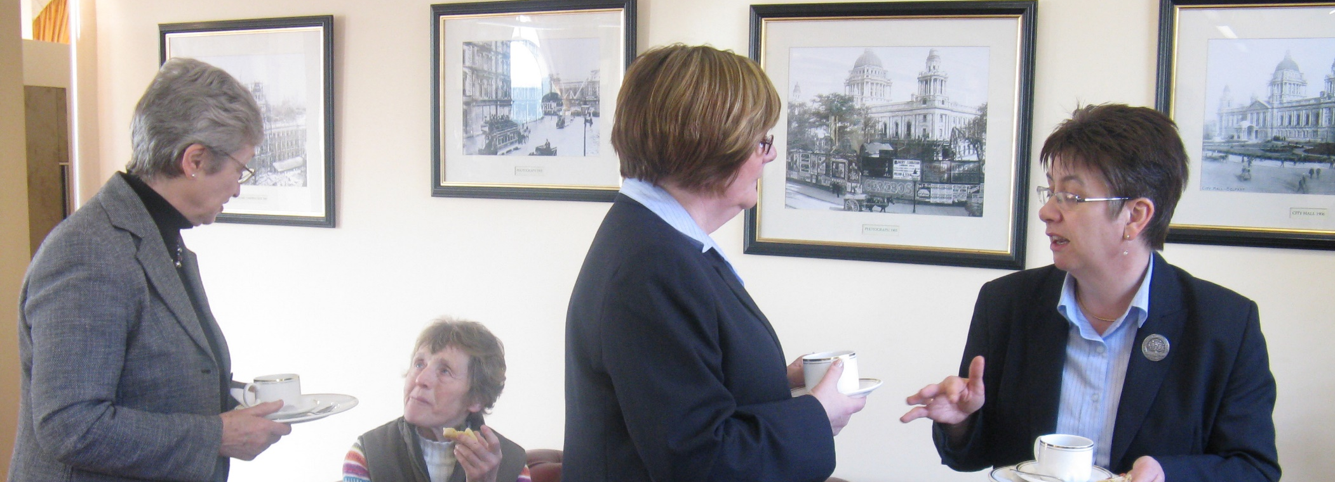
..Mission at Home
Deaconesses – PW Mission Fund contributed £250,000 to the Council for Mission in Ireland in 2016

Slide 8
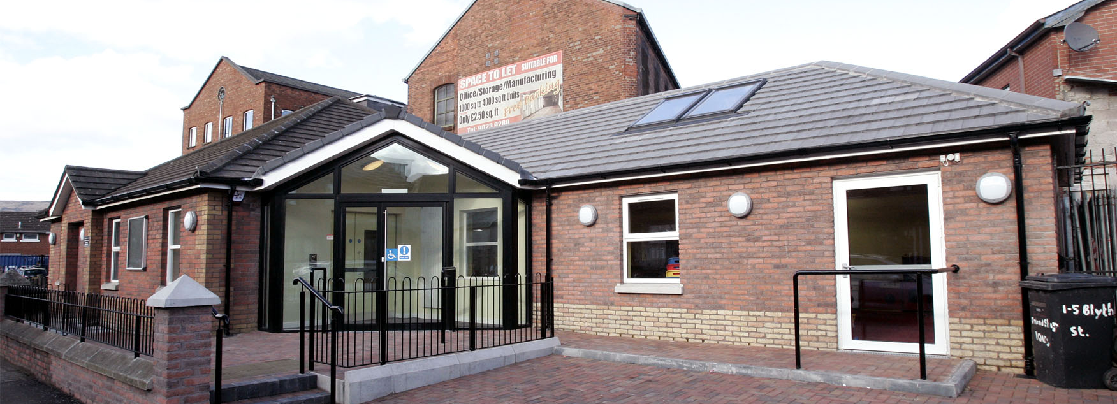
Local mission in South Belfast friendship house
Your partnership in the gospel through the work and witness in Friendship House

Slide 9
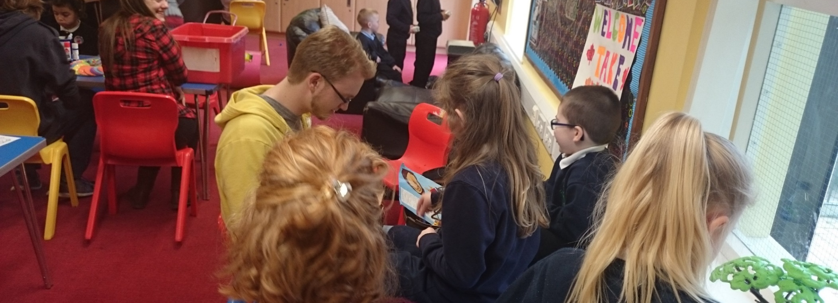
South Belfast friendship house – sandy row
PW MISSION FUND contributes to the ongoing ministry to children, teens and adults in South Belfast

Slide 10
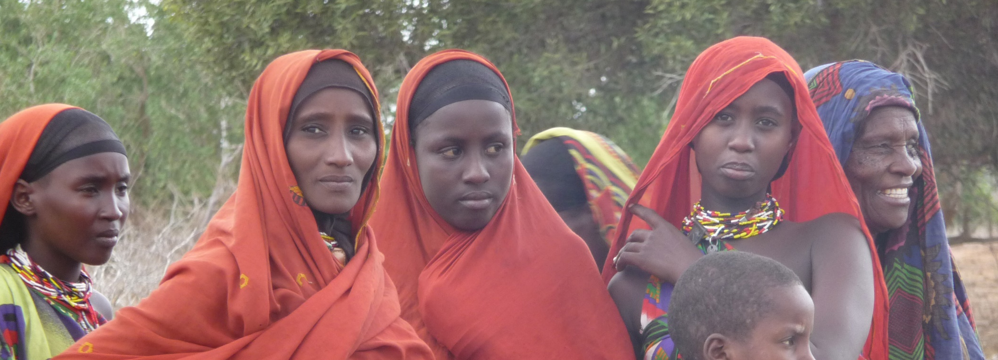
Global mission
Because of your generosity - PW MISSION FUND contributed £190,000 in 2016 - Council for Global Mission

Slide 11
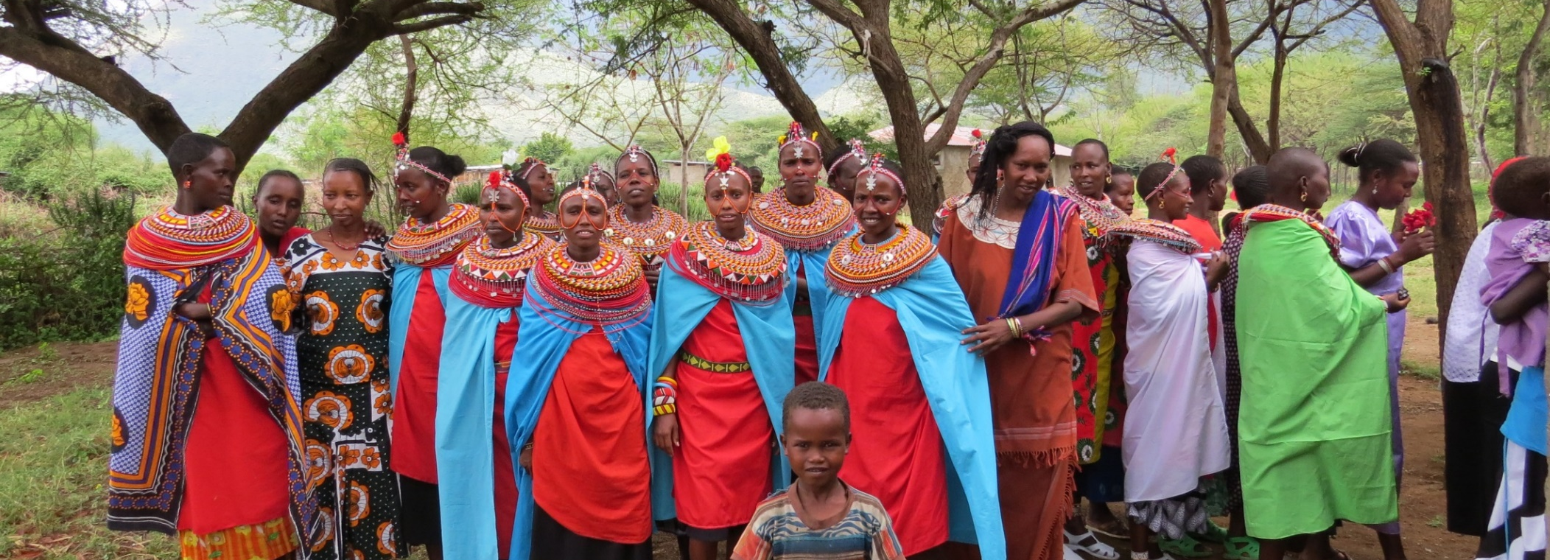
Your Partnership in the gospel reaches across our world
That all might hear and know the reality of Christ in their lives

Slide 12

Resourcing and equipping women’s ministry
INSPIRATIONS
A RESOURCE FOR WOMEN’S MINISTRY
Through your partnership we can inspire and equip women to do women’s ministry in their congregations

Slide 13
Through your partnership PW staff and volunteers can provide effective administration for the organisation

Slide 14
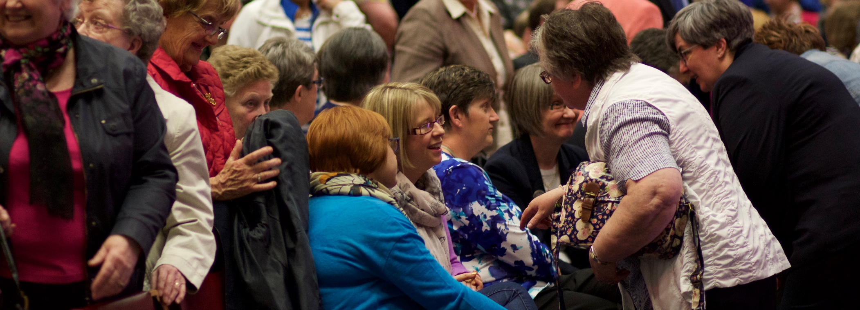
We can facilitate the development of women’s ministry throughout our church in Ireland
Providing training, organising Forums & Conferences

Slide 15
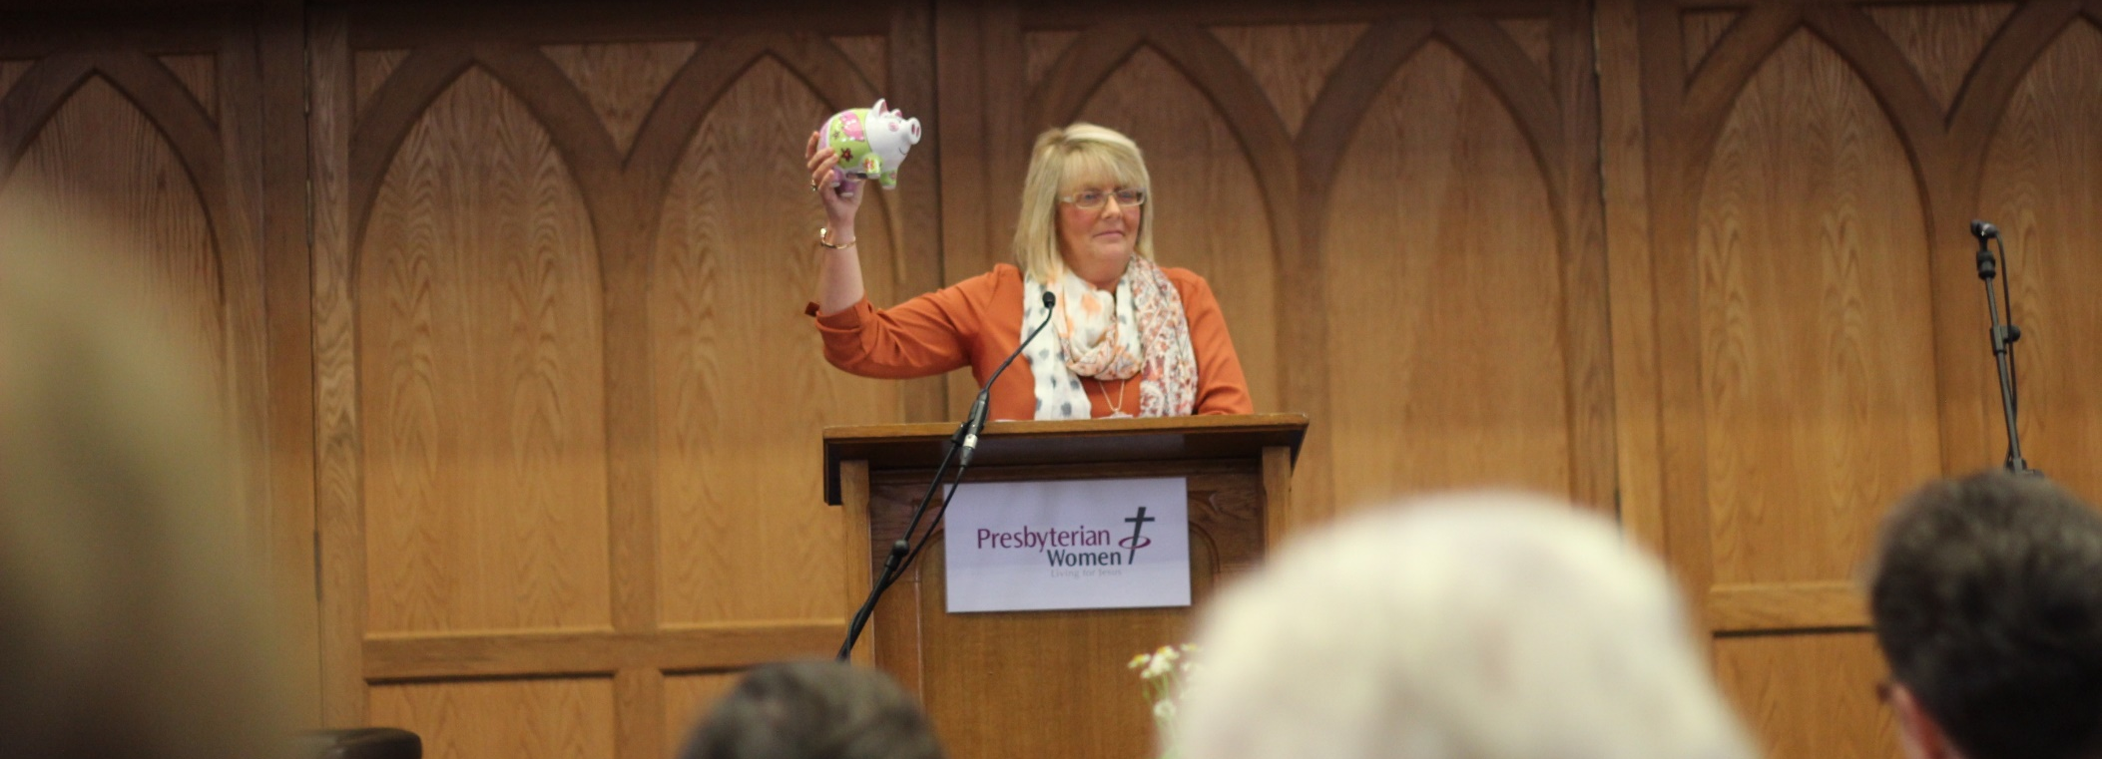
Because of your partnership, women are encouraged to become disciples of Christ

Slide 16
Through your giving we can support Special Projects at home and overseas

Slide 17
2016-17 Home - the big house

Slide 18
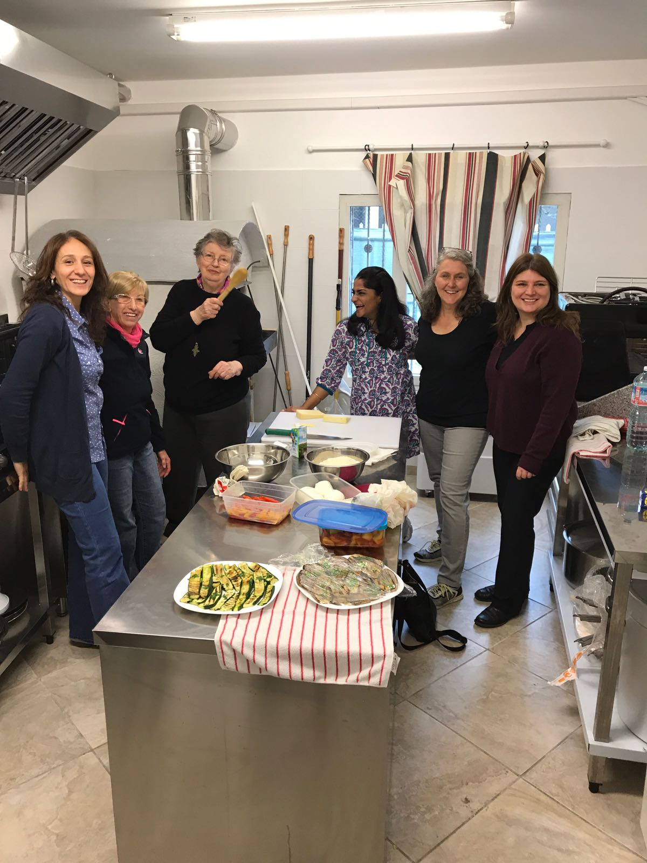
2016 -17 Overseas – The Johnstons in Mantova, Italy

Slide 19

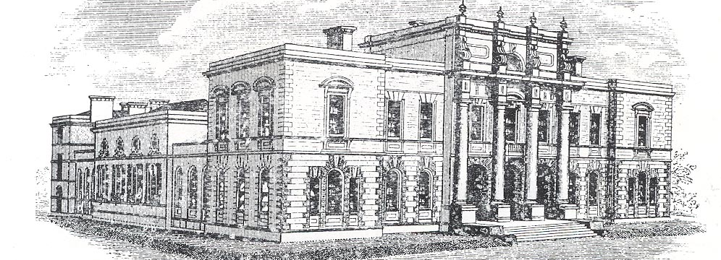
2017- 18 SPECIAL PROJECT – DEACONESS TRAINING
THREE NEW Student Deaconesses
Will commence a three year course in Diaconate Studies
at Union Theological College, Belfast,
September 2017

Slide 20
For we are God's workmanship, created in Christ Jesus, to do good works, which he has prepared in advance for us to do Ephesians 2v10
Thank you

