Slide 1
Matthew 18:15-20 15 If another member of the church sins against you, go and point out the fault when the two of you are alone. If the member listens to you, you have regained that one. 1. But if you are not listened to, take one or two others along with you, so that every word may be confirmed by the evidence of two or three witnesses. 17 It the member refuses to listen to them, tell it to the church; and if the offender refuses to listen even to the church, let such a one be to you as a Gentile and a tax collector. 18 Truly I tell you, whatever you bind on earth will be bound in heaven, and whatever you loose on earth will be loosed in heaven. 19 Again, truly I tell you, if tow of you agree on earth about anything you ask, it will be done for you by my Father in heaven. 20 For where two or three are gathered in my name, I am there among them. (NRSV)

Slide 2
Maintaining Healthy Congregations
Bible Study - Matthew 18:15-20
Restoring Broken Relationships

Slide 3
Step one: Matthew 18:15 Go and talk to the other person directly and privately.

Slide 4
Step two: Matthew 18:16 Take one or two others along with you to meet with that person

Slide 5
Step three: Matthew 18:17 ……tell it to the church

Slide 6
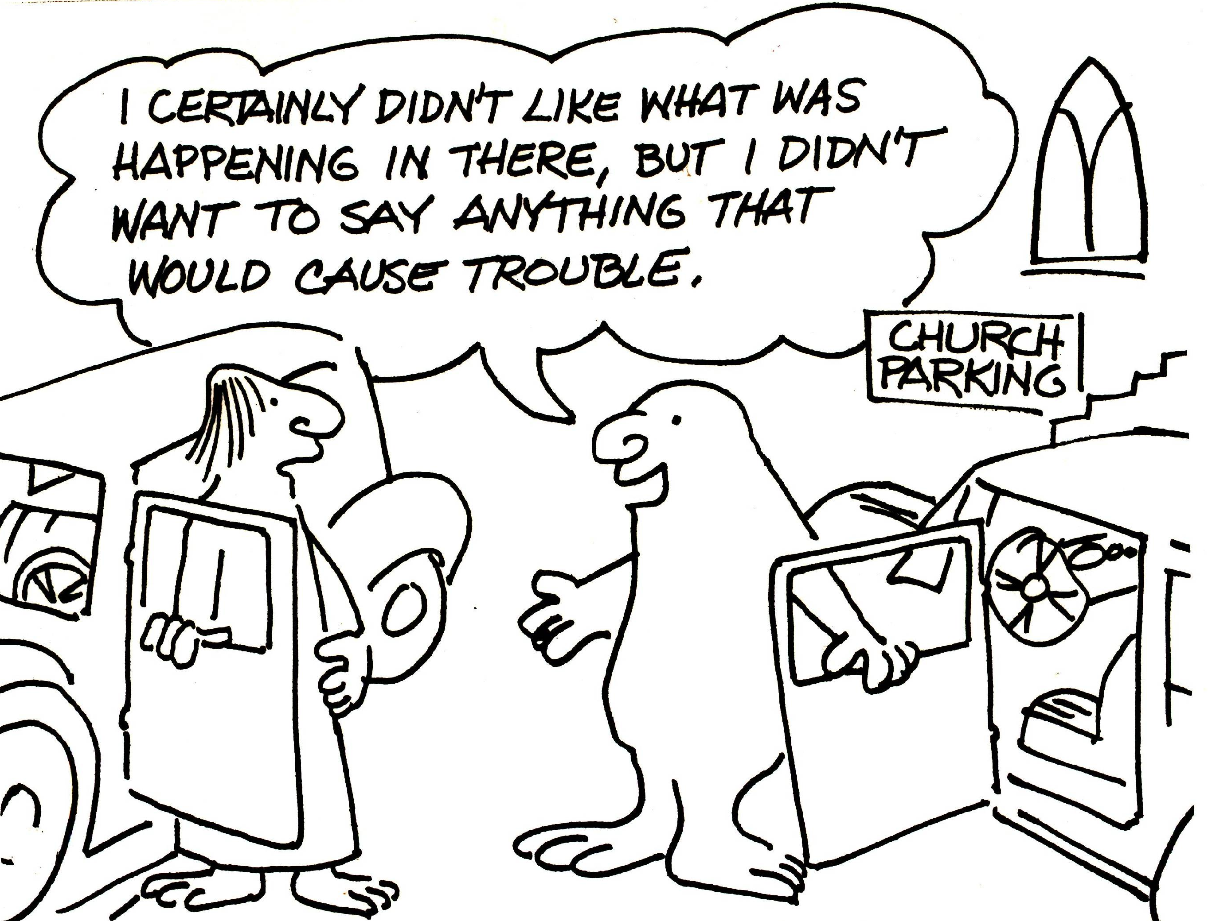
Matthew 18: 15-20

Slide 7
What would your immediate gut reaction be if you were asked to act as a third party in helping to resolve a disagreement between two members of your congregation?

Slide 8
What might be some important things to remember if you were asked to do this?

Slide 9
5 key points from Matthew 18:15-20
Deal with the situation directly and privately, if possible
If this doesn’t work, use others to help
It this doesn’t work, use the church, which has processes and resources for assisting during times of disagreement
Seek the restoration of the offender and your relationship with that person
Remember Jesus’ promise: “When two or three are gathered in my name…..I am with you”

