Slide 1


Being Transformed
Romans
12:2

Slide 2
Text goes here
“
”
Text goes here

Slide 3
Text here
Smaller text here

Slide 4
Text goes here
Romans
12:2

Slide 5
Text goes here
Text goes here

Slide 6
Text goes here
Romans
12:2

Slide 7
Text goes here
Small text goes here
Being Transformed
Romans
12:2

Slide 8
Title goes here

Slide 9
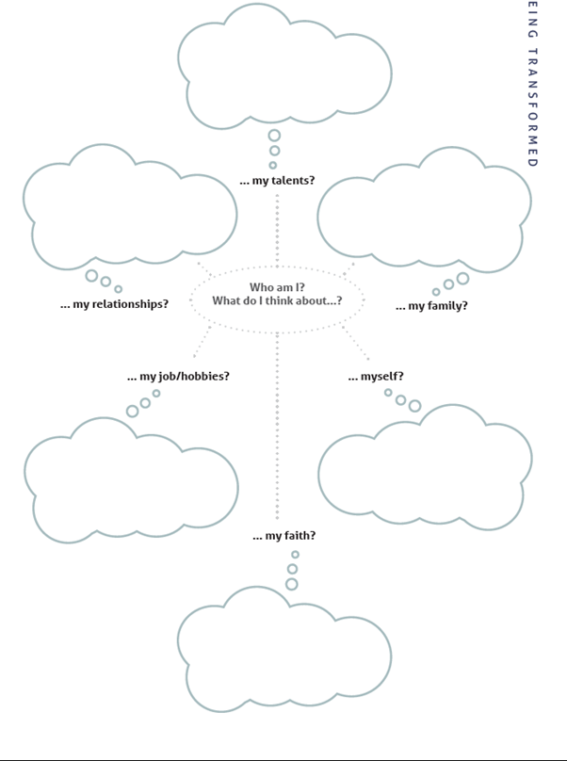
Text goes here
Small text goes here
Being Transformed
Romans
12:2

Slide 10
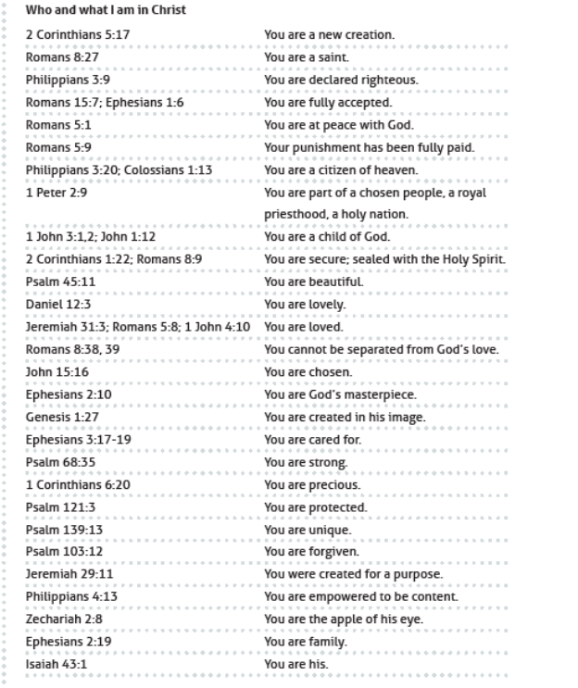
Text goes here
Small text goes here
Being Transformed
Romans
12:2

Slide 11

Text goes here
Smaller text here

