Slide 1
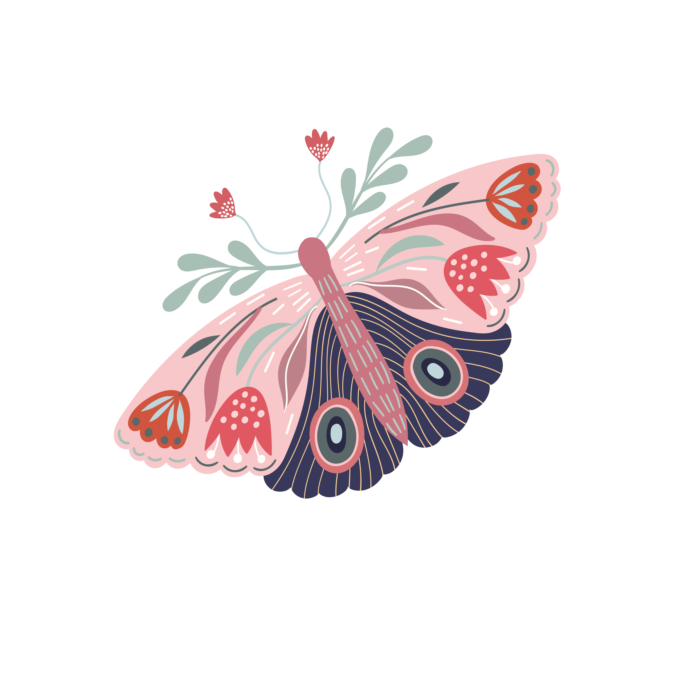
Being Transformed
Romans
12:2

Slide 2
Talk to the person beside you for a couple of minutes about someone God has used to be an influence in your life.
Being Transformed
Romans
12:2

Slide 3
What gives you confidence that transformed behaviour is possible? Who are you depending on for change?
Being Transformed
Romans
12:2

Slide 4
How does your position in Christ motivate you to consider how you live out your Christian life? How can you be intentional about being transformed in your behaviour?
Being Transformed
Romans
12:2

Slide 5
Make a list of Christlike characteristics that God’s children need to ‘put on’. As well as Colossians 3:5-17, consider Galatians 5:22-23. Talk together about the ones which are more difficult to put on than others.
Being Transformed
Romans
12:2

Slide 6
What would it look like if someone put Colossians 3:16 into practice and did it well?
Being Transformed
Romans
12:2

Slide 7
Talk through the ideas on the following slides together. Is there one thing you could put into practice? Why not try out some of the ideas with each other?

Slide 8
When having your quiet time, or after a Sunday service or midweek, develop the habit of praying through the Bible passage you have just read, applying the lessons to your own life.

Slide 9
Perhaps you could start a book club where everyone reads a chapter of a book each week or month and then meet to discuss what you have learnt and the impact it is having on your day-to-day life.

Slide 10
Consider developing accountability relationships. Think of the relationships as “compass living”, that is: North = someone to look up to who can be a spiritual mentor East and West = your peers, those in the same season of life as you South = someone you can disciple by walking alongside them to share what God has been teaching you

Slide 11
When meeting with Christian friends, practise bringing conversations around to spiritual things, having conversations which will help both of you in your spiritual growth. Having ‘rosebud’ conversations can help with this. Talk about: A rose = something that is going well for you A bud = something you are looking forward to A thorn = something that is difficult for you at the moment

