Slide 1
Being Transformed
Romans
12:2

Slide 2
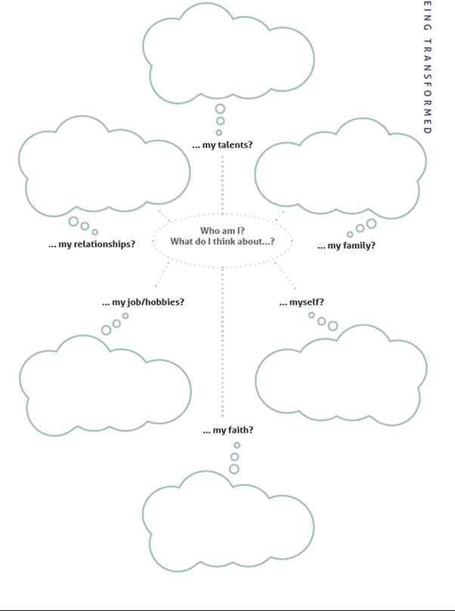
Who do you think you are?
In each cloud write words or phrases you instinctively apply to yourself.
Being Transformed

Slide 3
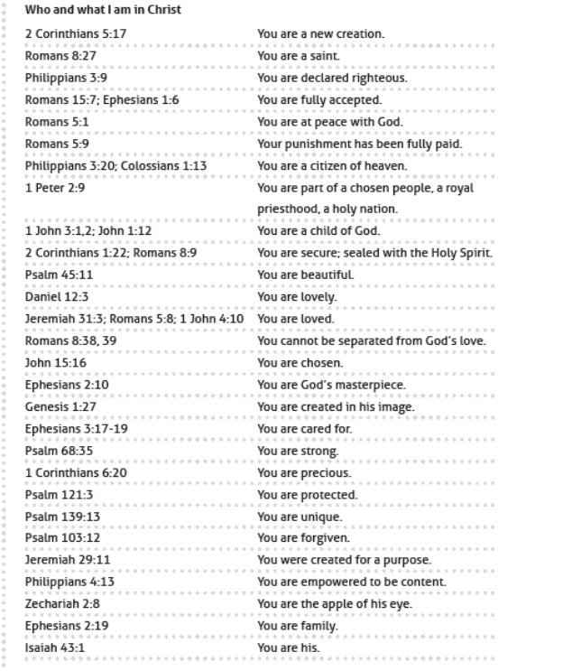
Who are you in Christ?
Choose from these verses to correct or confirm your instinctive thoughts.
Being Transformed

Slide 4
Who and What I am in Christ
2 Corinthians 5:17 | a new creation
Romans 8:27 | a saint
Philippians 3:9 | declared righteous
Romans 15:7; Ephesians 1:6 | fully accepted
Romans 5:1 | at peace with God
Romans 5:9 | my punishment has been fully paid
Philippians 3:20; Colossians 1:13 | a citizen of heaven
1 Peter 2:9 | part of a chosen people, a royal priesthood, a holy nation
1 John 3:1,2; John 1:12 | a child of God
2 Corinthians 1:22; Romans 8:9 | secure, sealed with the Holy Spirit
Psalm 45:11 | beautiful
Daniel 12:3 | lovely
Jeremiah 31:3; Romans 5:8; 1 John 4:10 | loved
Romans 8:38, 39 | cannot be separated from God’s love
John 15:16 | chosen
Ephesians 2:10 | God’s masterpiece
Genesis 1:27 | created in God’s image
Ephesians 3:17-19 | cared for
Psalm 68:35 | strong
1 Corinthians 6:20 | precious
Psalm 121:3 | protected
Psalm 139:13 | unique
Psalm 103:12 | forgiven
Jeremiah 29:11 | created for a purpose
Philippians 4:13 | empowered to be content
Zechariah 2:8 | the apple of his eye
Ephesians 2:19 | family
Isaiah 43:1 | his

